Slide 1
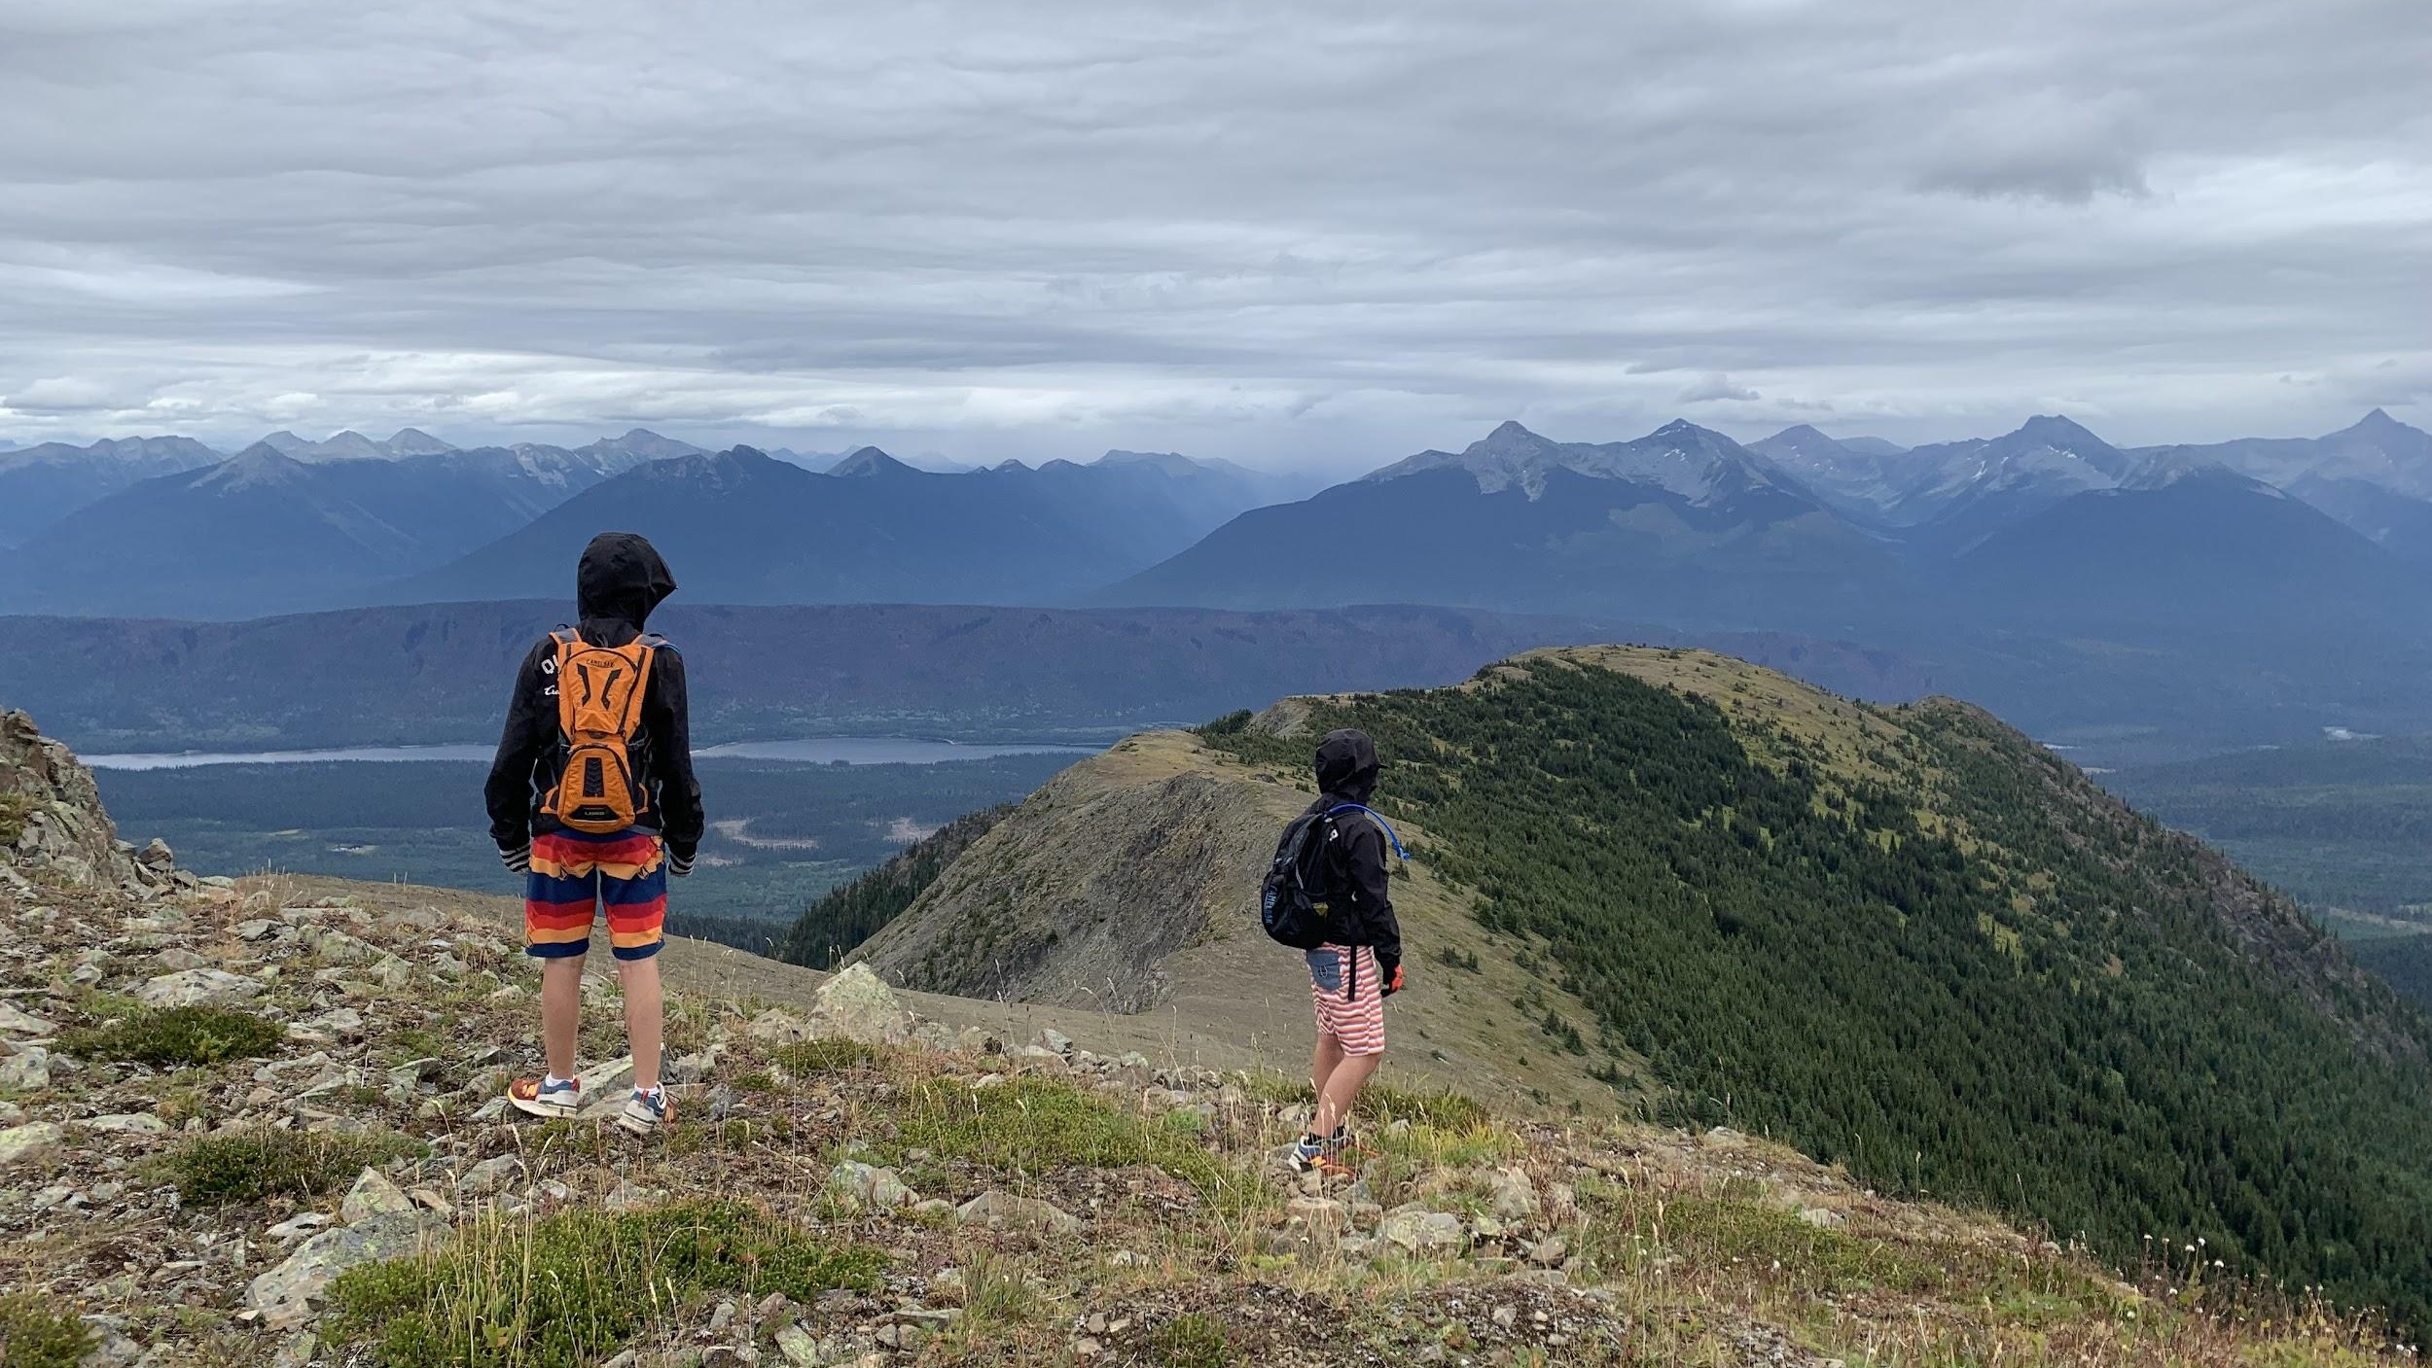
Teaching & Reaching Summits
By Joni Hesselgrave
EDUC 394: Pedagogy, Curriculum & Teaching - School of Education, University of Northern BC
Notes:
Hello everyone. I appreciate your time this evening as I discuss teaching & reaching summits.
In my slideshow, I incorporate personal images from this past summer where I completed the #7SummitsWellsChallenge. 3/7 summits were conquered with my children.
Climbing mountains with 3 young kids is a lot like teaching!

Slide 2
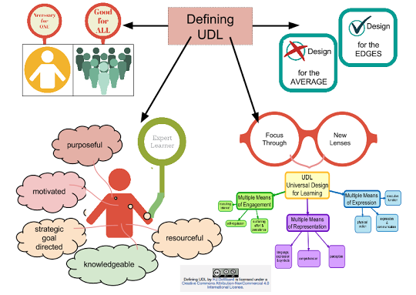
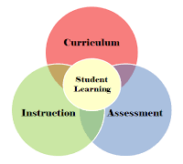
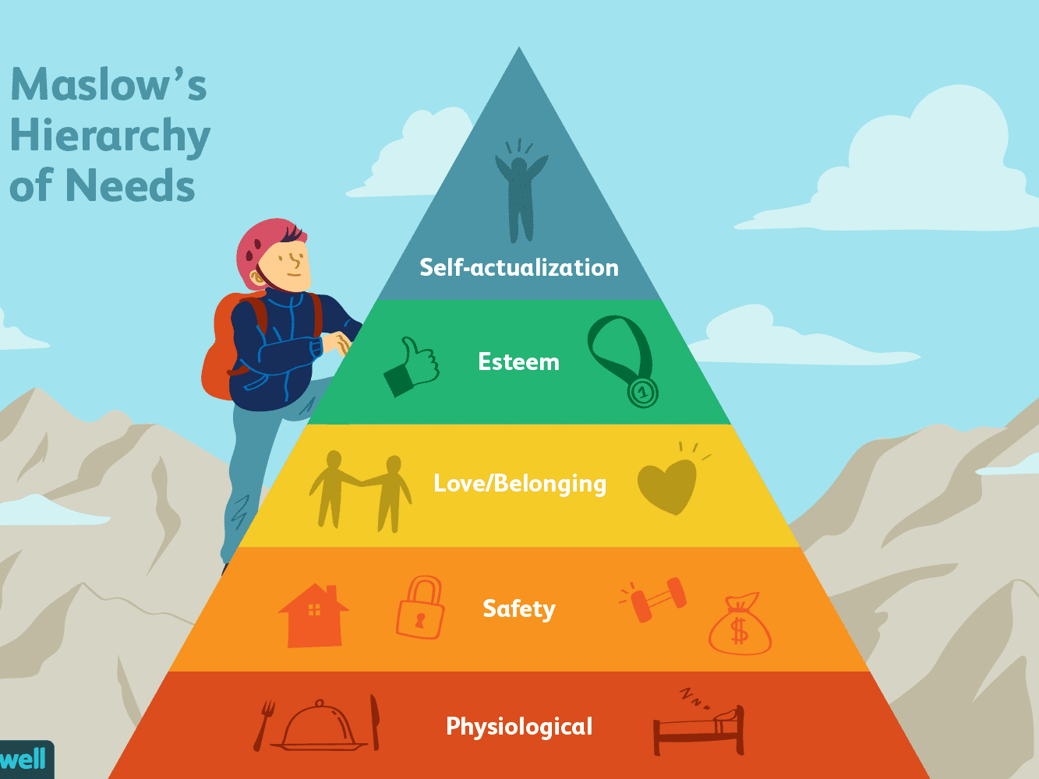
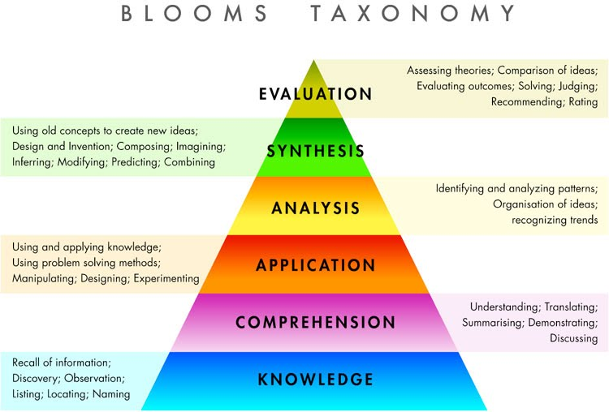
In teaching, we must put our students ~ their needs & their learning ~ at the centre!
Even Maslow & Bloom get the “Summit” Idea 💡
Notes:
We must be deliberate in ensuring that every action we take—in implementing the curriculum, in designing our instruction, and in planning and completing assessment—is centred on our students.
We must be observant: if a student’s needs go unmet (as set out in Maslow’s Hierarchy of Needs) they will not successfully achieve the learning levels set out in Bloom’s Taxonomy of Learning.
Our goal is to help students reach “Self-actualization” and higher-order learning.
Universal Design for Learning is utilized by teachers to ensure that every student is reached.

Slide 3
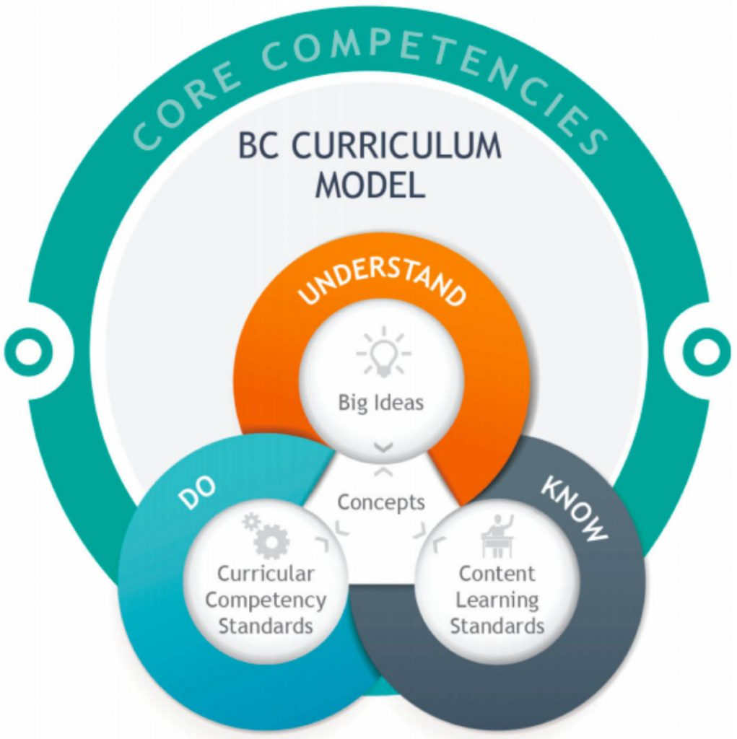
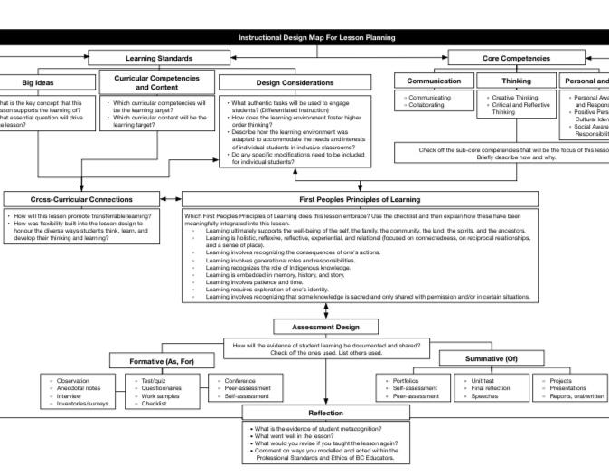
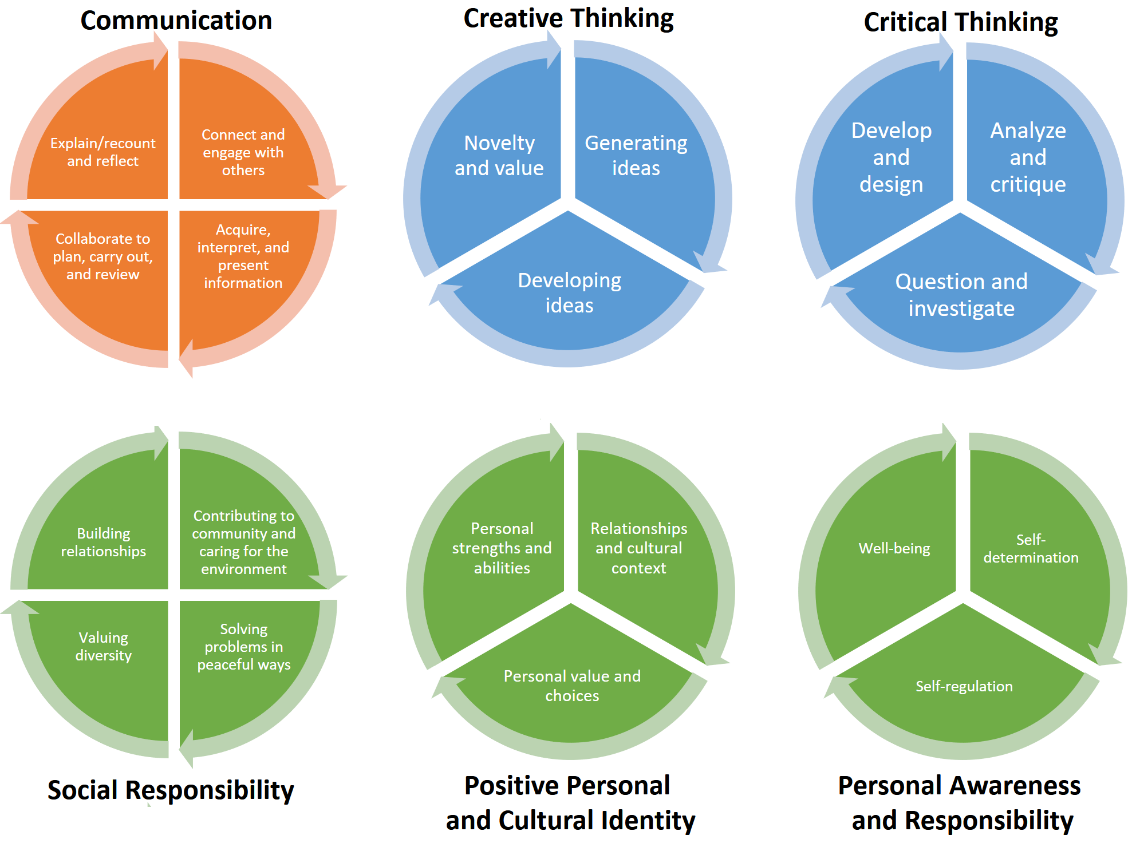
Within the parameters of our teaching, we must follow BC’s Redesigned Curriculum. Focusing on “Do” (Competencies), “Know” (Content) and “Understand” (Big Ideas)
Notes:
We need to focus on our students’ ability to “Do”: to communicate; to think creatively & critically; and to be personally & socially aware and responsible while fostering a positive personal and cultural identity.
We also need to ensure that we teach certain content so that students come out of our classrooms with specific grade-level knowledge—the “Know”—and an understanding of the “Big Ideas.”

Slide 4
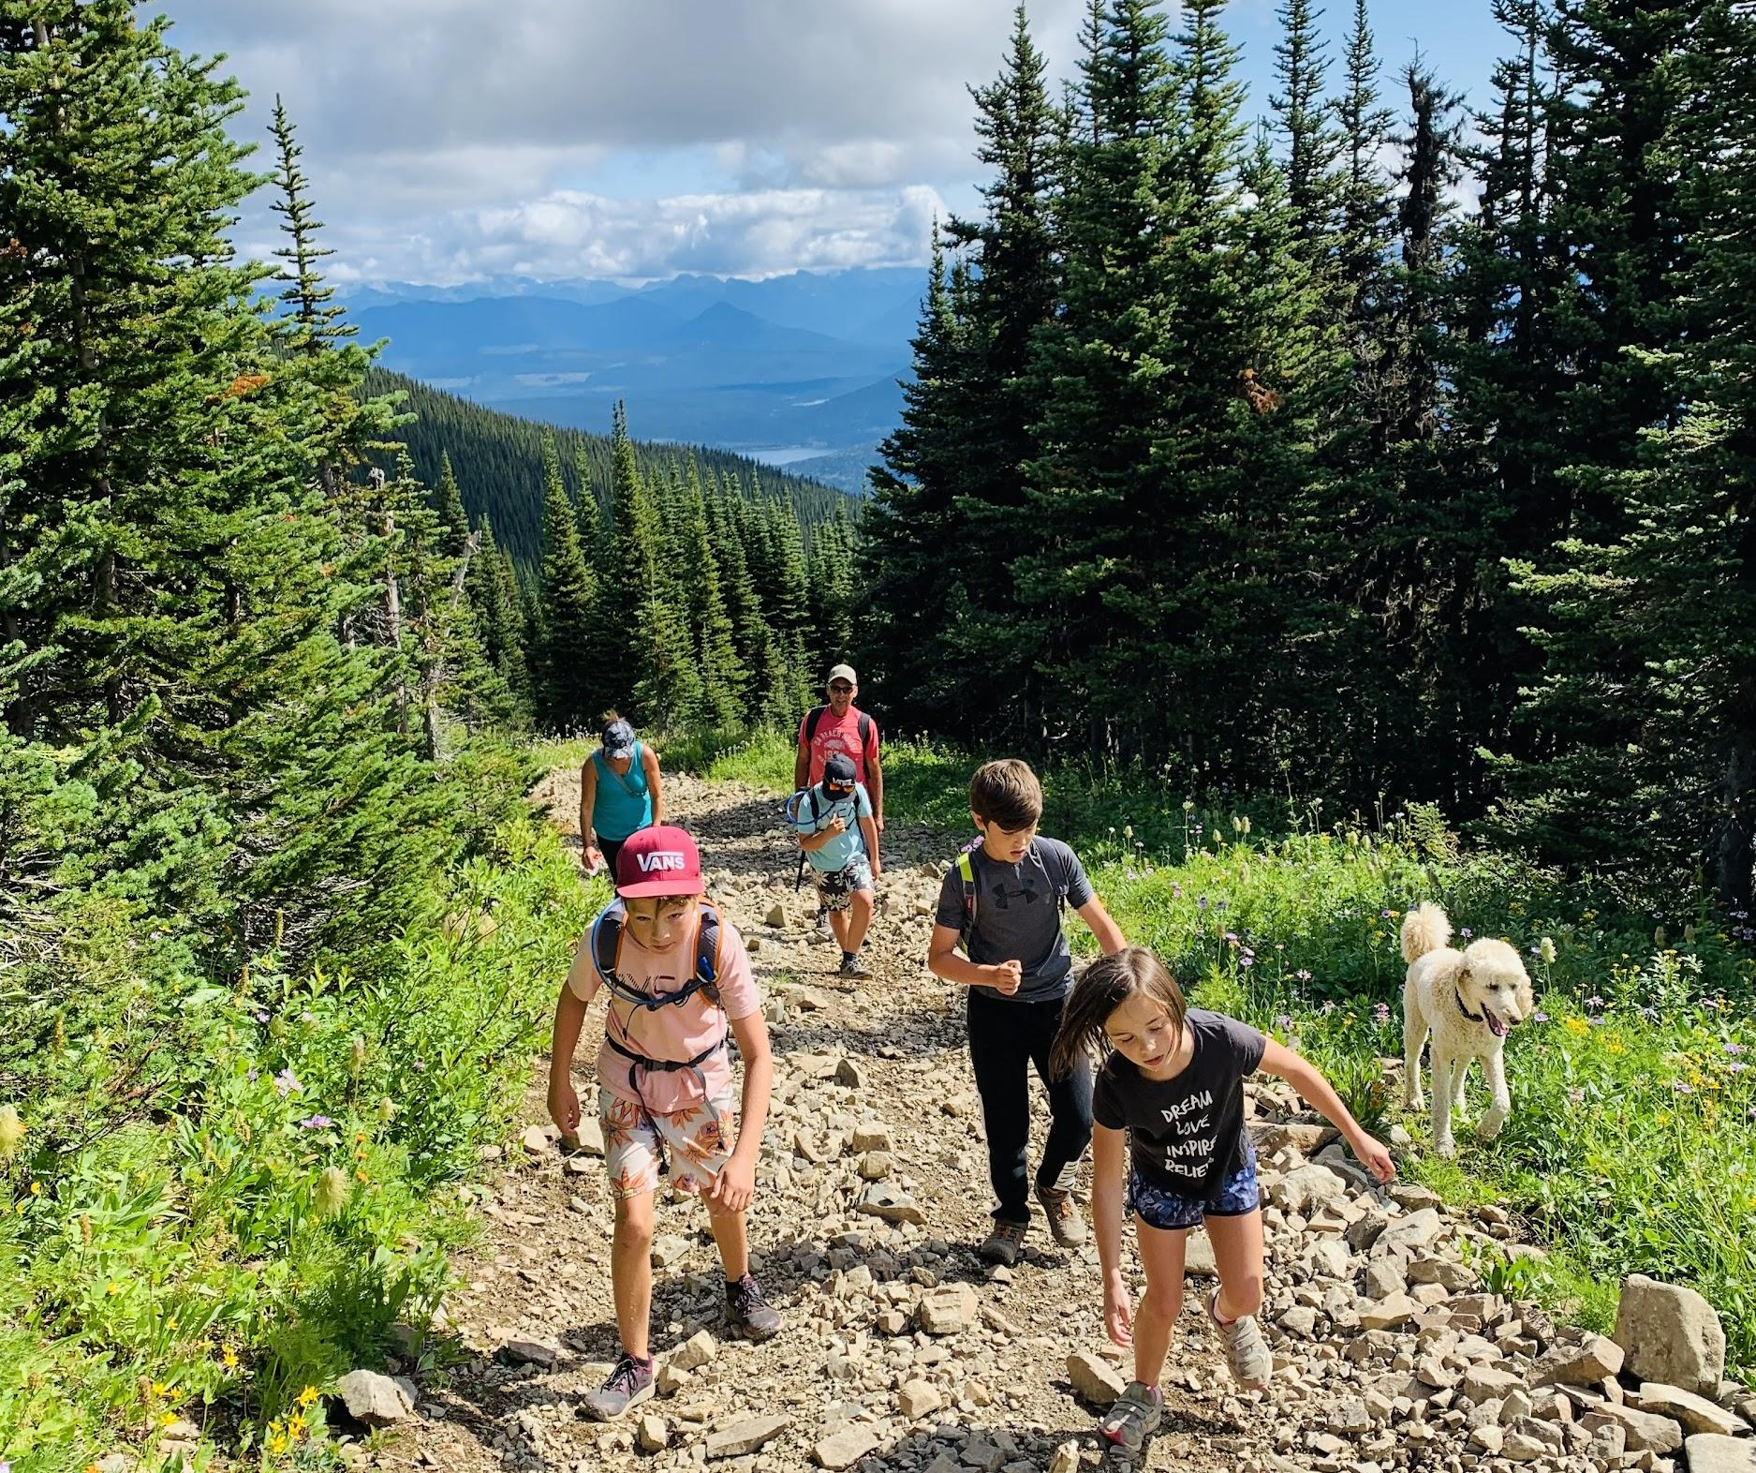
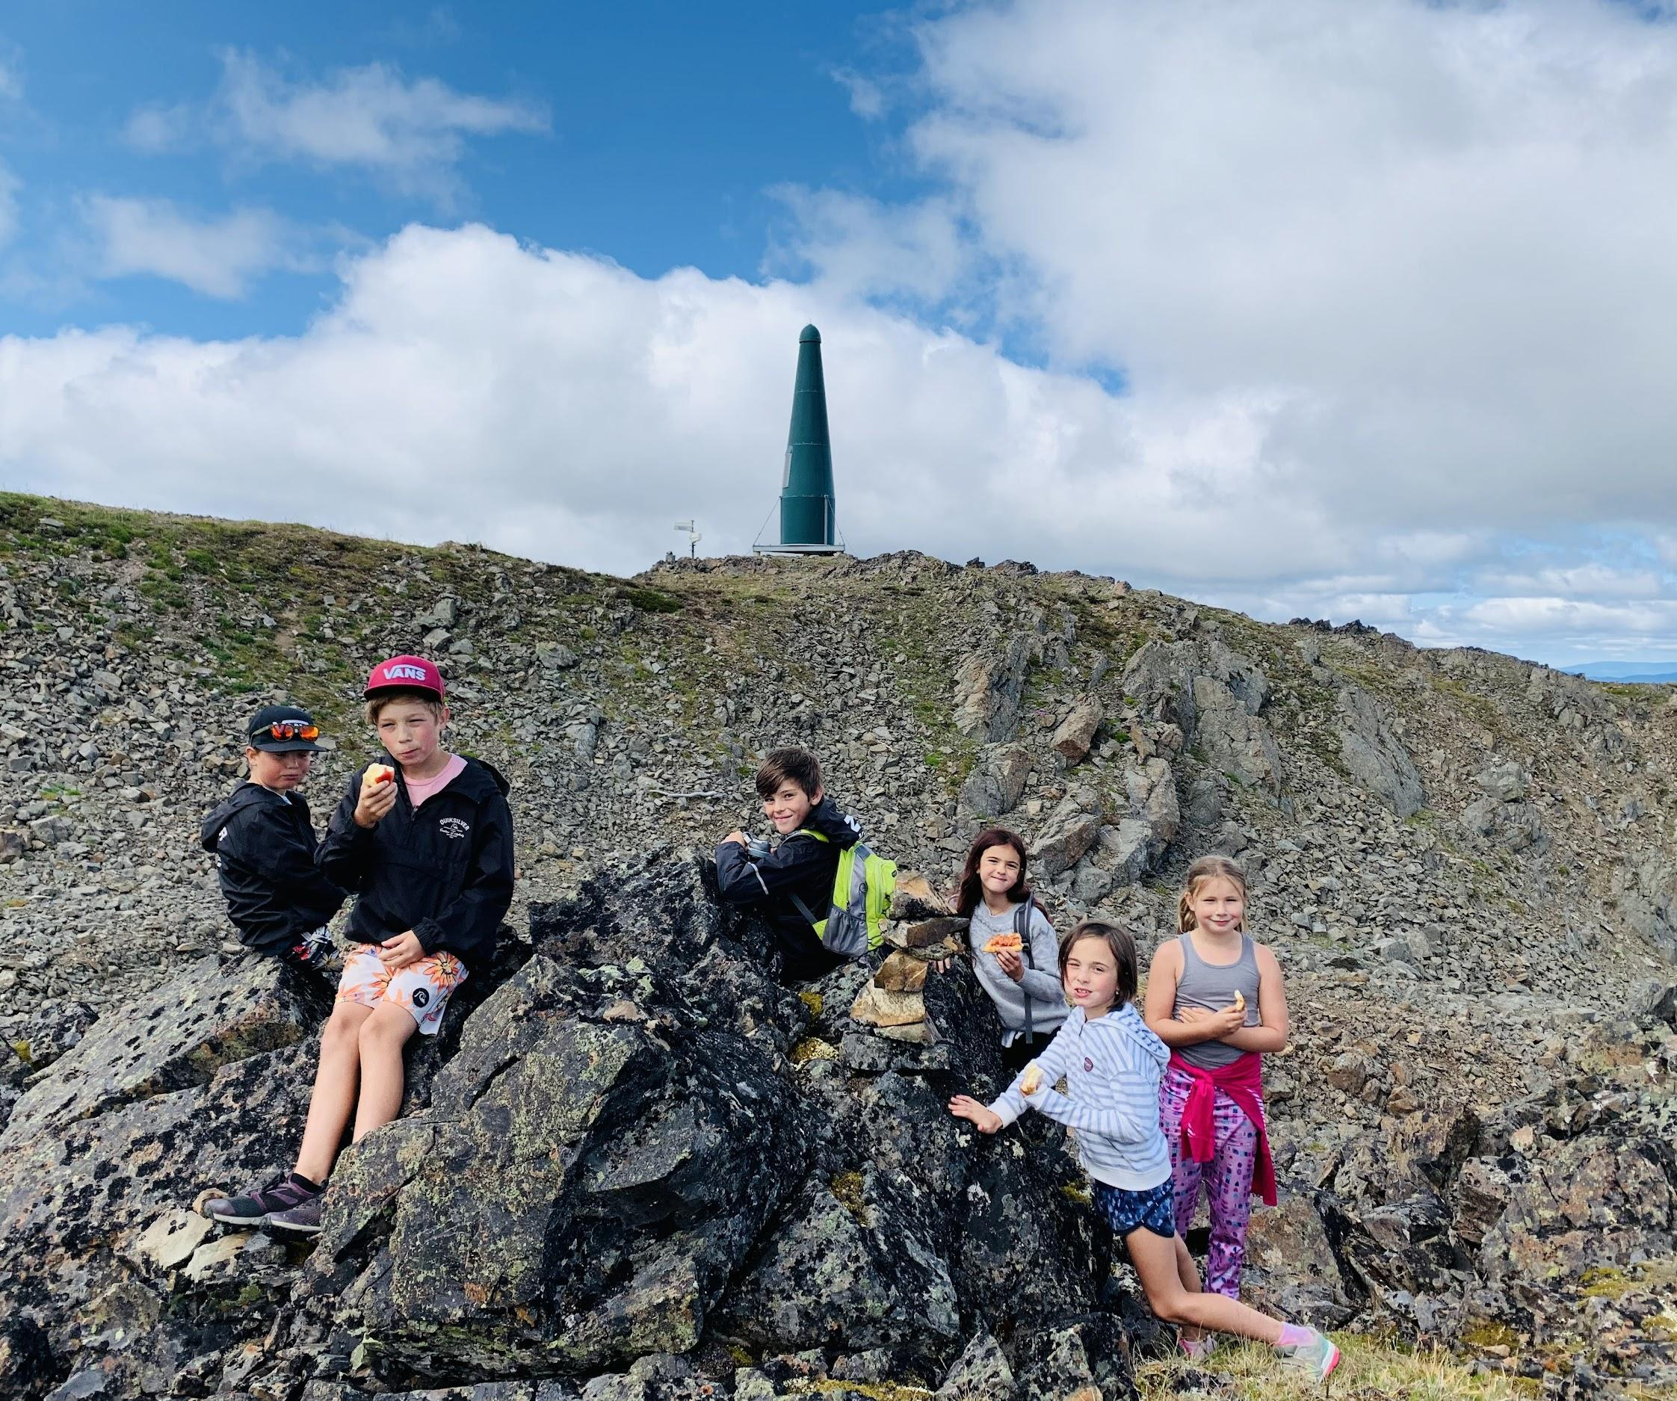
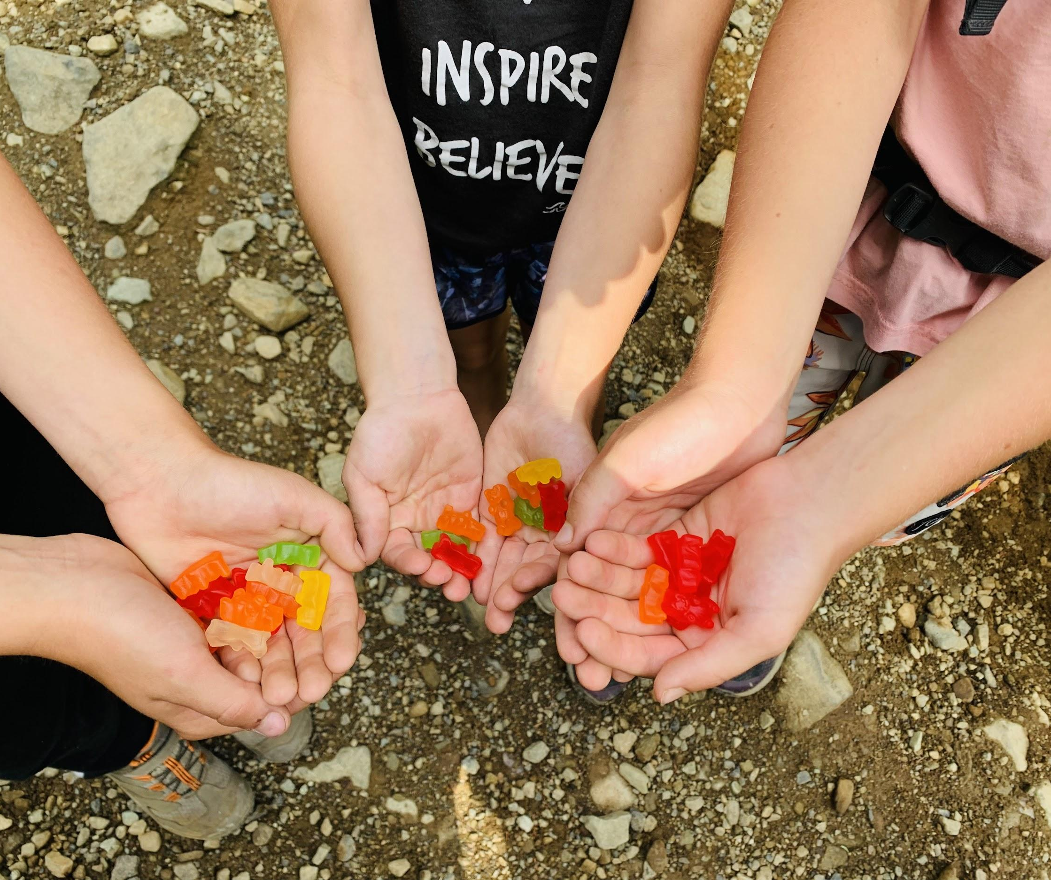
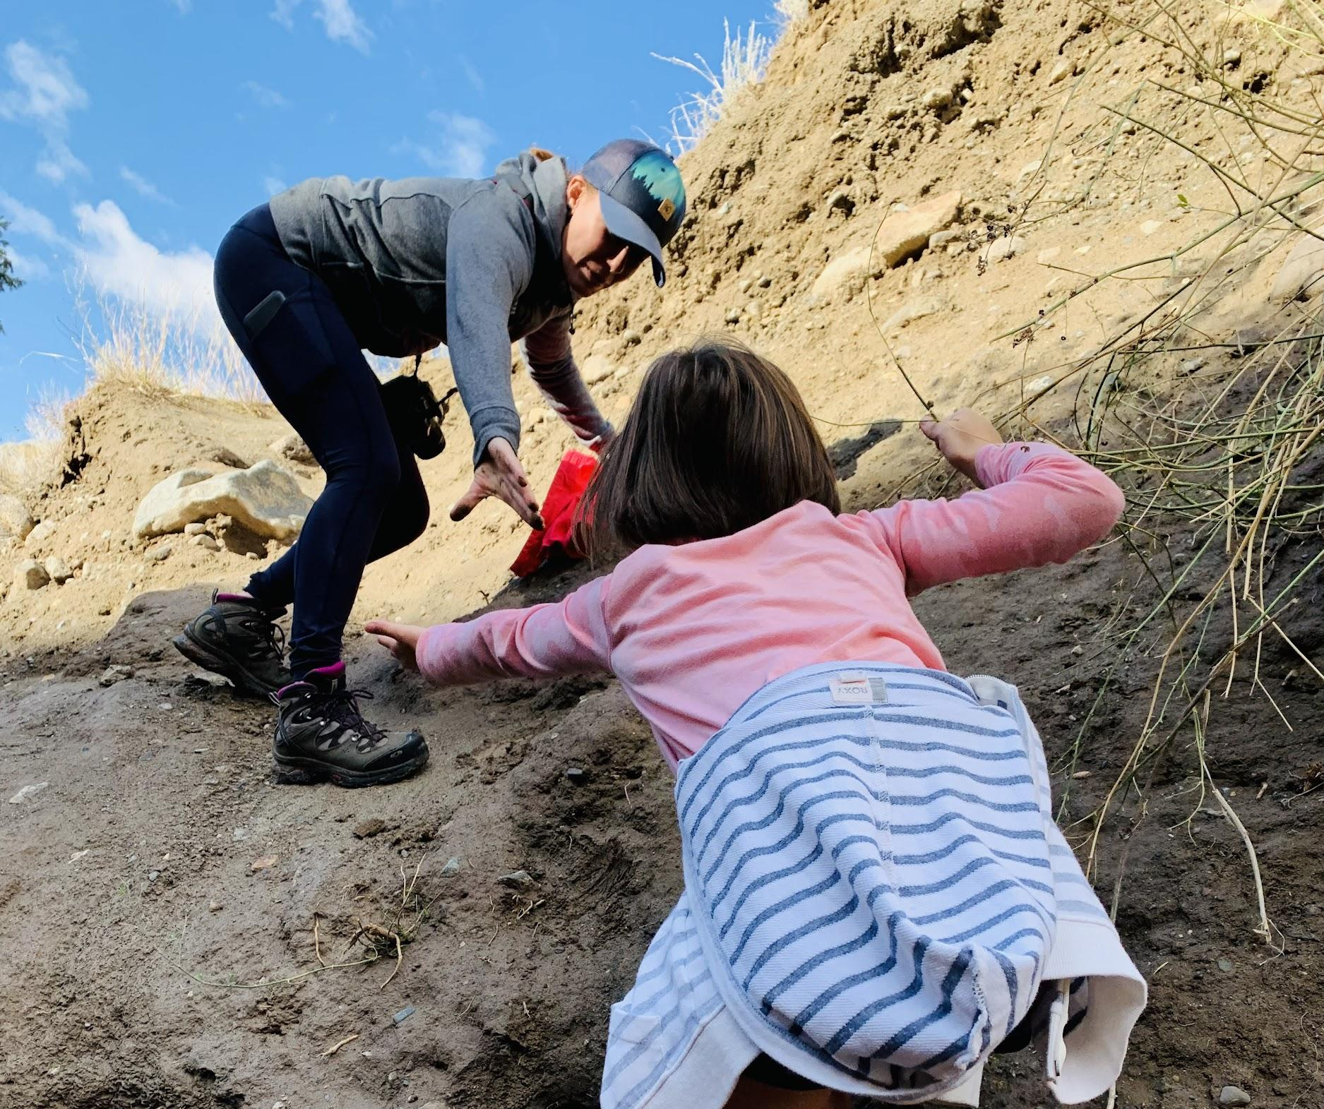
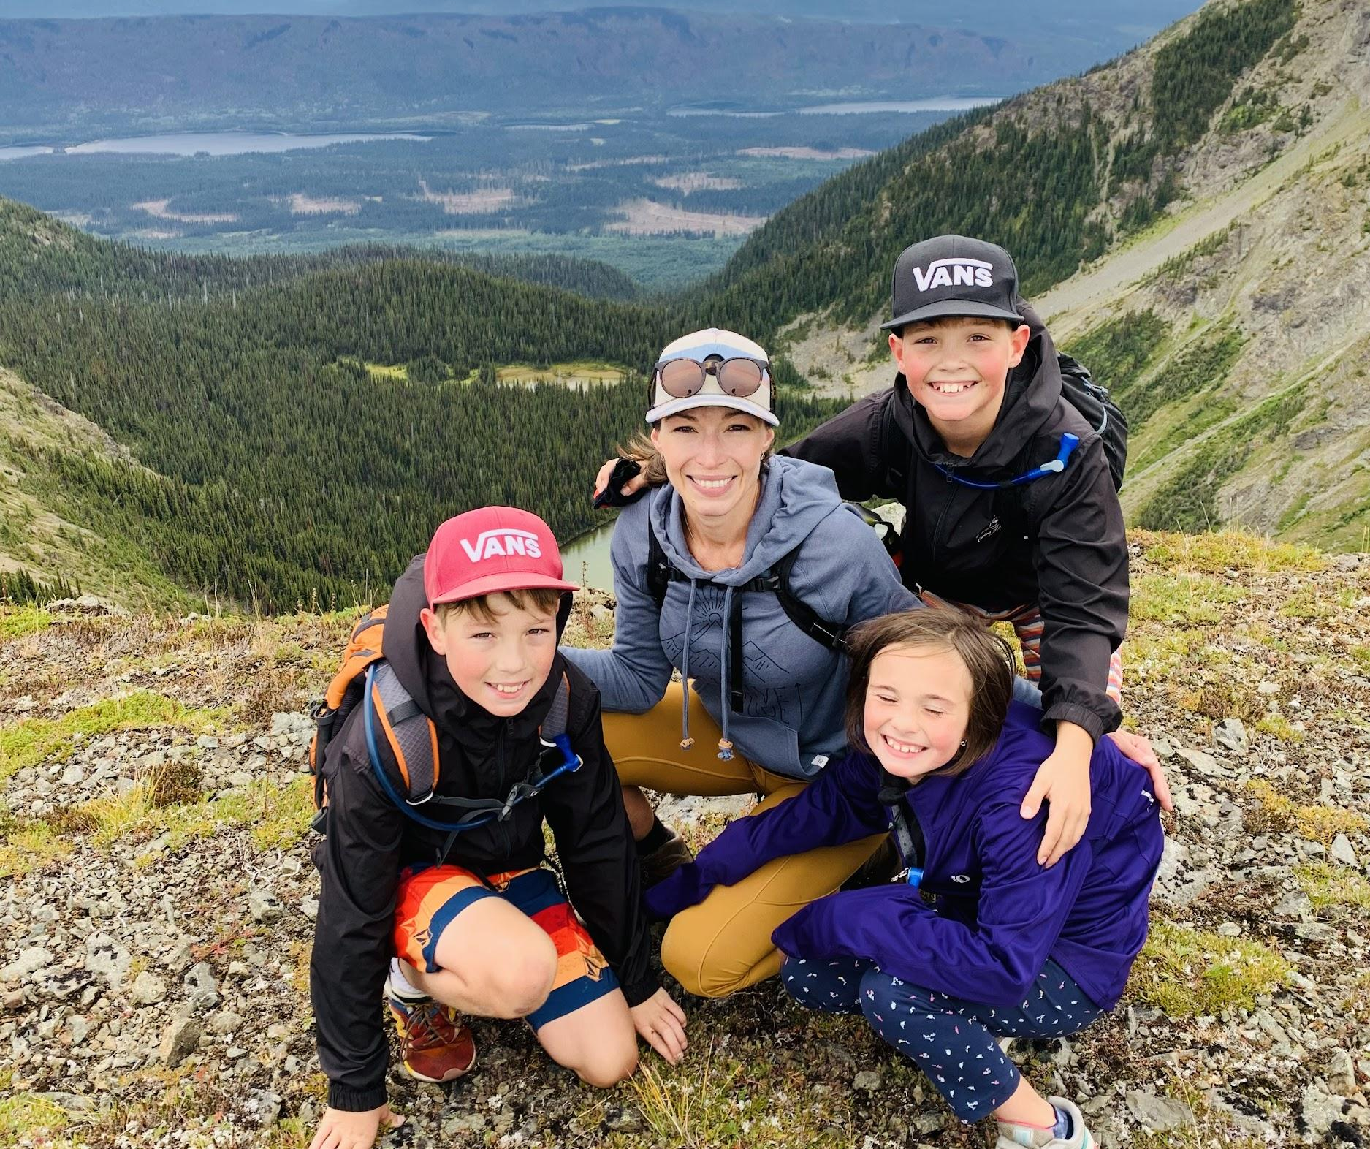
In teaching, we must tap into Relationships & the “Gatekeepers of Learning”: Emotion & Motivation
Notes:
I am not necessarily advocating that we “bribe” our students with candy (but, if it works, it works, lol).
What I am saying is that we must have positive relationships with our students and be keenly aware of their emotions (positive & negative). We must make educational experiences positive so that learning can take place. And, we need to find out what intrinsically motivates our students so as to fuel their desires to learn and engage (OECD, “Nature of Learning”, 2012).

Slide 5
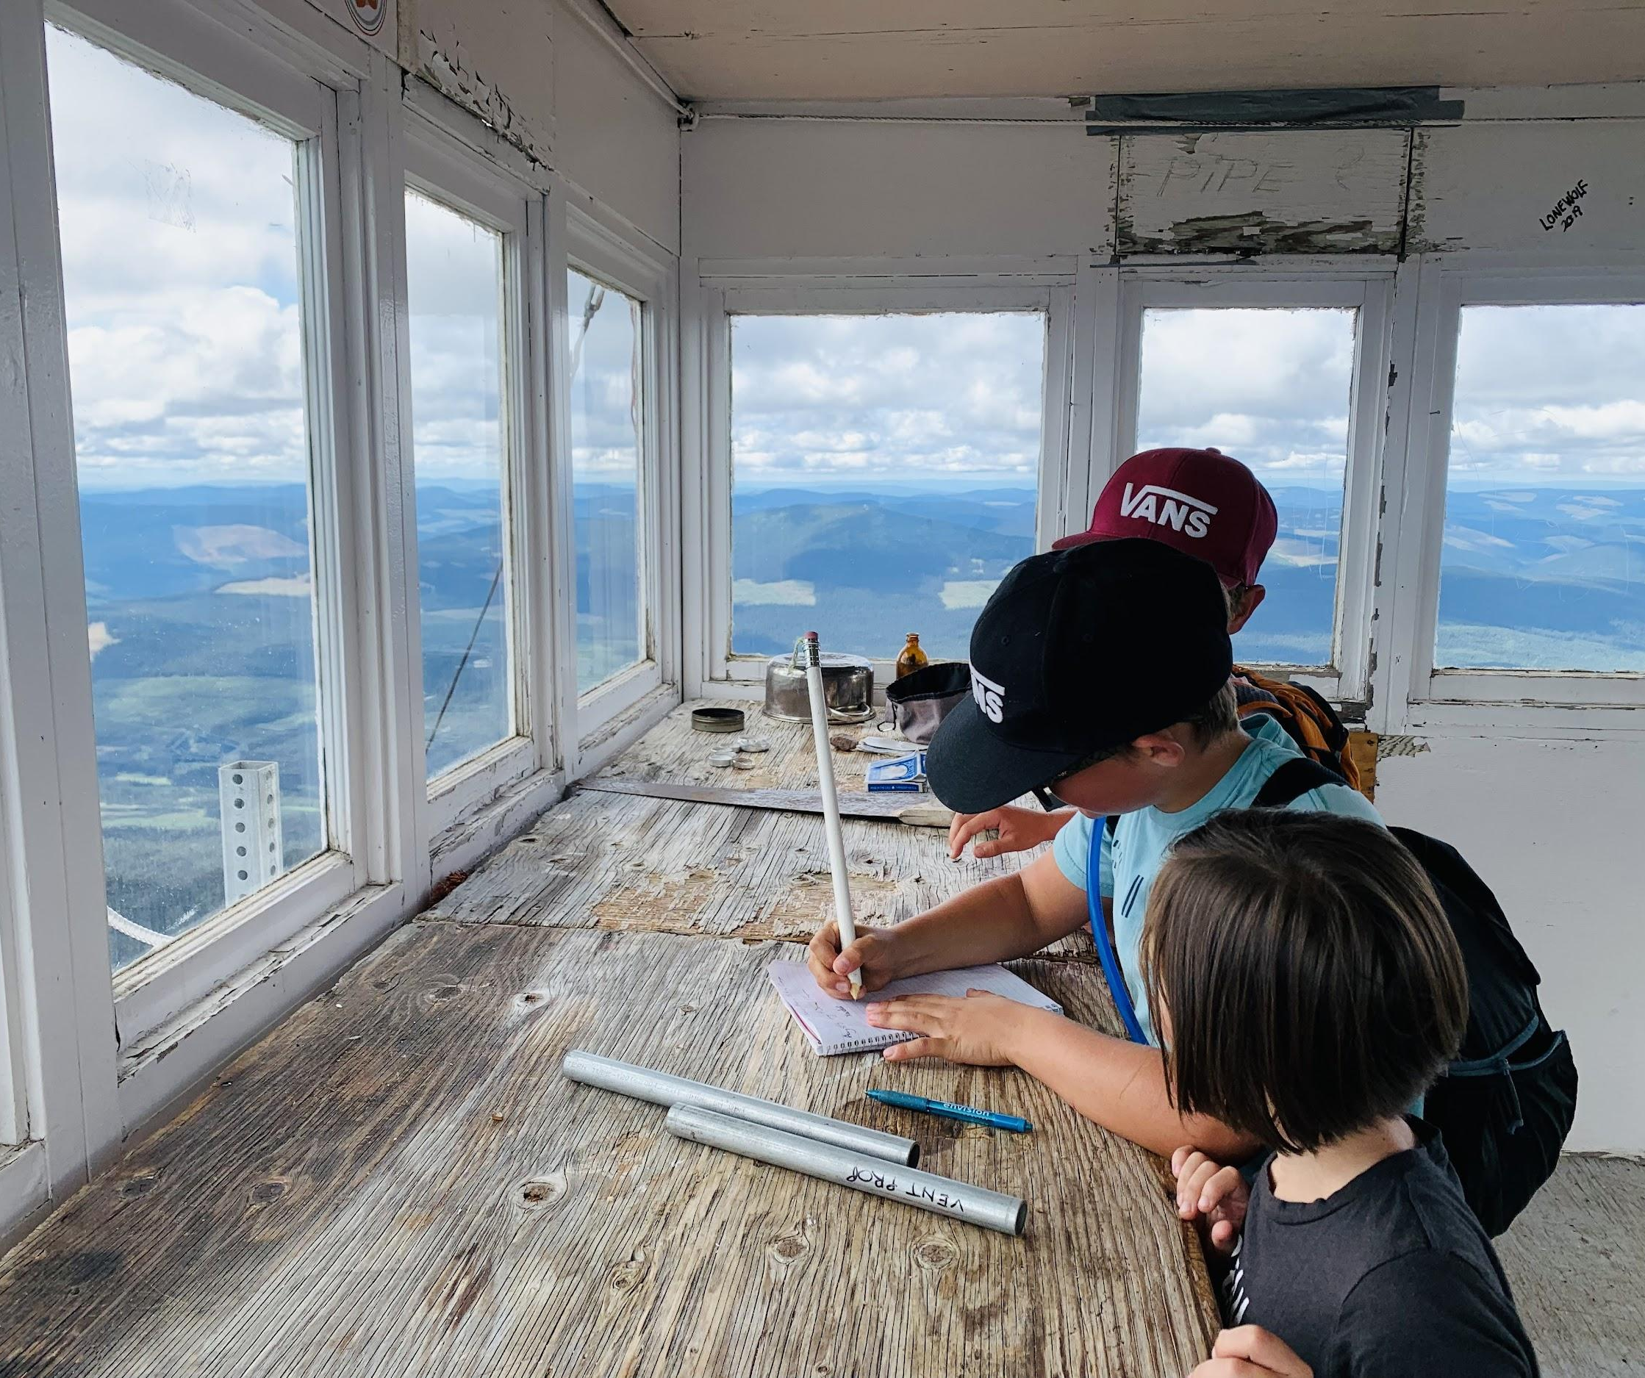
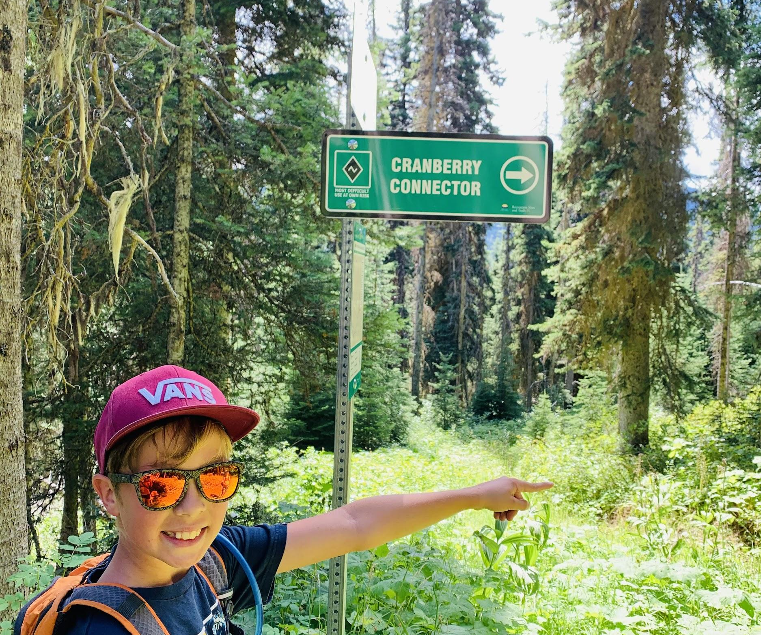
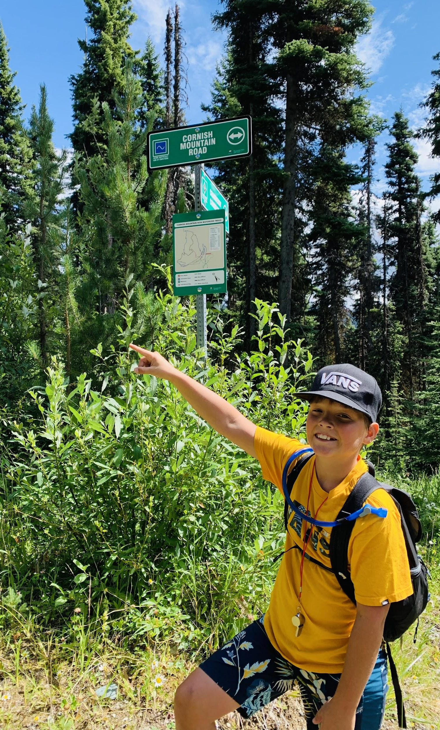
In teaching, we must assess our students based on BC’s Redesigned Curriculum
Notes:
We must ask ourselves “How will the evidence of learning be documented and shared?”
Assessment comes in many forms and we have the autonomy to choose which form suits each situation.
The goal is assessment FOR learning.
Teachers must use assessment to improve student capacity and to continuously challenge individual improvement and growth, while ensuring that everyone reaches the summit—no climber left behind!

Slide 6
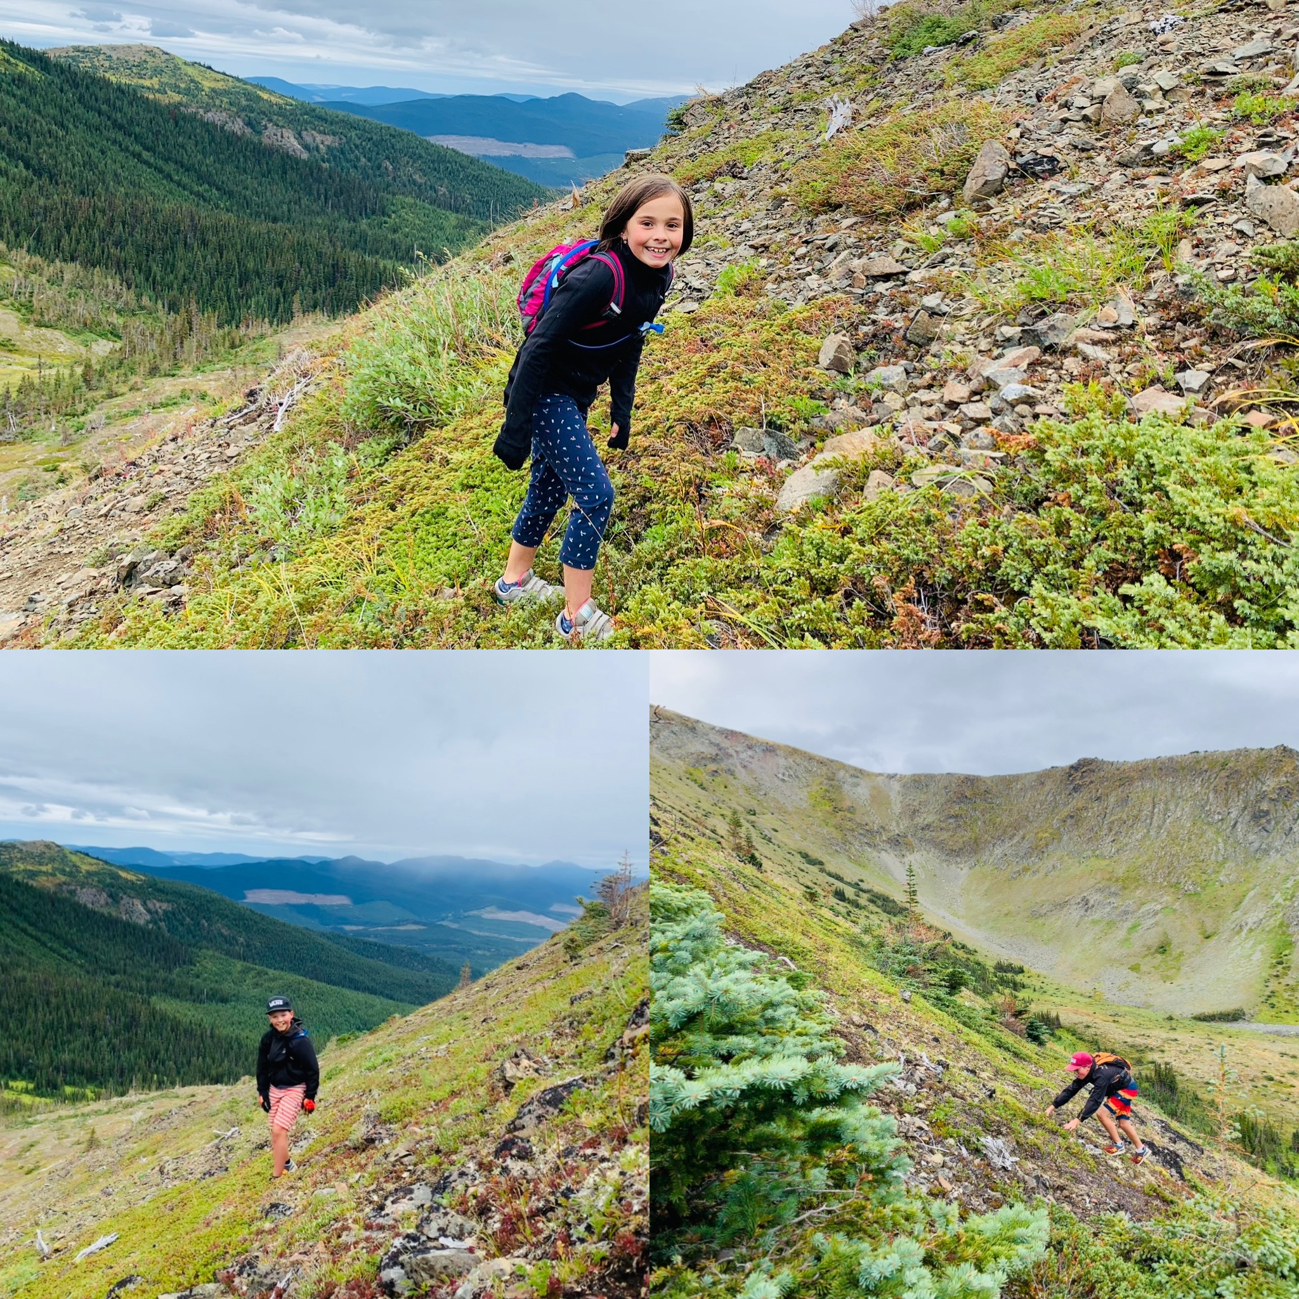
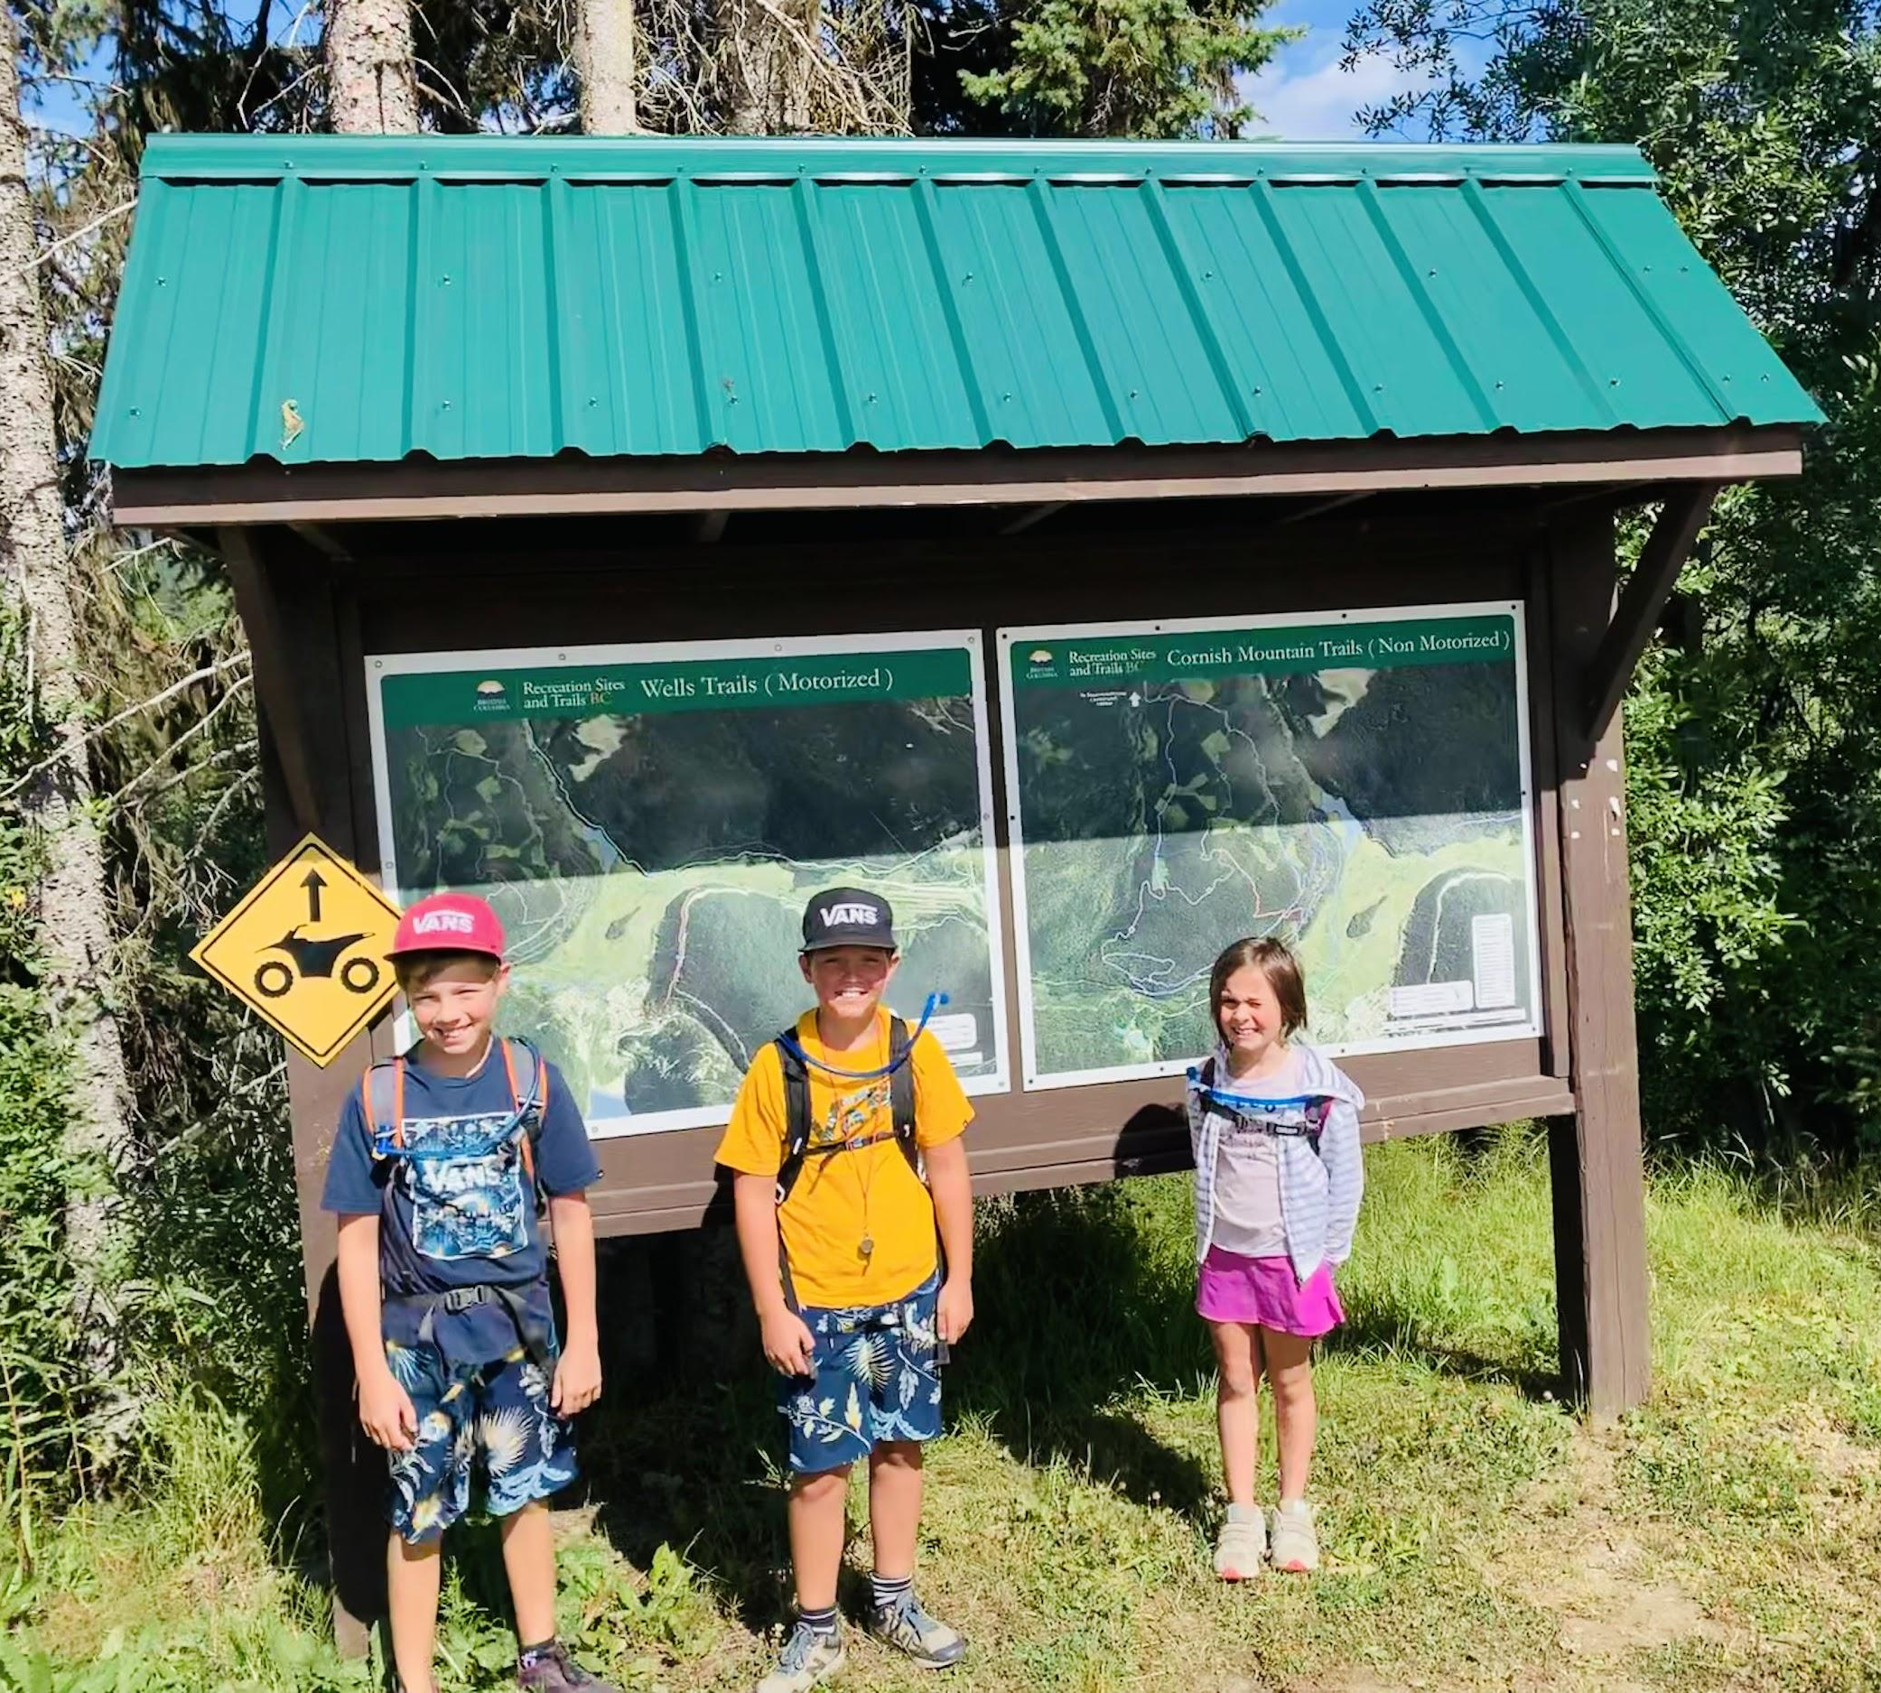
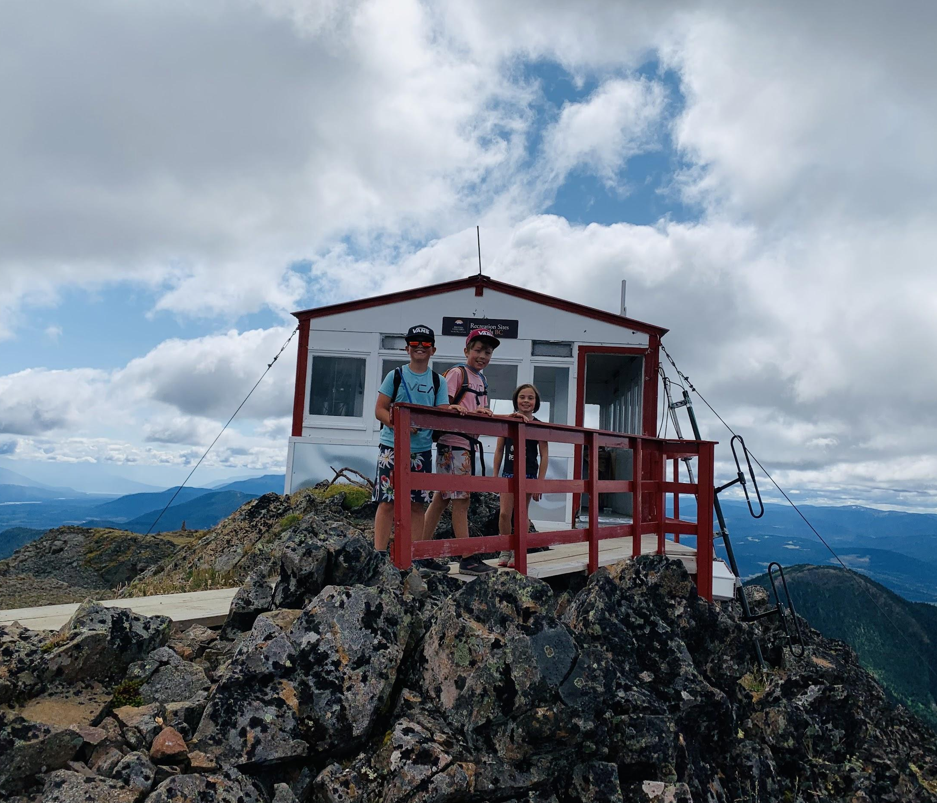
Student readiness should be assessed diagnostically ~ at the beginning of the journey
Student growth should be assessed summatively ~ at the “Summit”
Student progress should be assessed formally ~ throughout the journey
Notes:
Some climbers arrive with overflowing packs and an abundance of material and human resources; others arrive less equipped with empty packs and limited resources.
Experience varies and it is often difficult to gauge climber readiness. If guides are unaware of their climbers’ strengths and stretches, they cannot meet the climbers where they are at and the expedition can go awry.
Teachers, like guides, must make themselves aware of every student’s capabilities, assessing them individually—at the beginning of the expedition, throughout the climb, and at the summit—so that necessary action can be taken to help each climber move forward (onward and upward, one foot in front of the other, one step at a time).

Slide 7
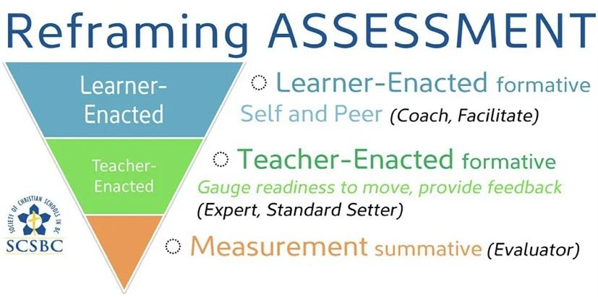
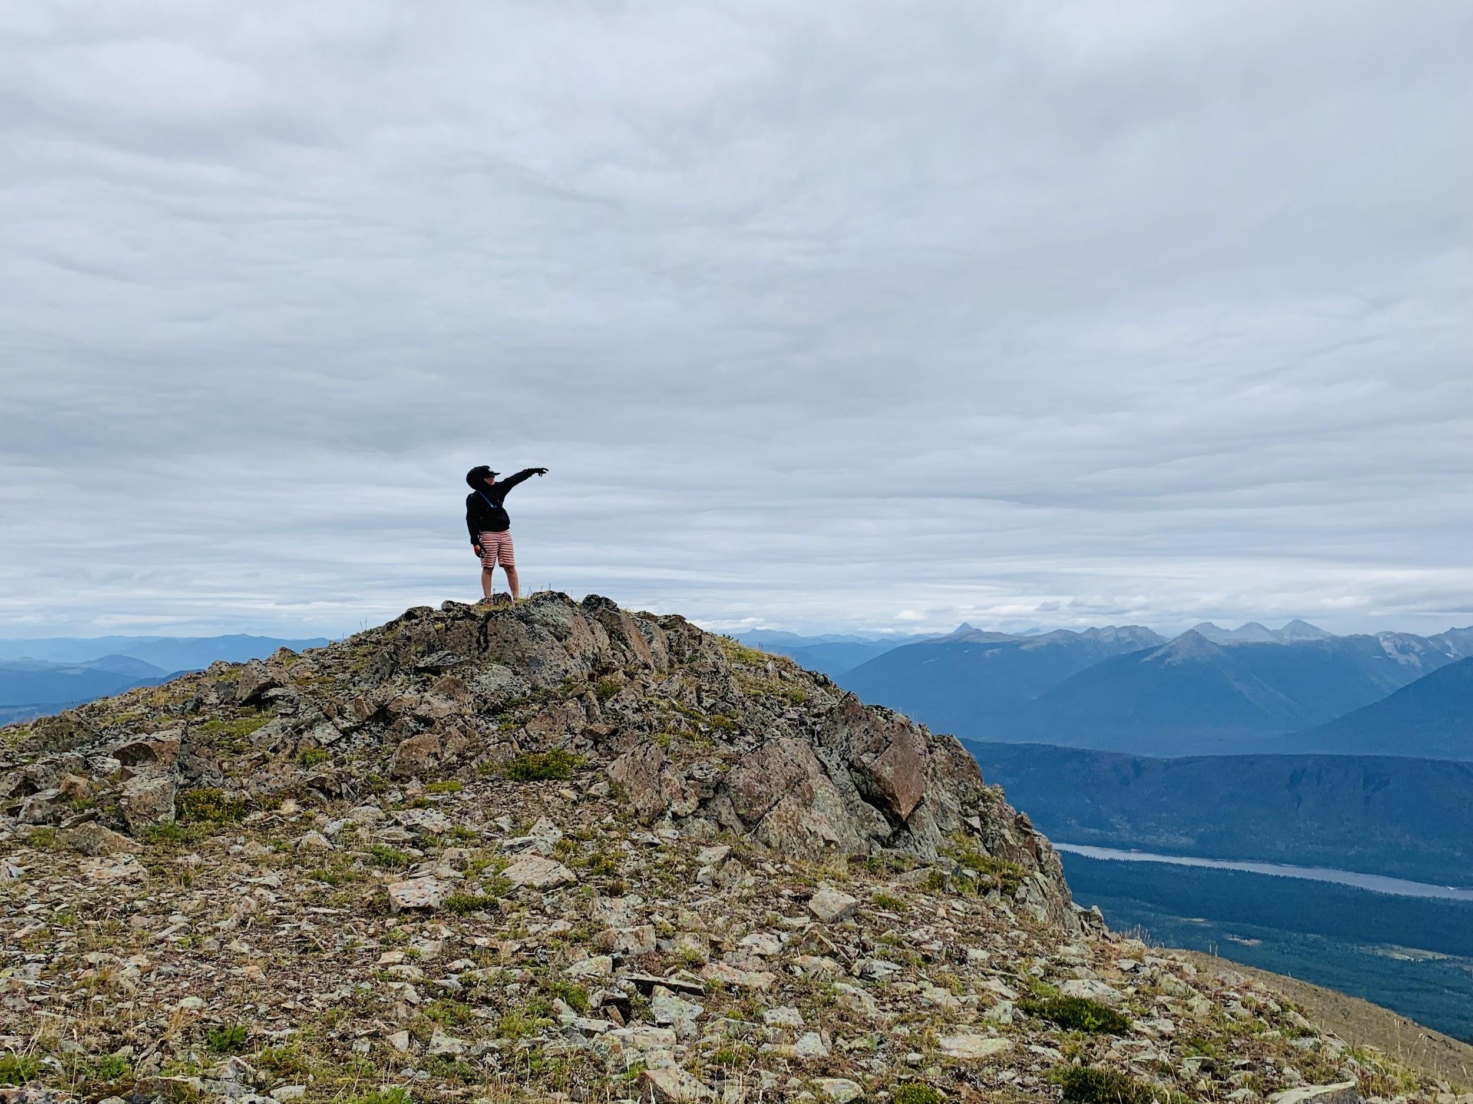
Opportunities for Self-assessment should also be incorporated at every stage of the journey ~ from beginning to end!
Notes:
Teachers, like guides, must provide opportunities for students to assess themselves, encouraging questions such as: what are my strengths and what are my stretches?; what do I know now that I did not know before?; what am I proud of; what would I do differently and what would I do again?

Slide 8
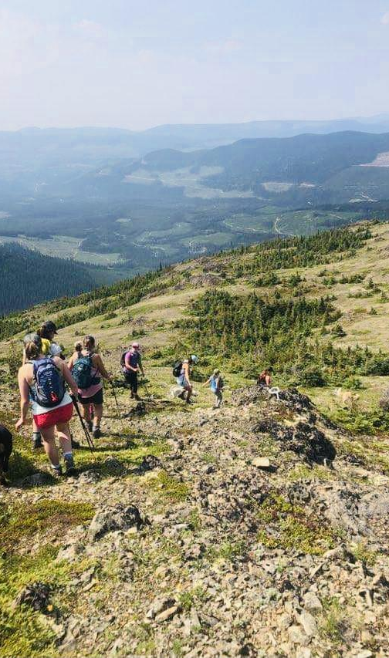
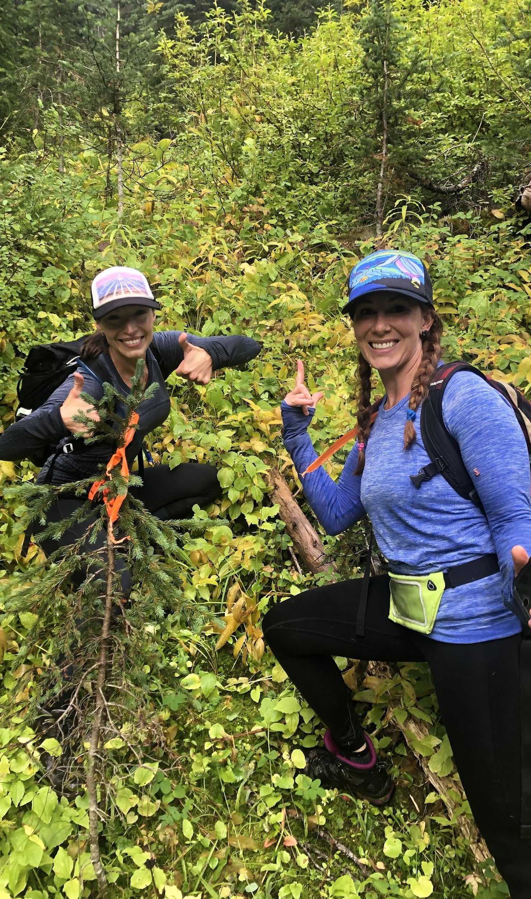
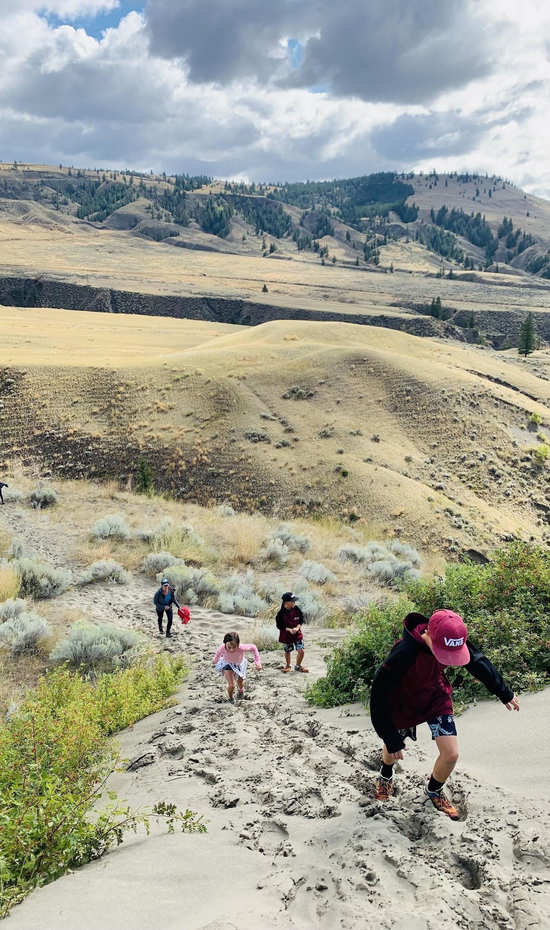
In teaching, we have teacher autonomy!
We can blaze our own trails while following in the footsteps of great teachers before us!
Notes:
Teacher autonomy is important, but we do not have to reinvent the wheel every time we step into the classroom.
We can draw upon the experiences of those who came before us.
We can adopt and adapt, putting our own stamp on teaching.
Here, you see the excitement on a friend & I’s face as we find a trail marker after being lost in deep brush! Thanks to this marker, left by a hiker before us, we got back on track and reached the summit.

Slide 9
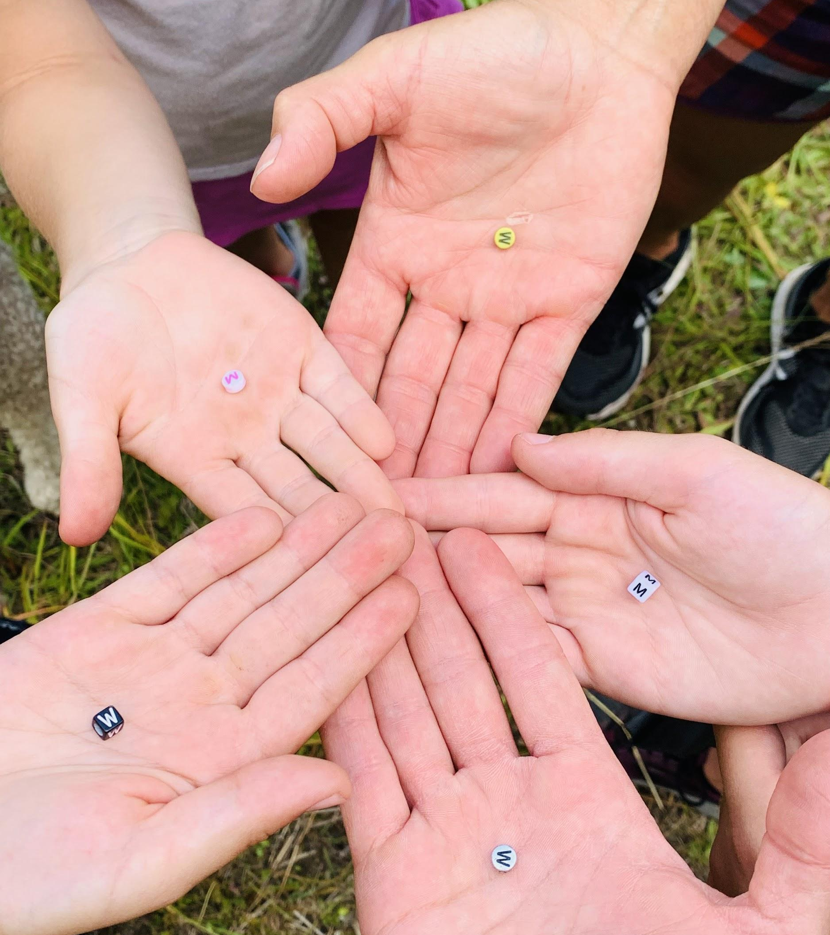
In teaching, we must remember the importance of collaboration:
Teacher-student
Student-student
Teacher-teacher
No one can teach or learn alone..everyone has a hand in Education!
Notes:
Teacher-student, Student-student, and Teacher-teacher collaboration is essential!
No one can teach or learn alone…everyone has a hand in Education! We must work together!
Here, me, my children, and my mom hold beads from a summit cairn. Our collaboration paid off!

Slide 10
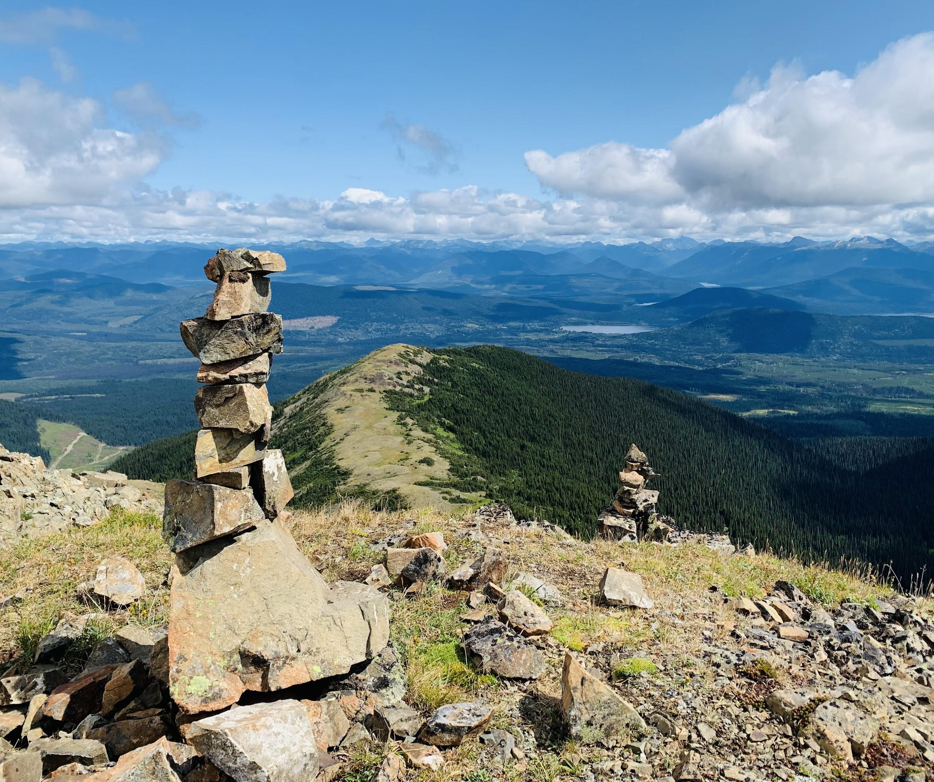
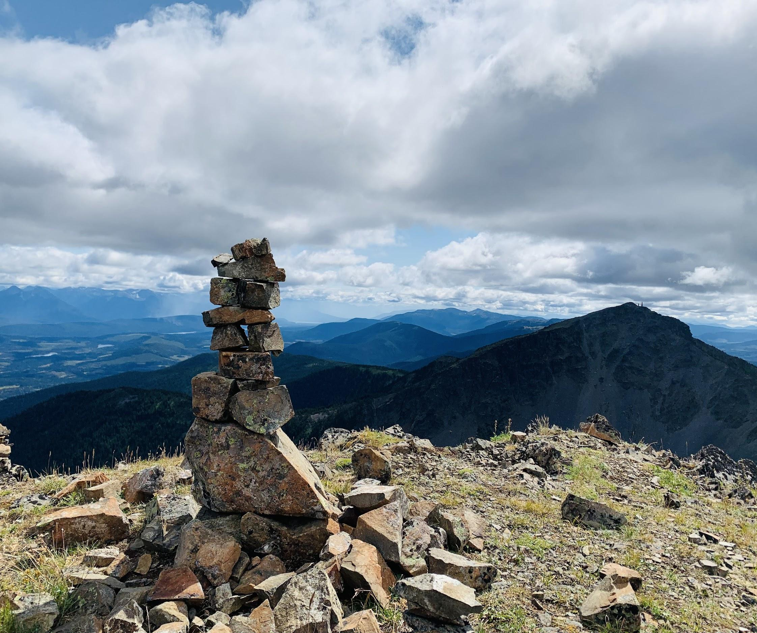
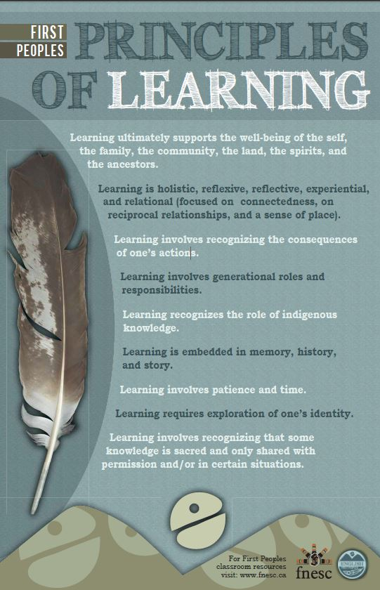
In teaching, we must honour the First Peoples Principles of Learning and the Nine R’s
Notes:
They help us create culturally safe classrooms where all students are given a voice, feel valued, and are respected.
Relationships are crucial and help build capacity and contribute to learning.
Students are responsible for their learning and must be given the space to learn and make mistakes, knowing they are supported by teachers and fellow learners.
Our classrooms must be reciprocal—a two-way street of teaching and learning.
Classrooms must be relevant—historically and socio-culturally.
Reverence should be given to the land as we work towards reclamation and reconciliation.
Reflexivity must be taught and practiced.

Slide 11
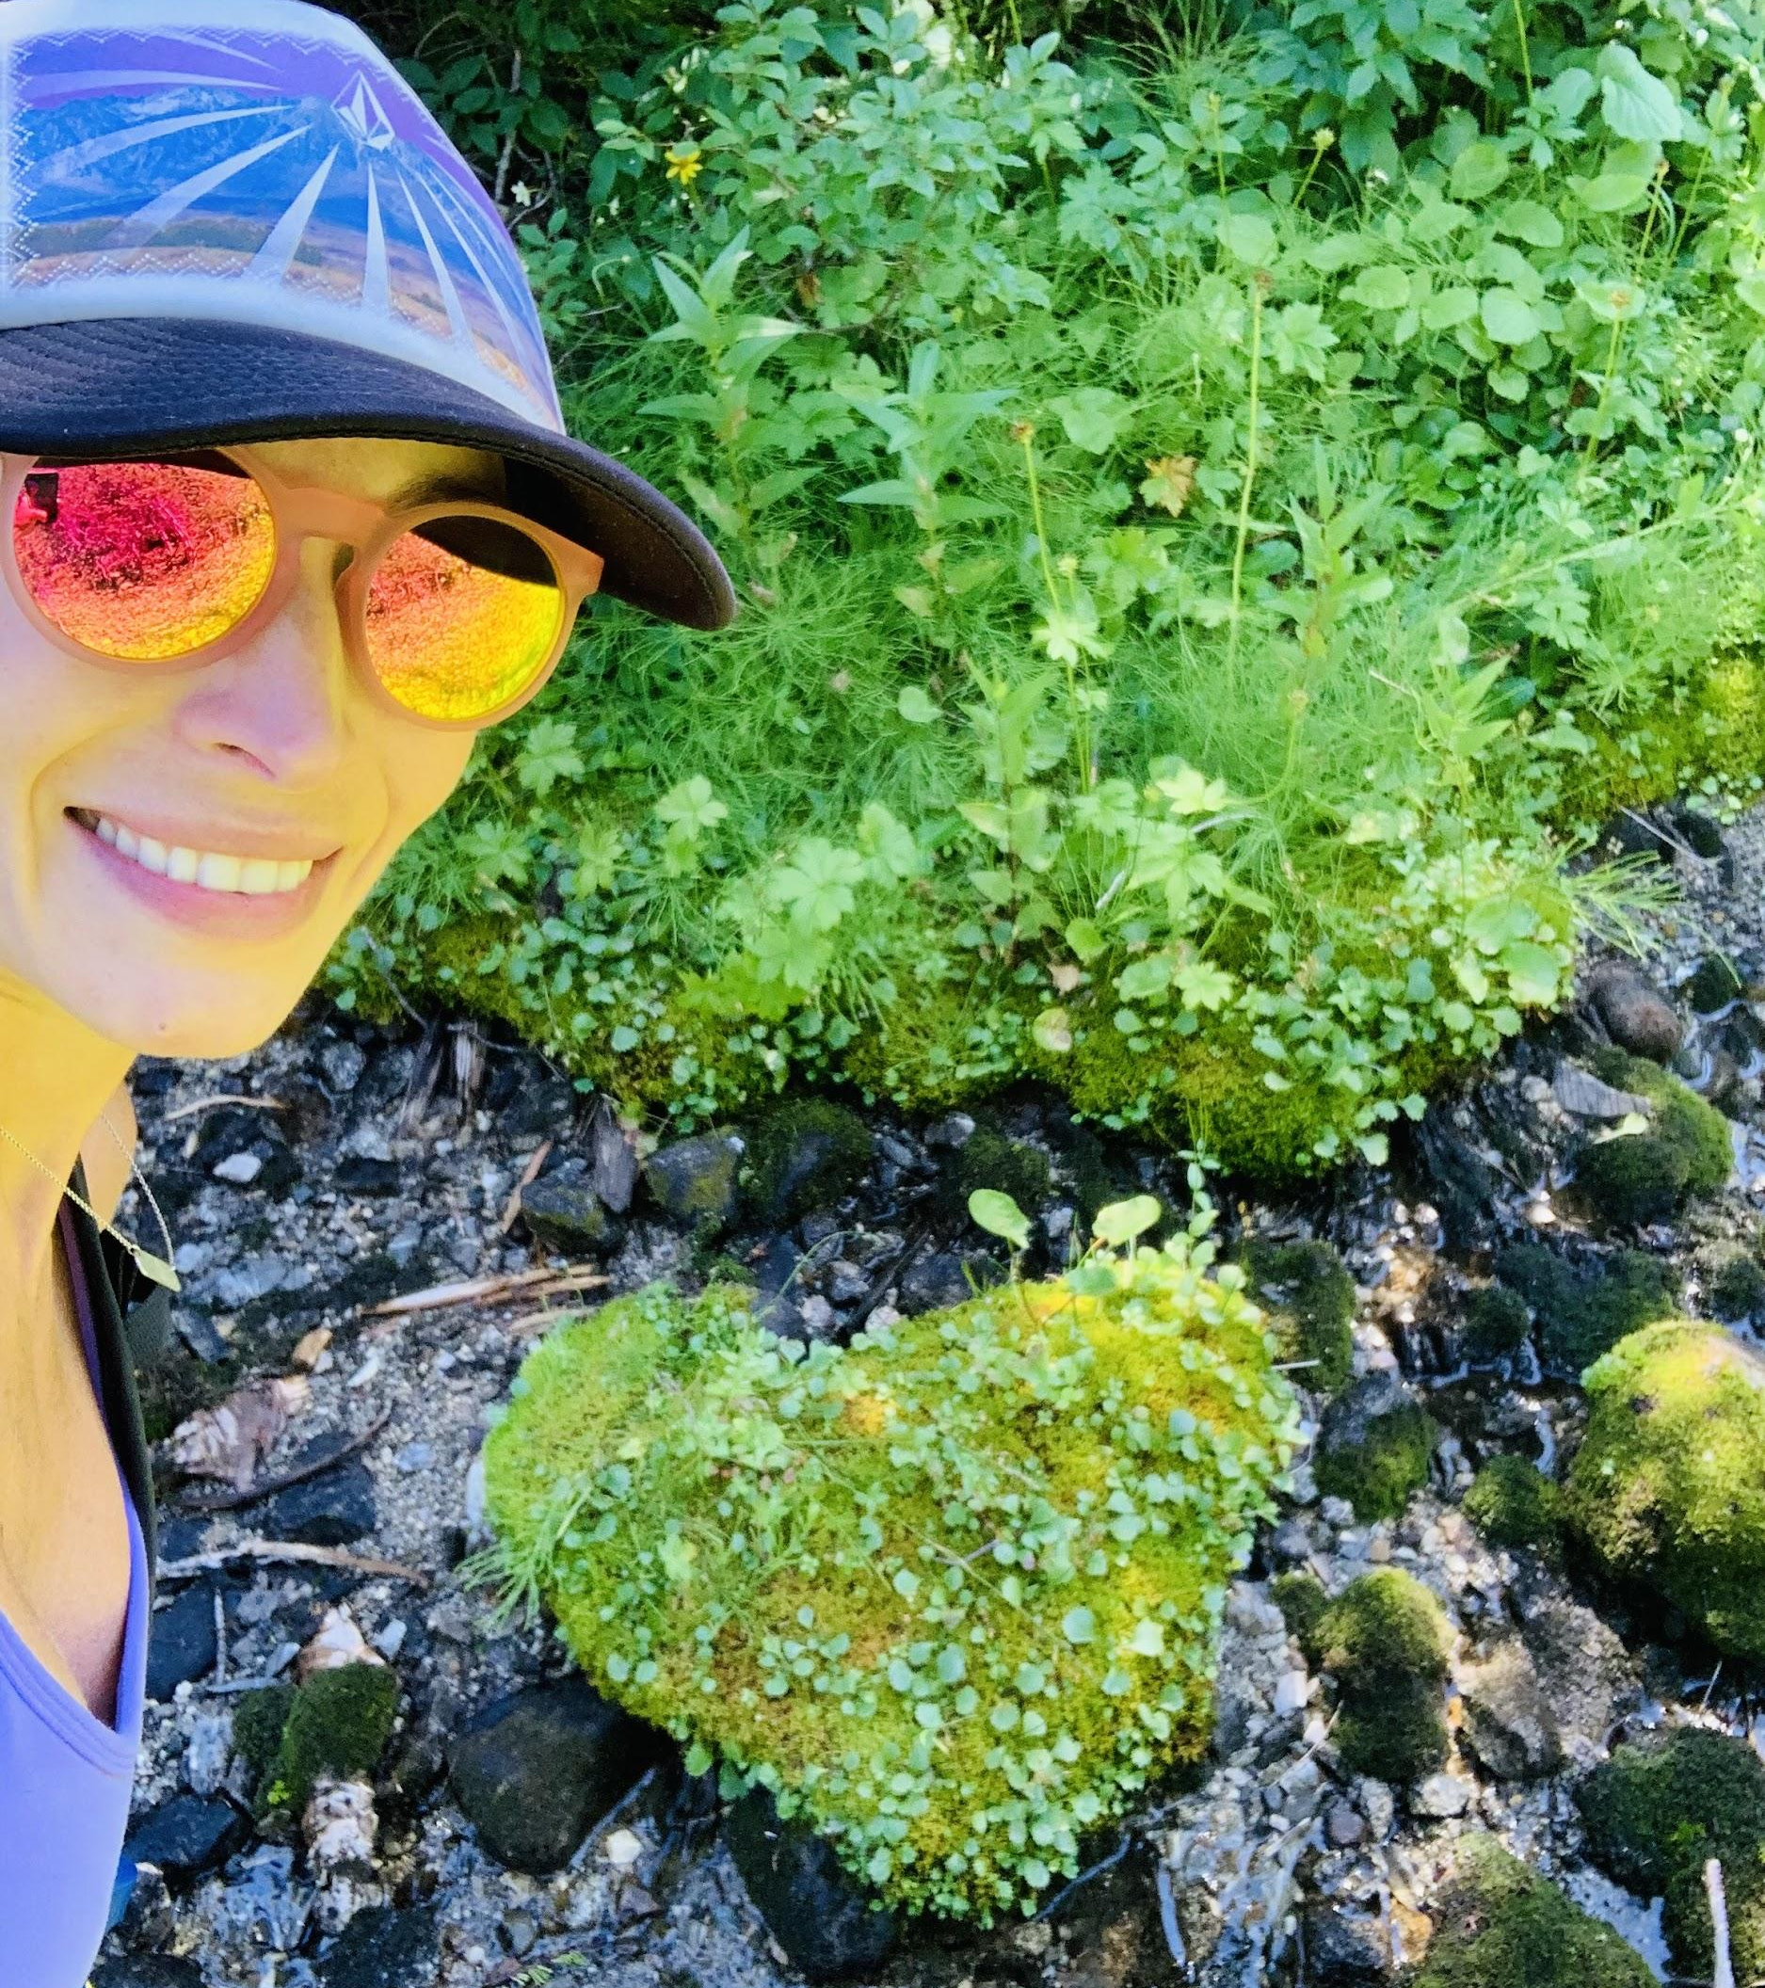
In teaching, we will truly make a difference if we teach from the HEART ♥️
Notes:
Good ol Parker Palmer (1997), giving us grand words of truth & wisdom!
Teaching is only effective if it comes from the heart–when we practice integrity and stay true to our identities.
Students are sly detectives…they know when we are not being authentic…they can smell it a mile away!!

Slide 12
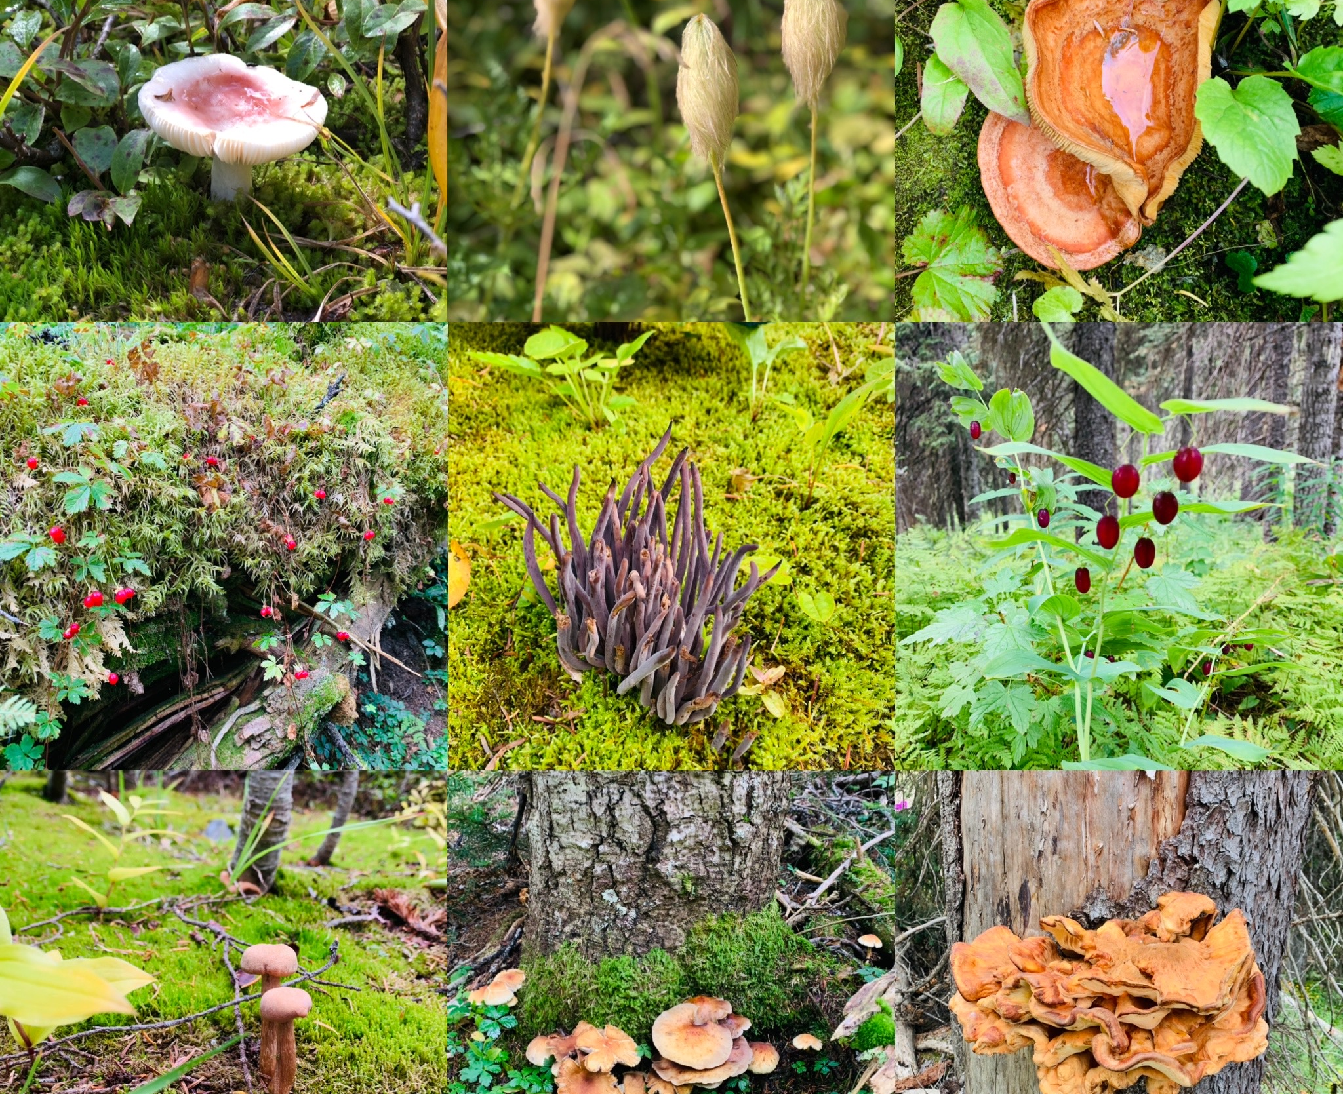
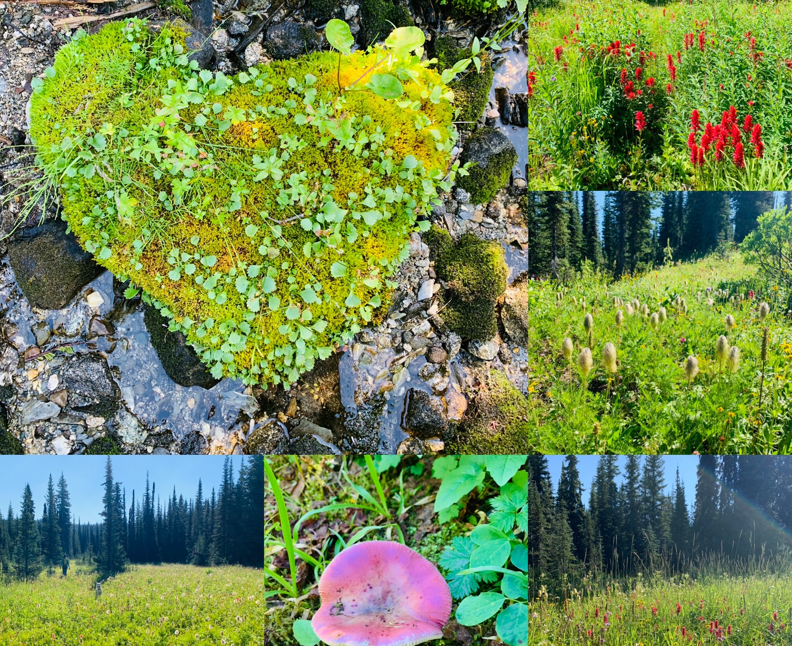
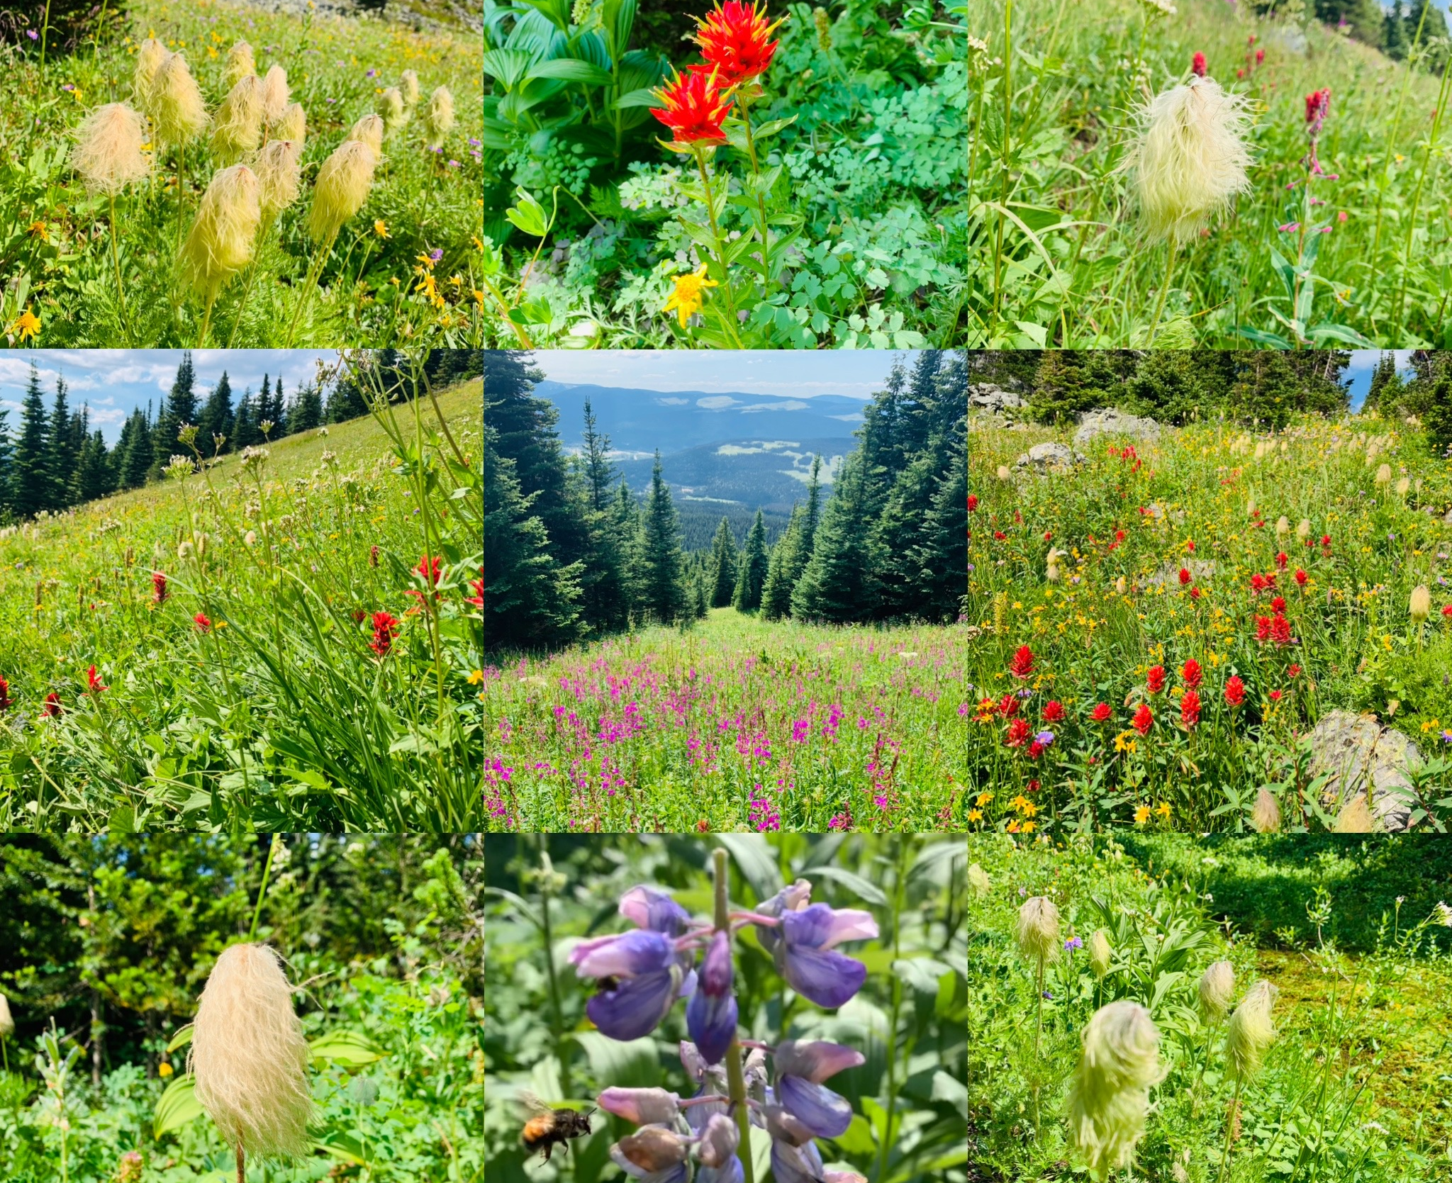
In teaching, we must appreciate & admire student diversity!
Every student, like flora and fauna, is unique, special & worthy of inclusion ♥
Notes:
Every student, like flora and fauna, is unique, special & worthy of inclusion ♥️
Students differ socio-economically, ethnically, racially, culturally, physically, sexually, cognitively, and intellectually.
We must make ourselves aware of student differences and celebrate and respect them.

Slide 13
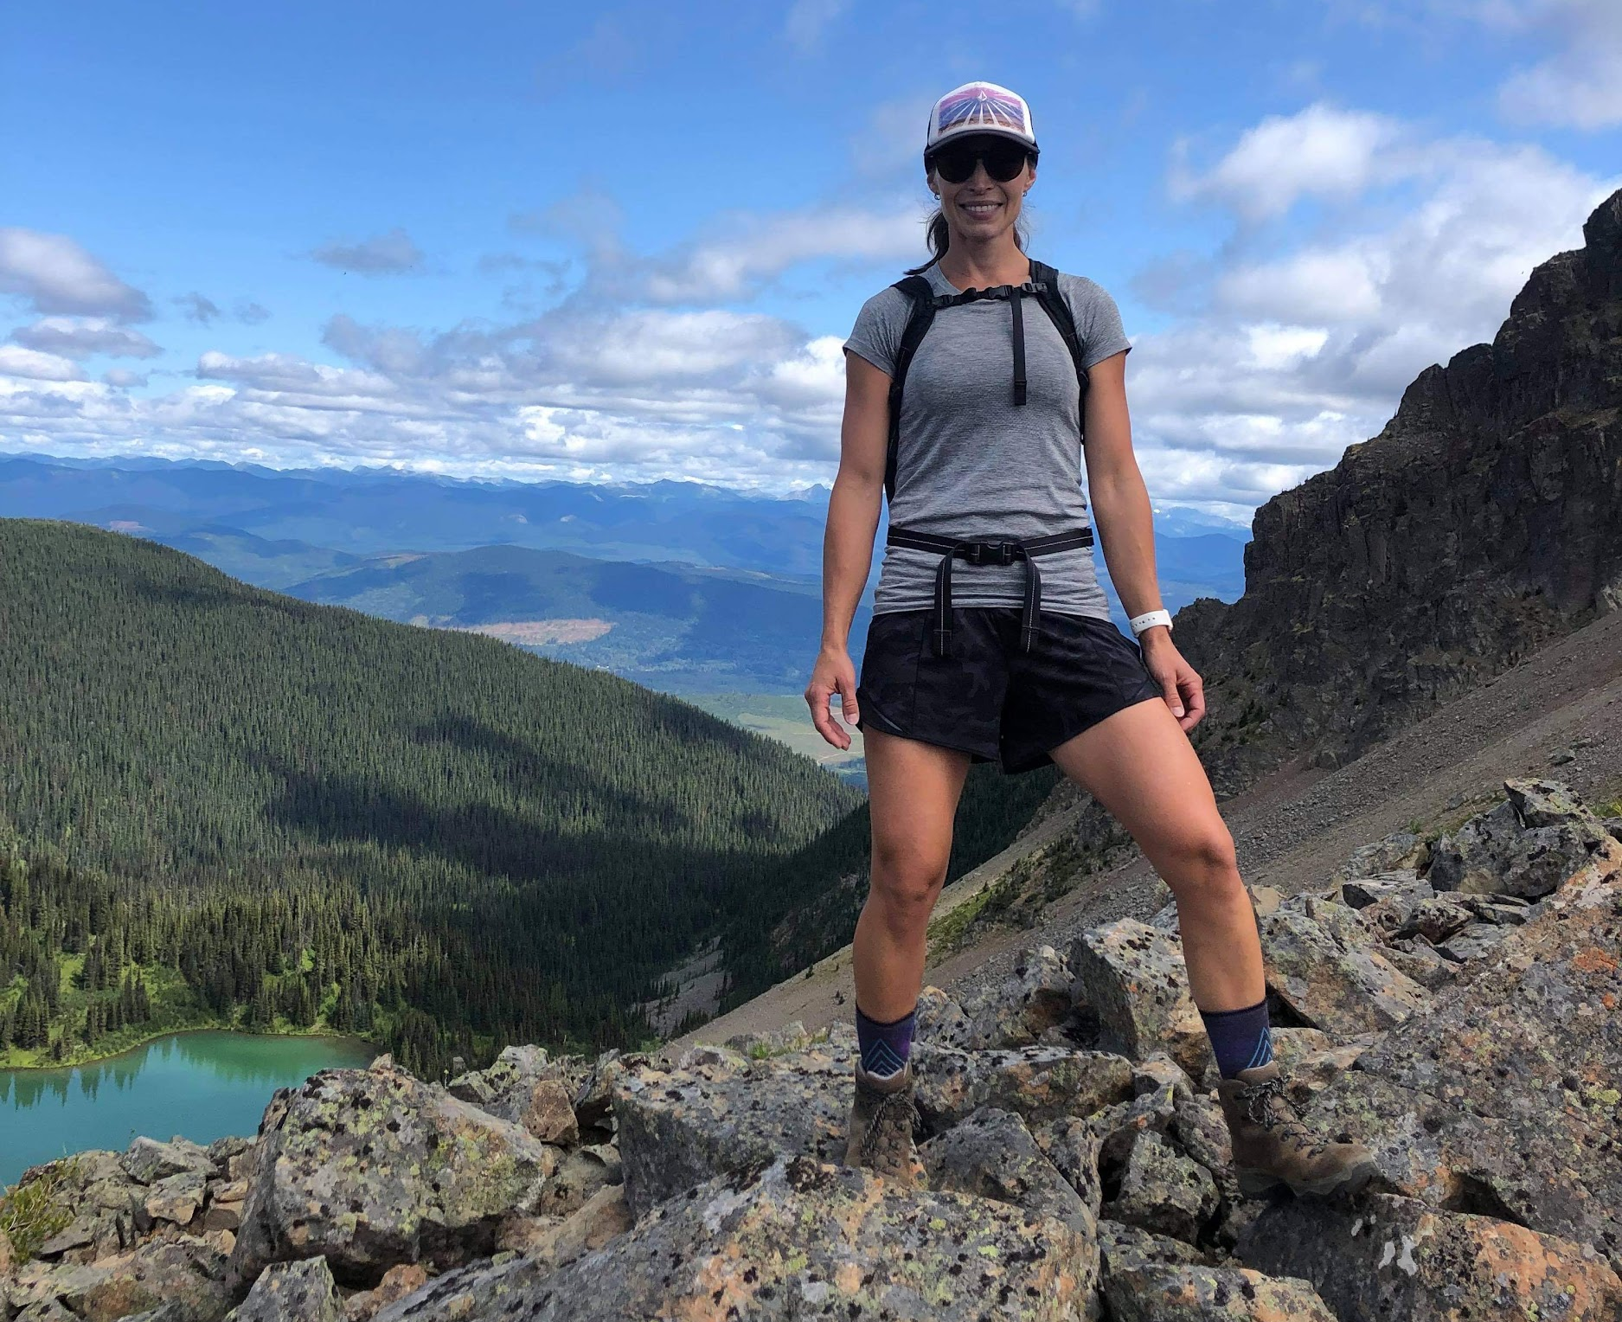
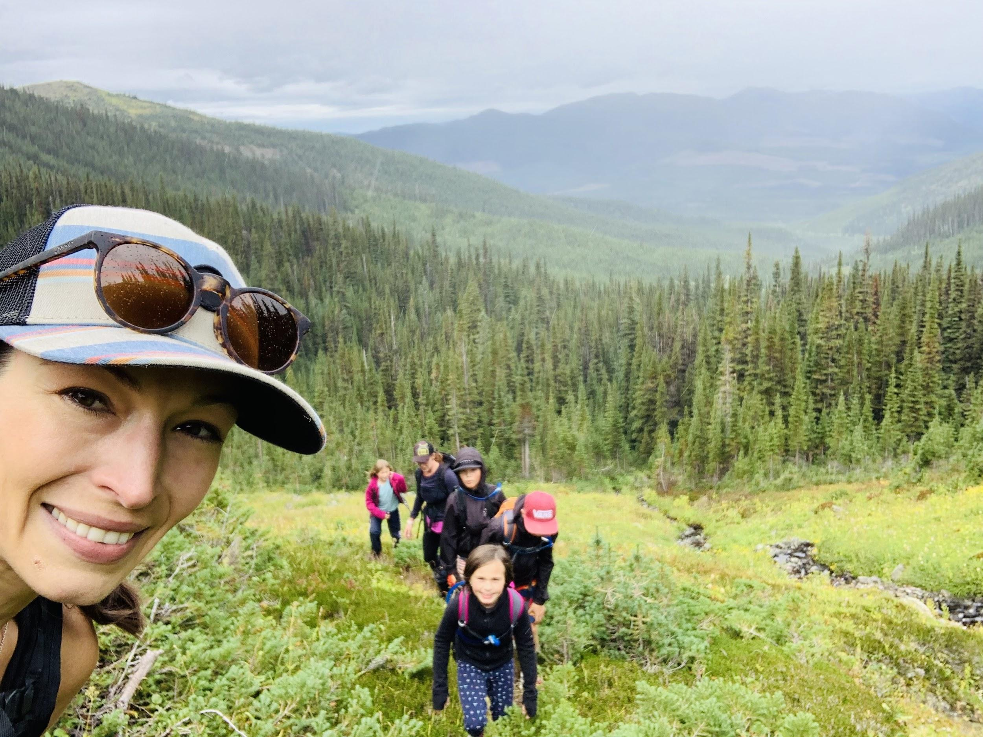
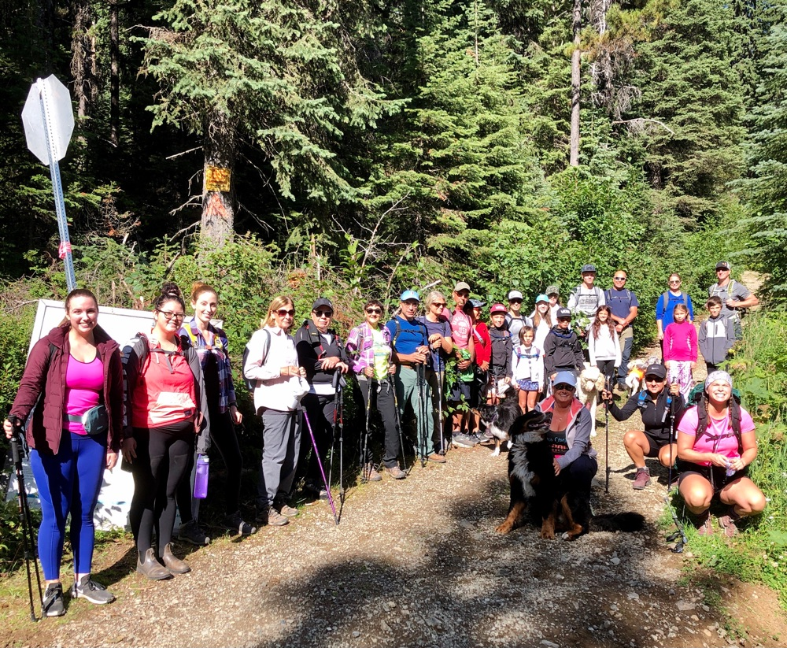
In teaching, differentiated instruction and learning opportunities are key!
Learning can occur individually, in a small group, or as a class!
Notes:
We must be responsive to student readiness, interests, and learning preferences (Province of ON, 2008).
We must use the information gathered from these areas to vary the learning environment, our instruction, and our assessment.
In addition to learning groups, we must draw upon different instructional approaches to successfully meet the diverse needs of our learners—those that learn visually, audially, textually, or kinesthetically.
We must also offer choice when it comes to how students “show they know”; whether it be written, spoken, visual, or in a performance.

Slide 14
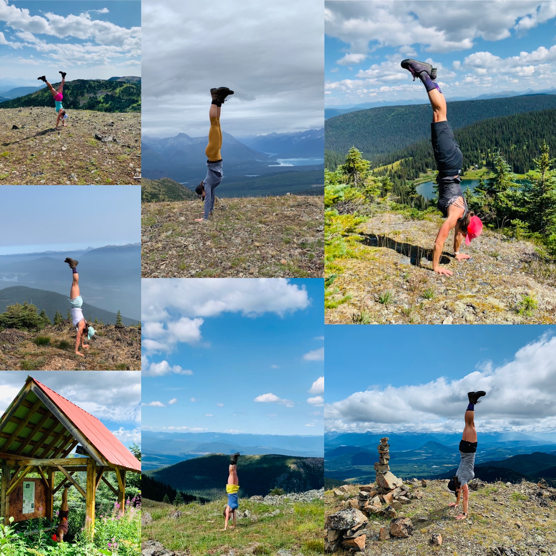
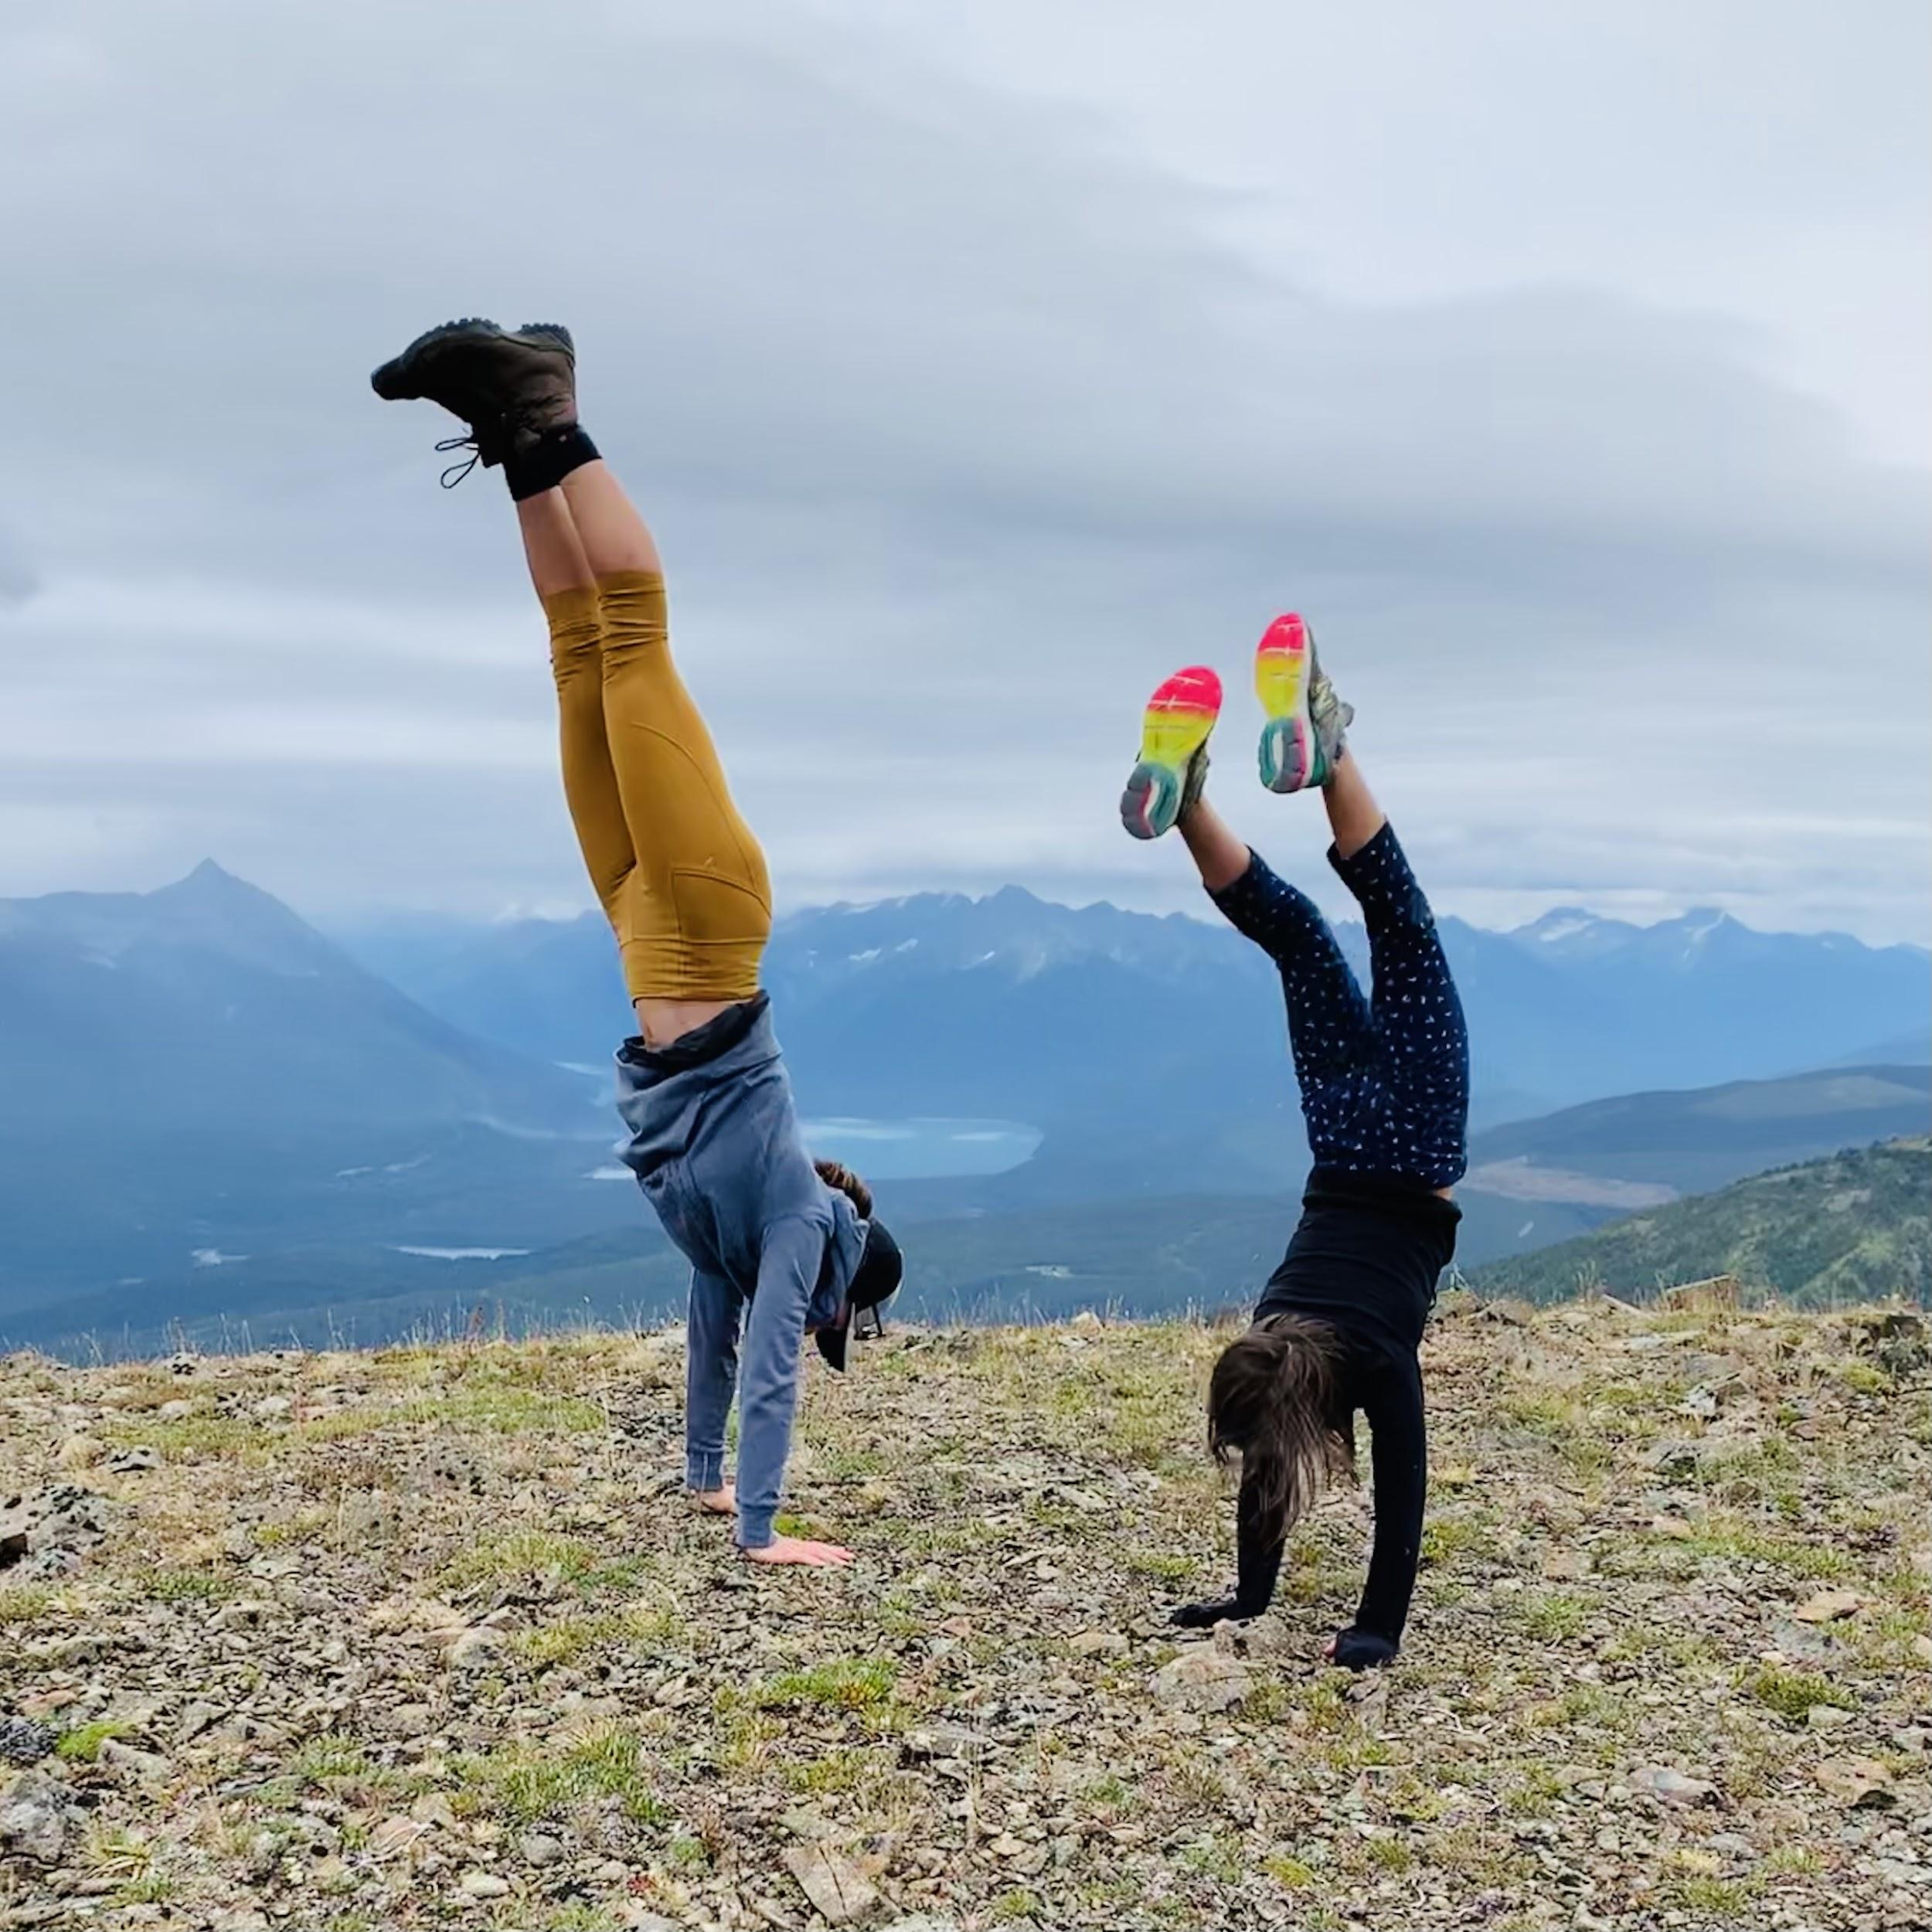
In teaching, we often feel like we are standing on our heads to reach ALL of our diverse learners!
But, when we reach them, it is magic!
Notes:
Accessing all the types of intelligences in our classrooms is challenging.
Differentiated Instruction and Universal Design for Learning are two pedagogical strategies that can be incorporated into our teaching practice and into our classrooms to help us reach as many students as possible.
Reaching summits with diverse learners is no easy feat–but it is definitely a worthwhile one!

Slide 15
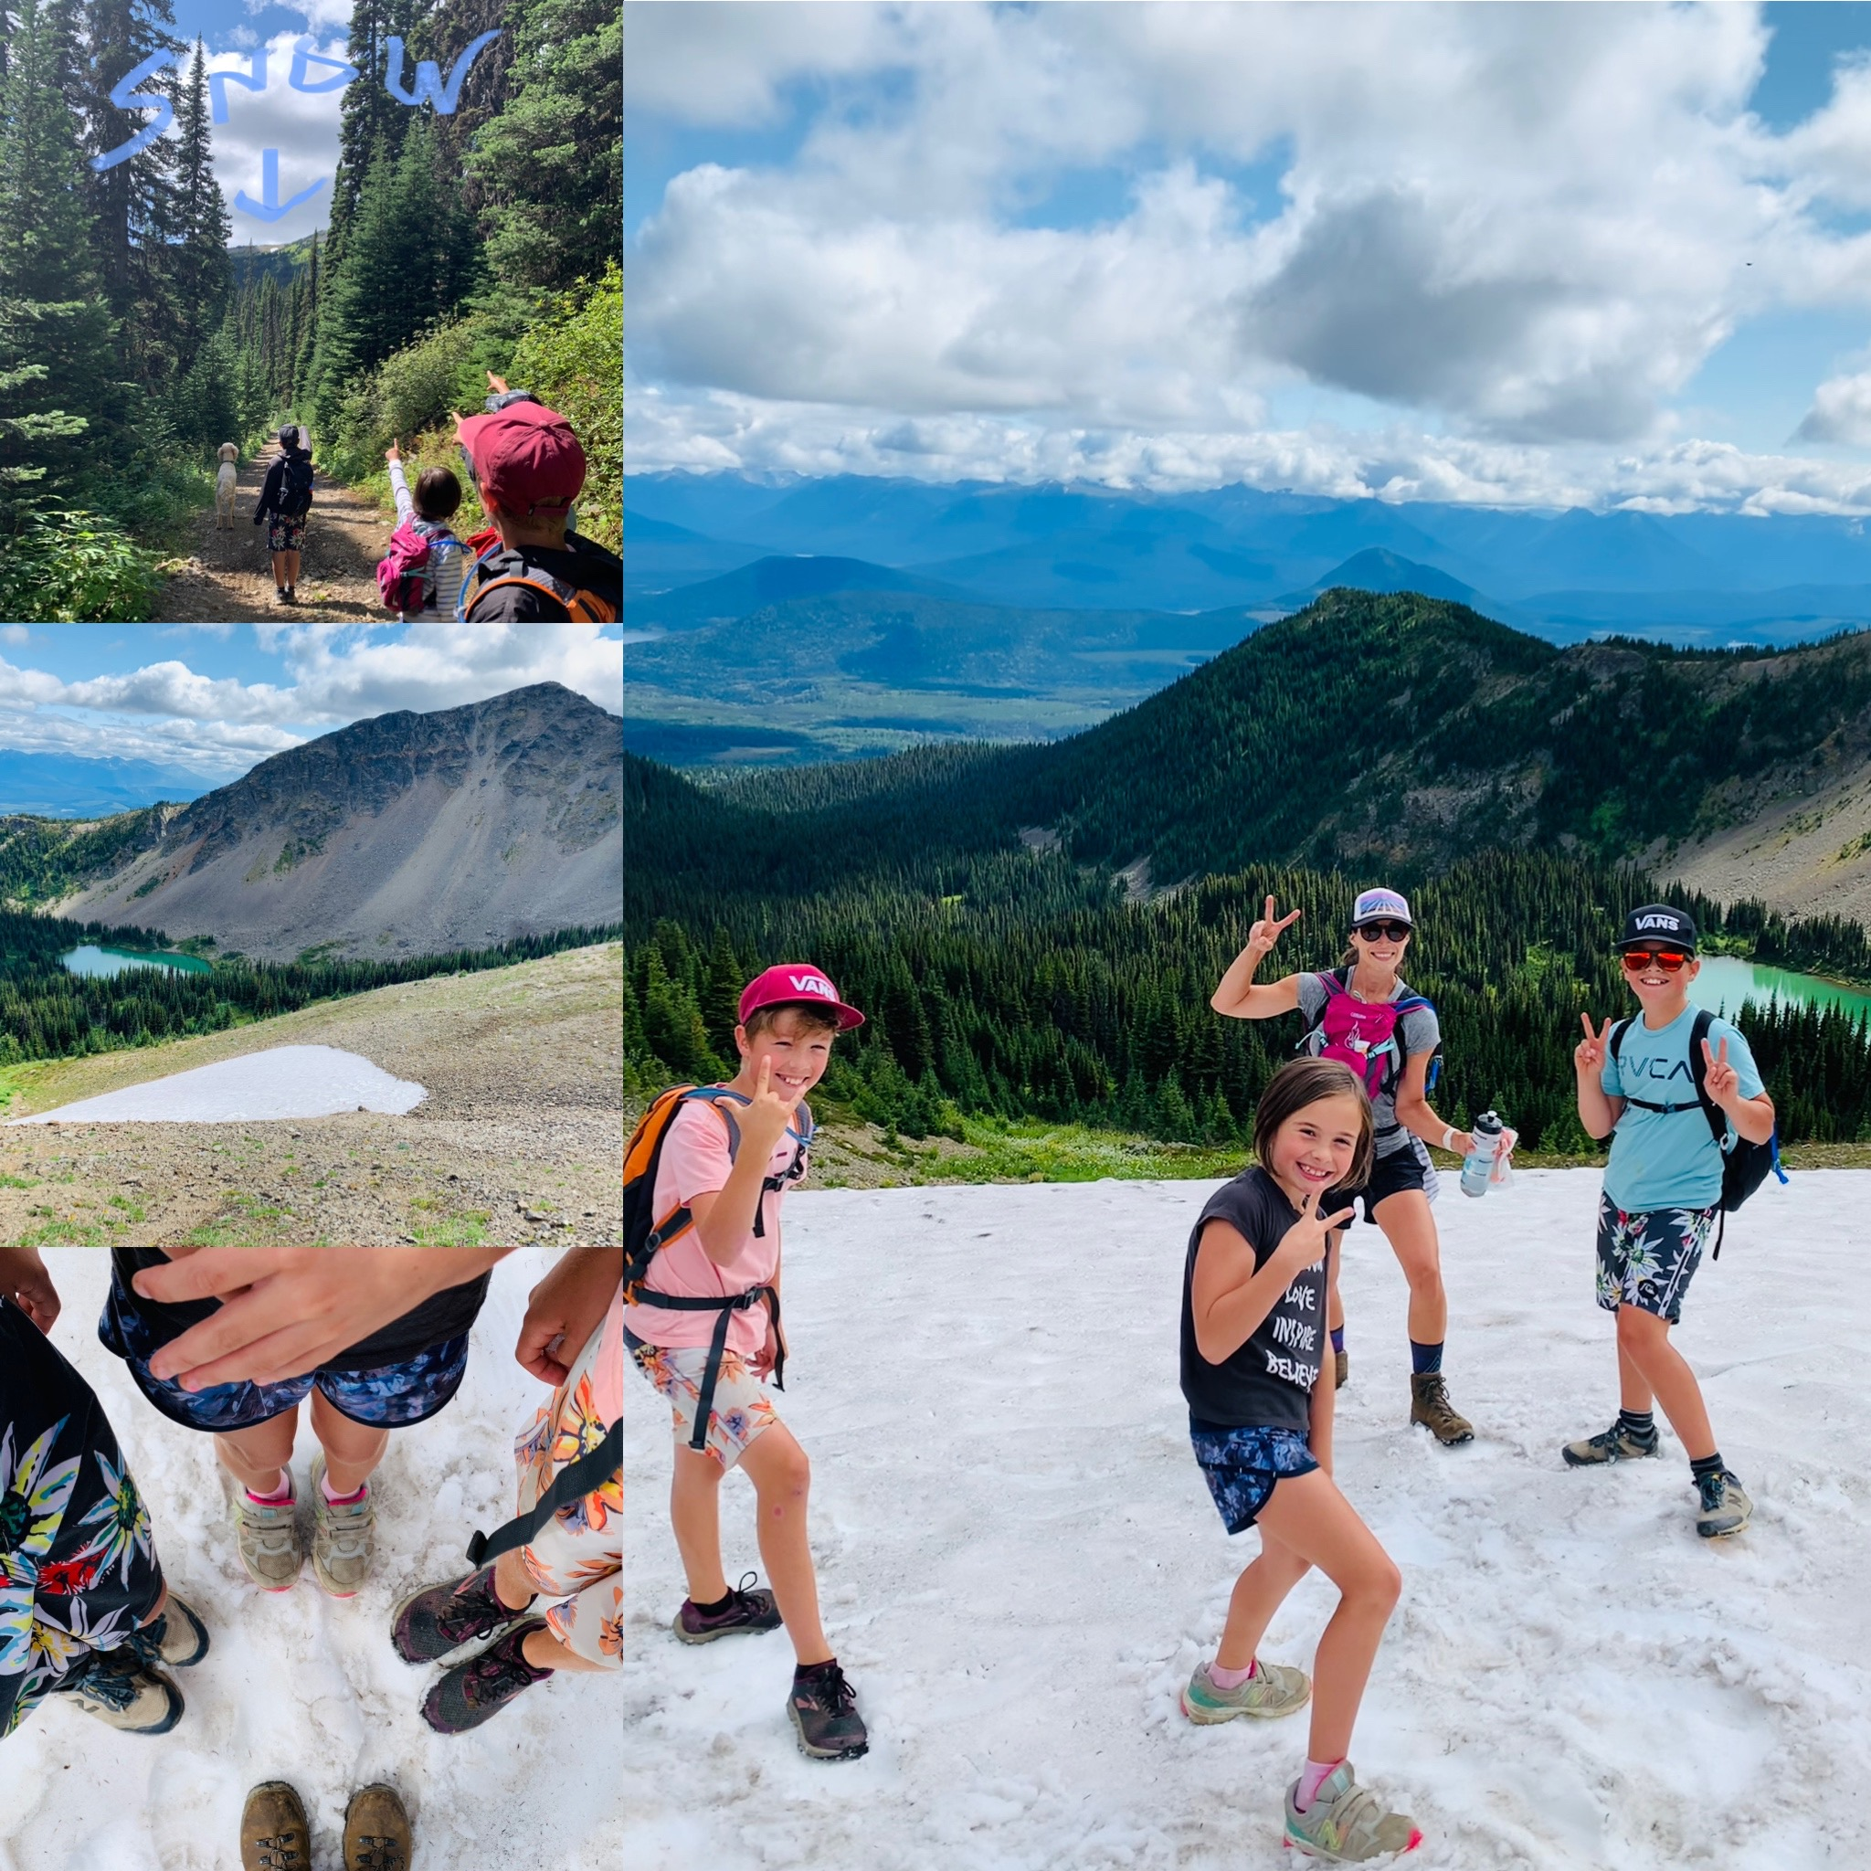
In teaching, everything is unpredictable!!
You must be flexible and adaptable!
My advice: smile & roll with it!!
Notes:
Here, my children and I are pictured in the Snow…at the end of July?!?!
Classroom teaching is the epitome of “Snow in July” ;-) Totally unpredictable!
We made the best of it: “smiling and rolling with it!”

Slide 16
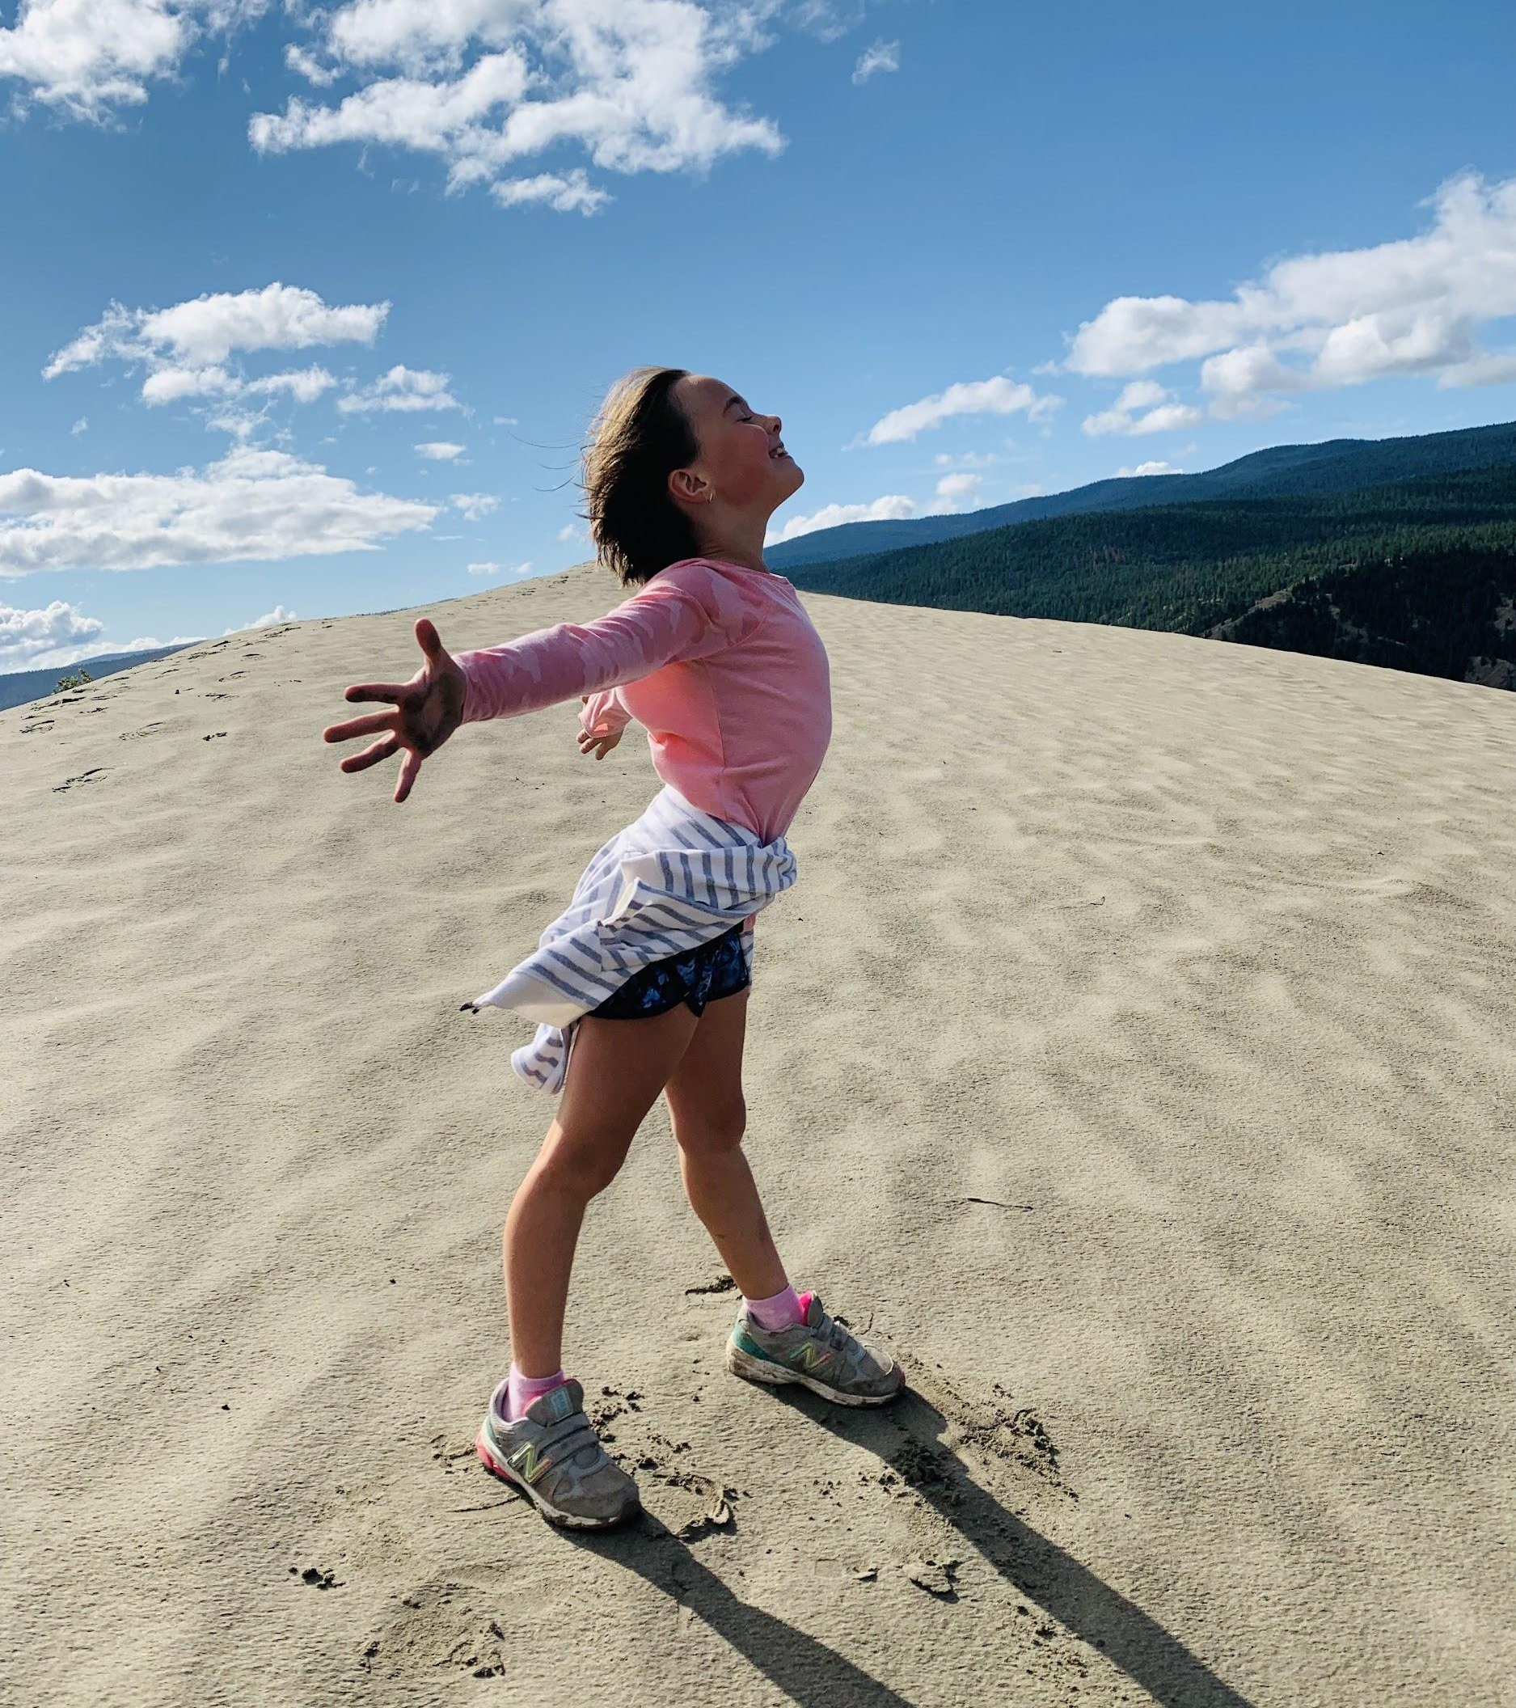
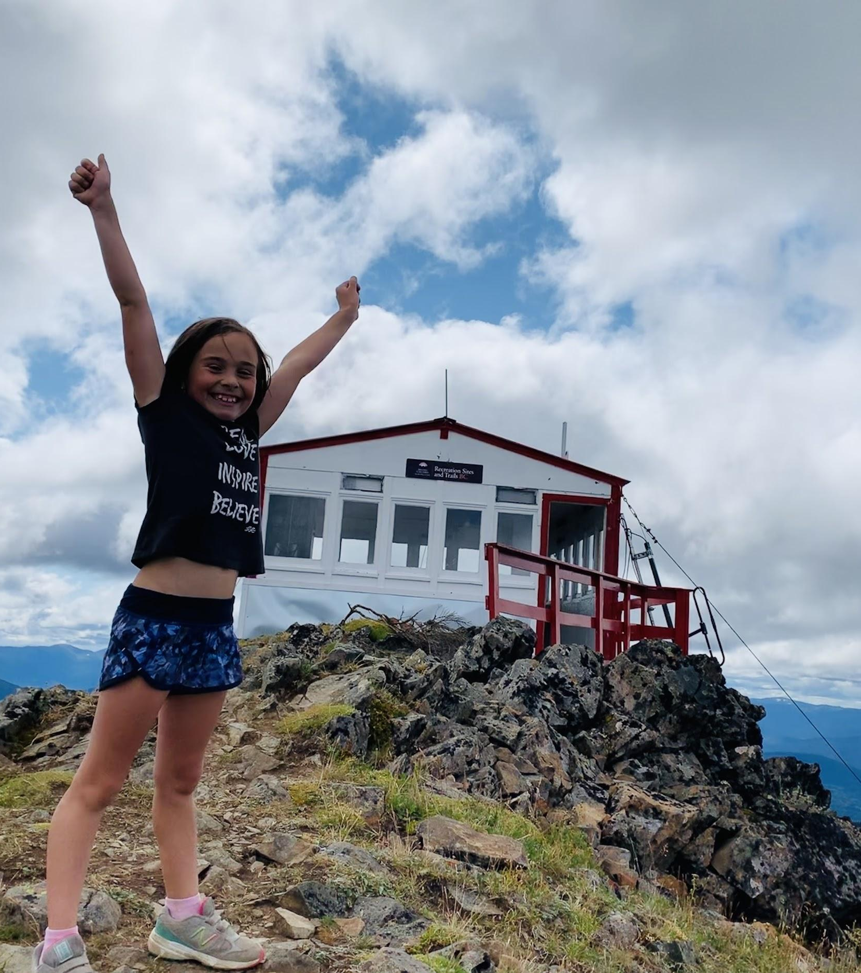
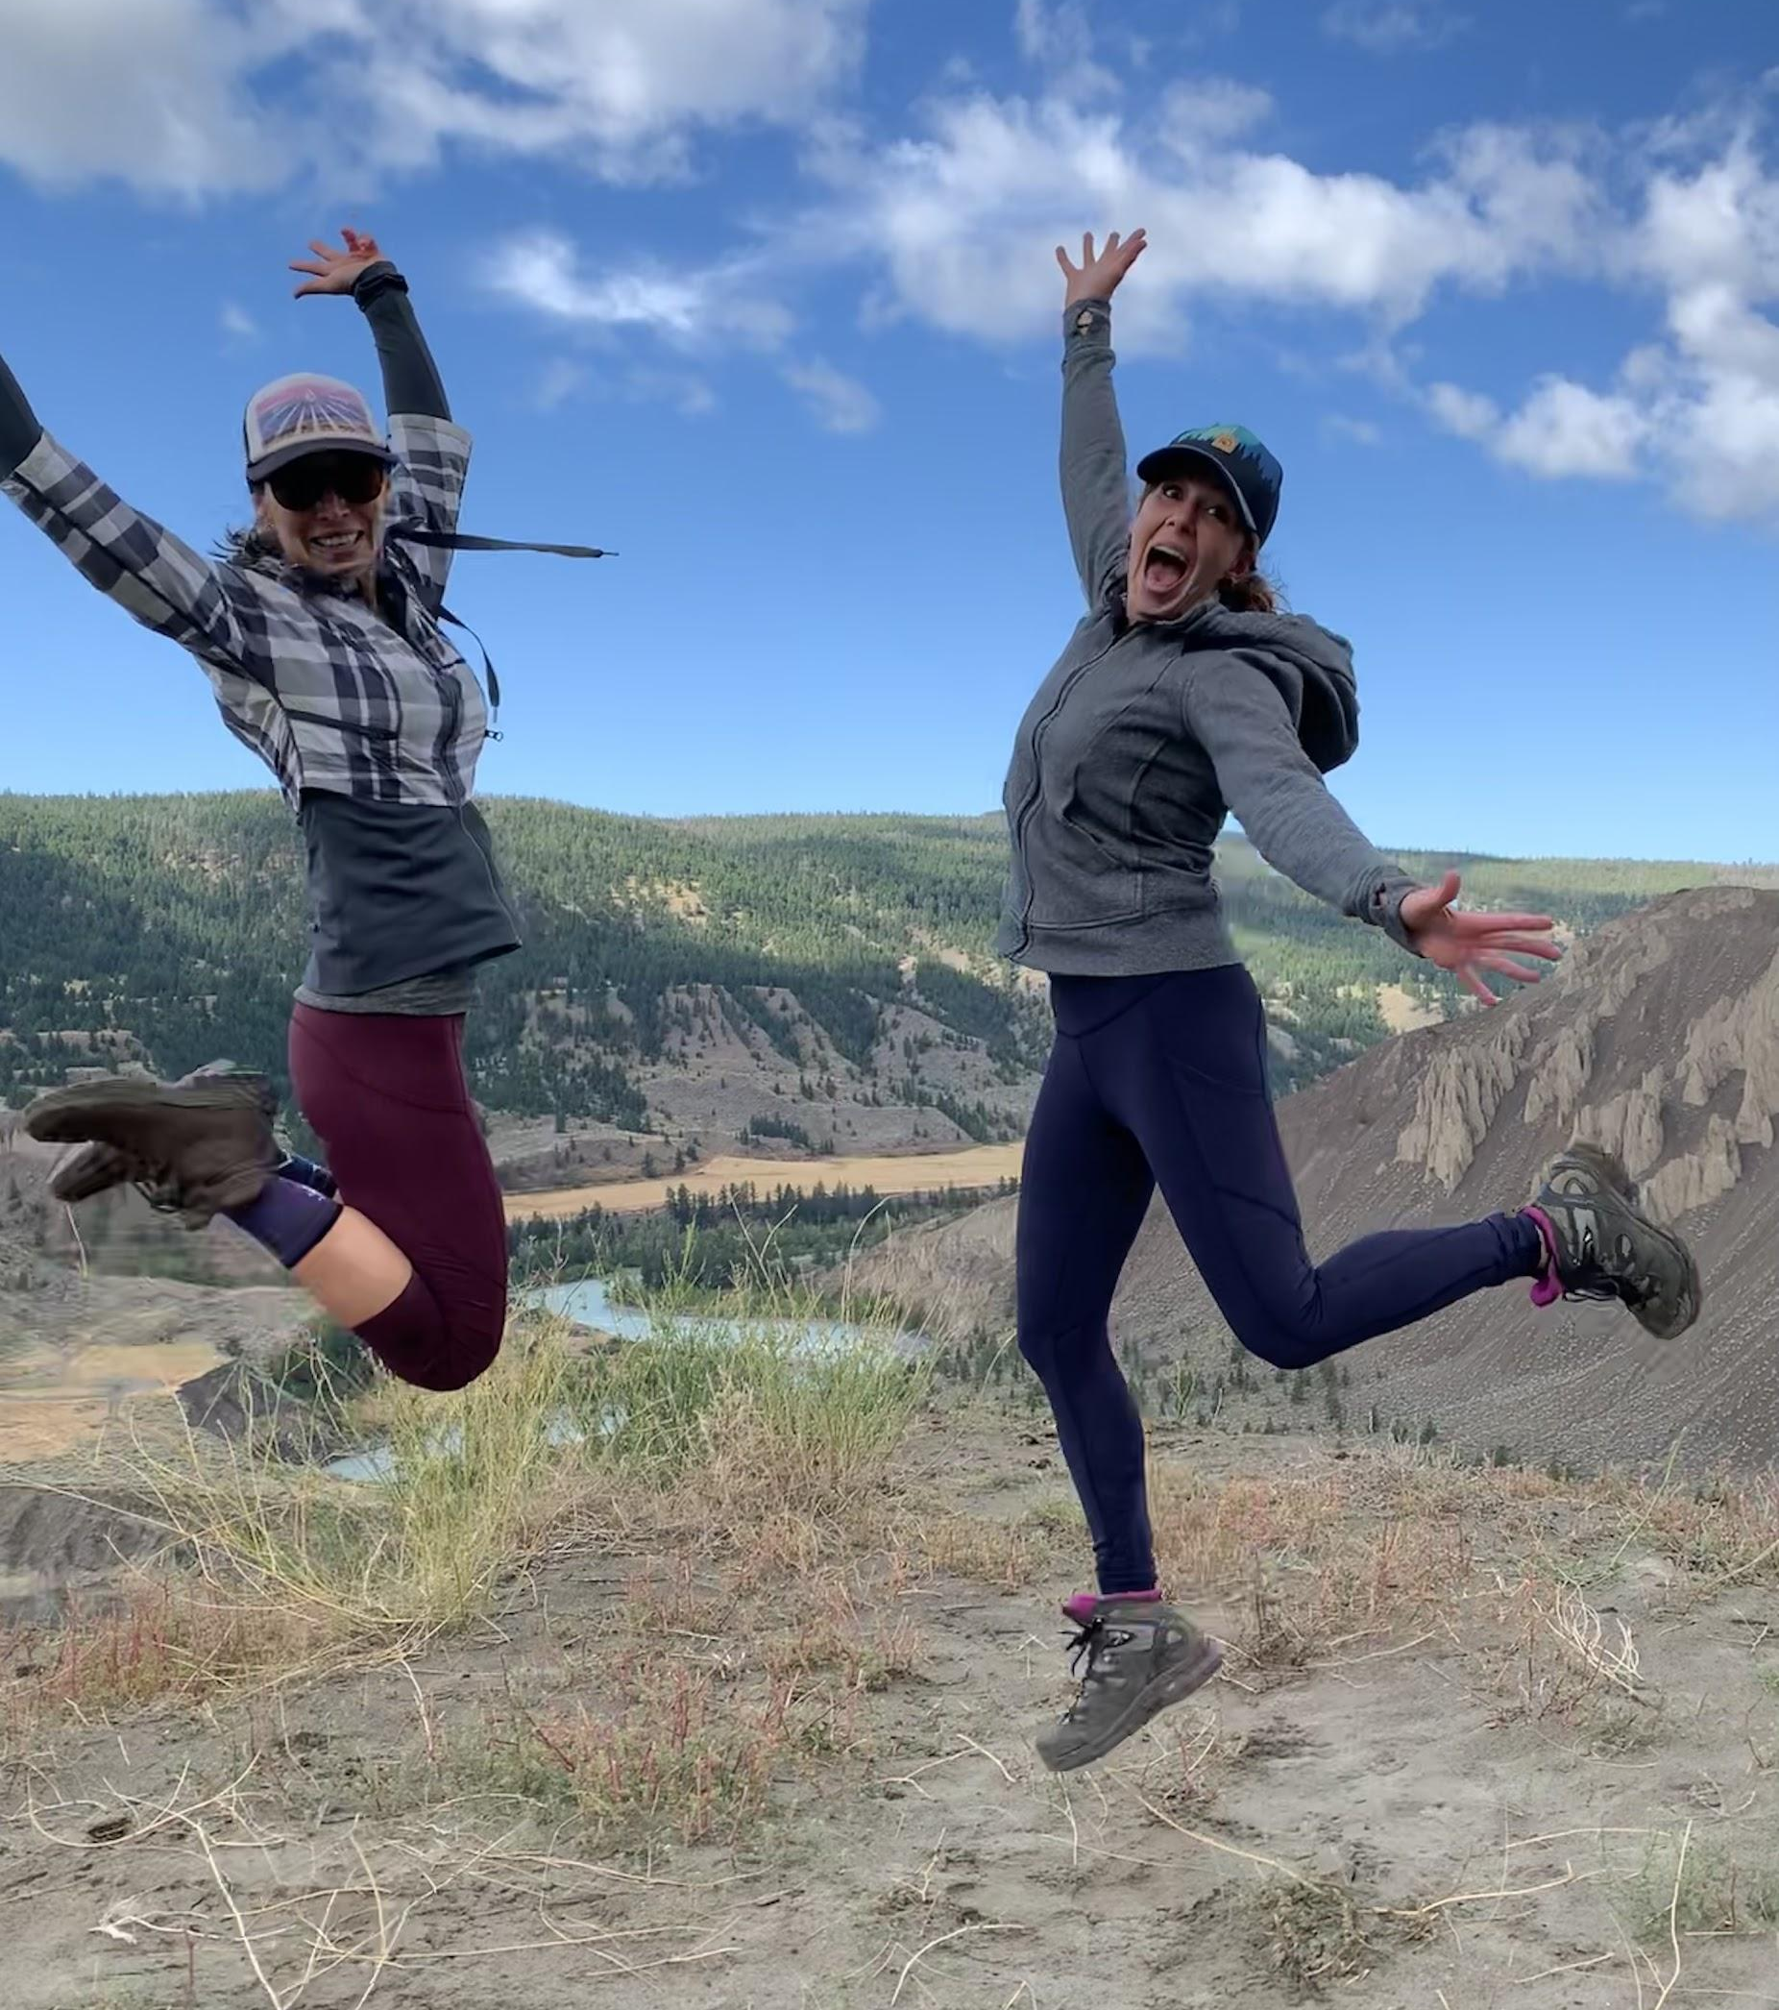
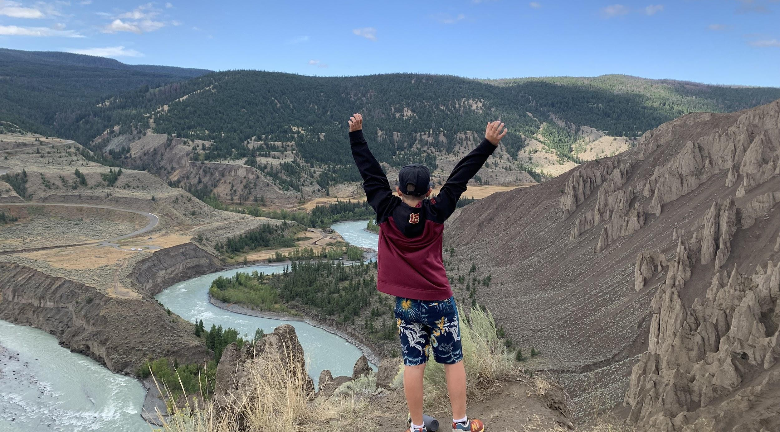
In teaching, we must celebrate every victory!
Notes:
When I think about celebrating educational victories, I think about Hamish Brewer—the “tattooed, skateboarding principal” of Fred Lynn Middle School—and his speech How radical love transformed a school (2019).
Brewer’s concern and passion for education and his students transformed one of the toughest schools in Virginia. Brewer’s message to teachers is that no accomplishment is too small and that we must celebrate every chance we get.

Slide 17
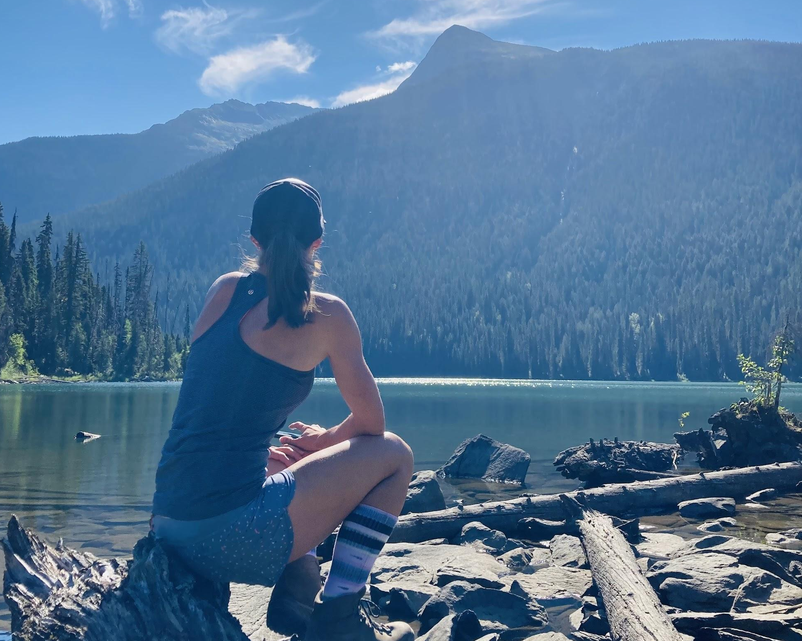
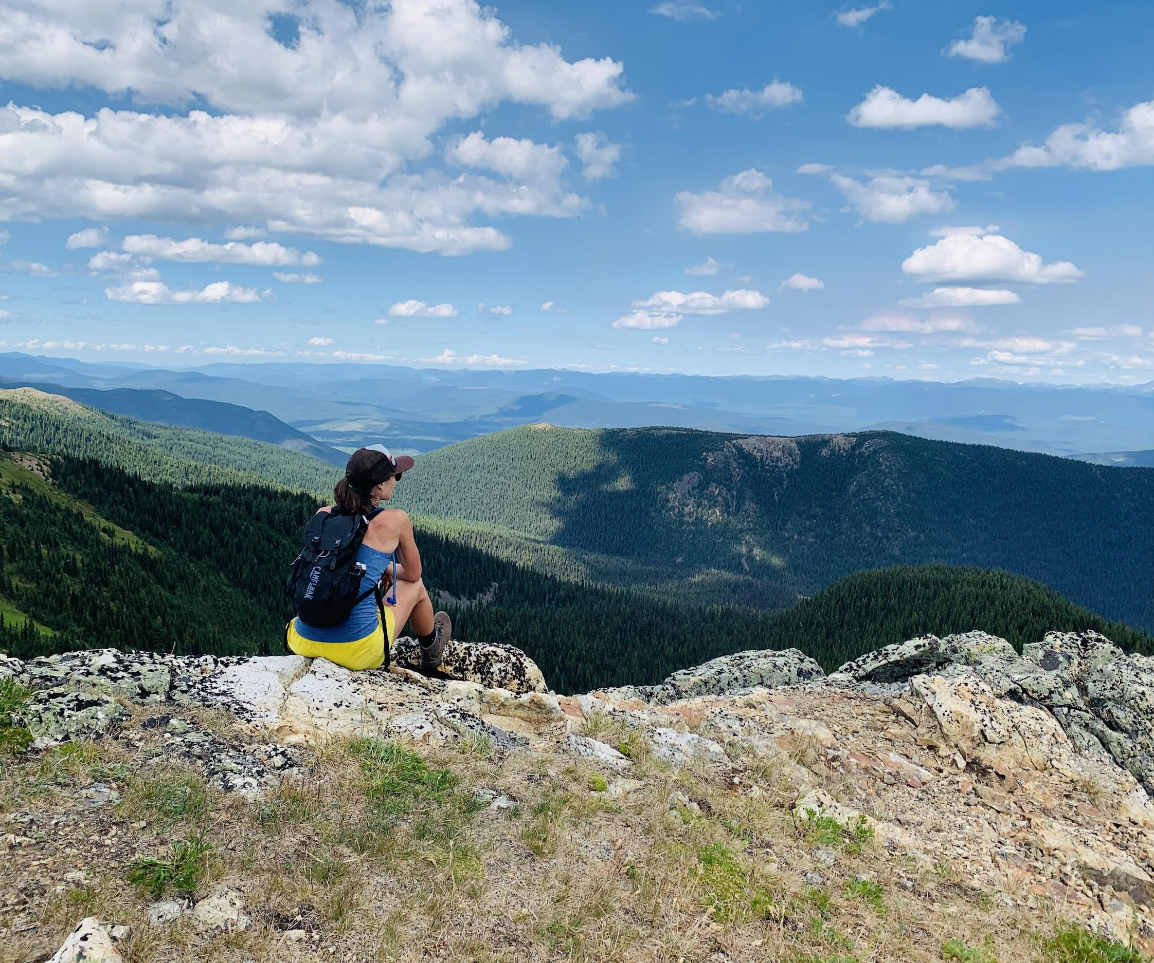
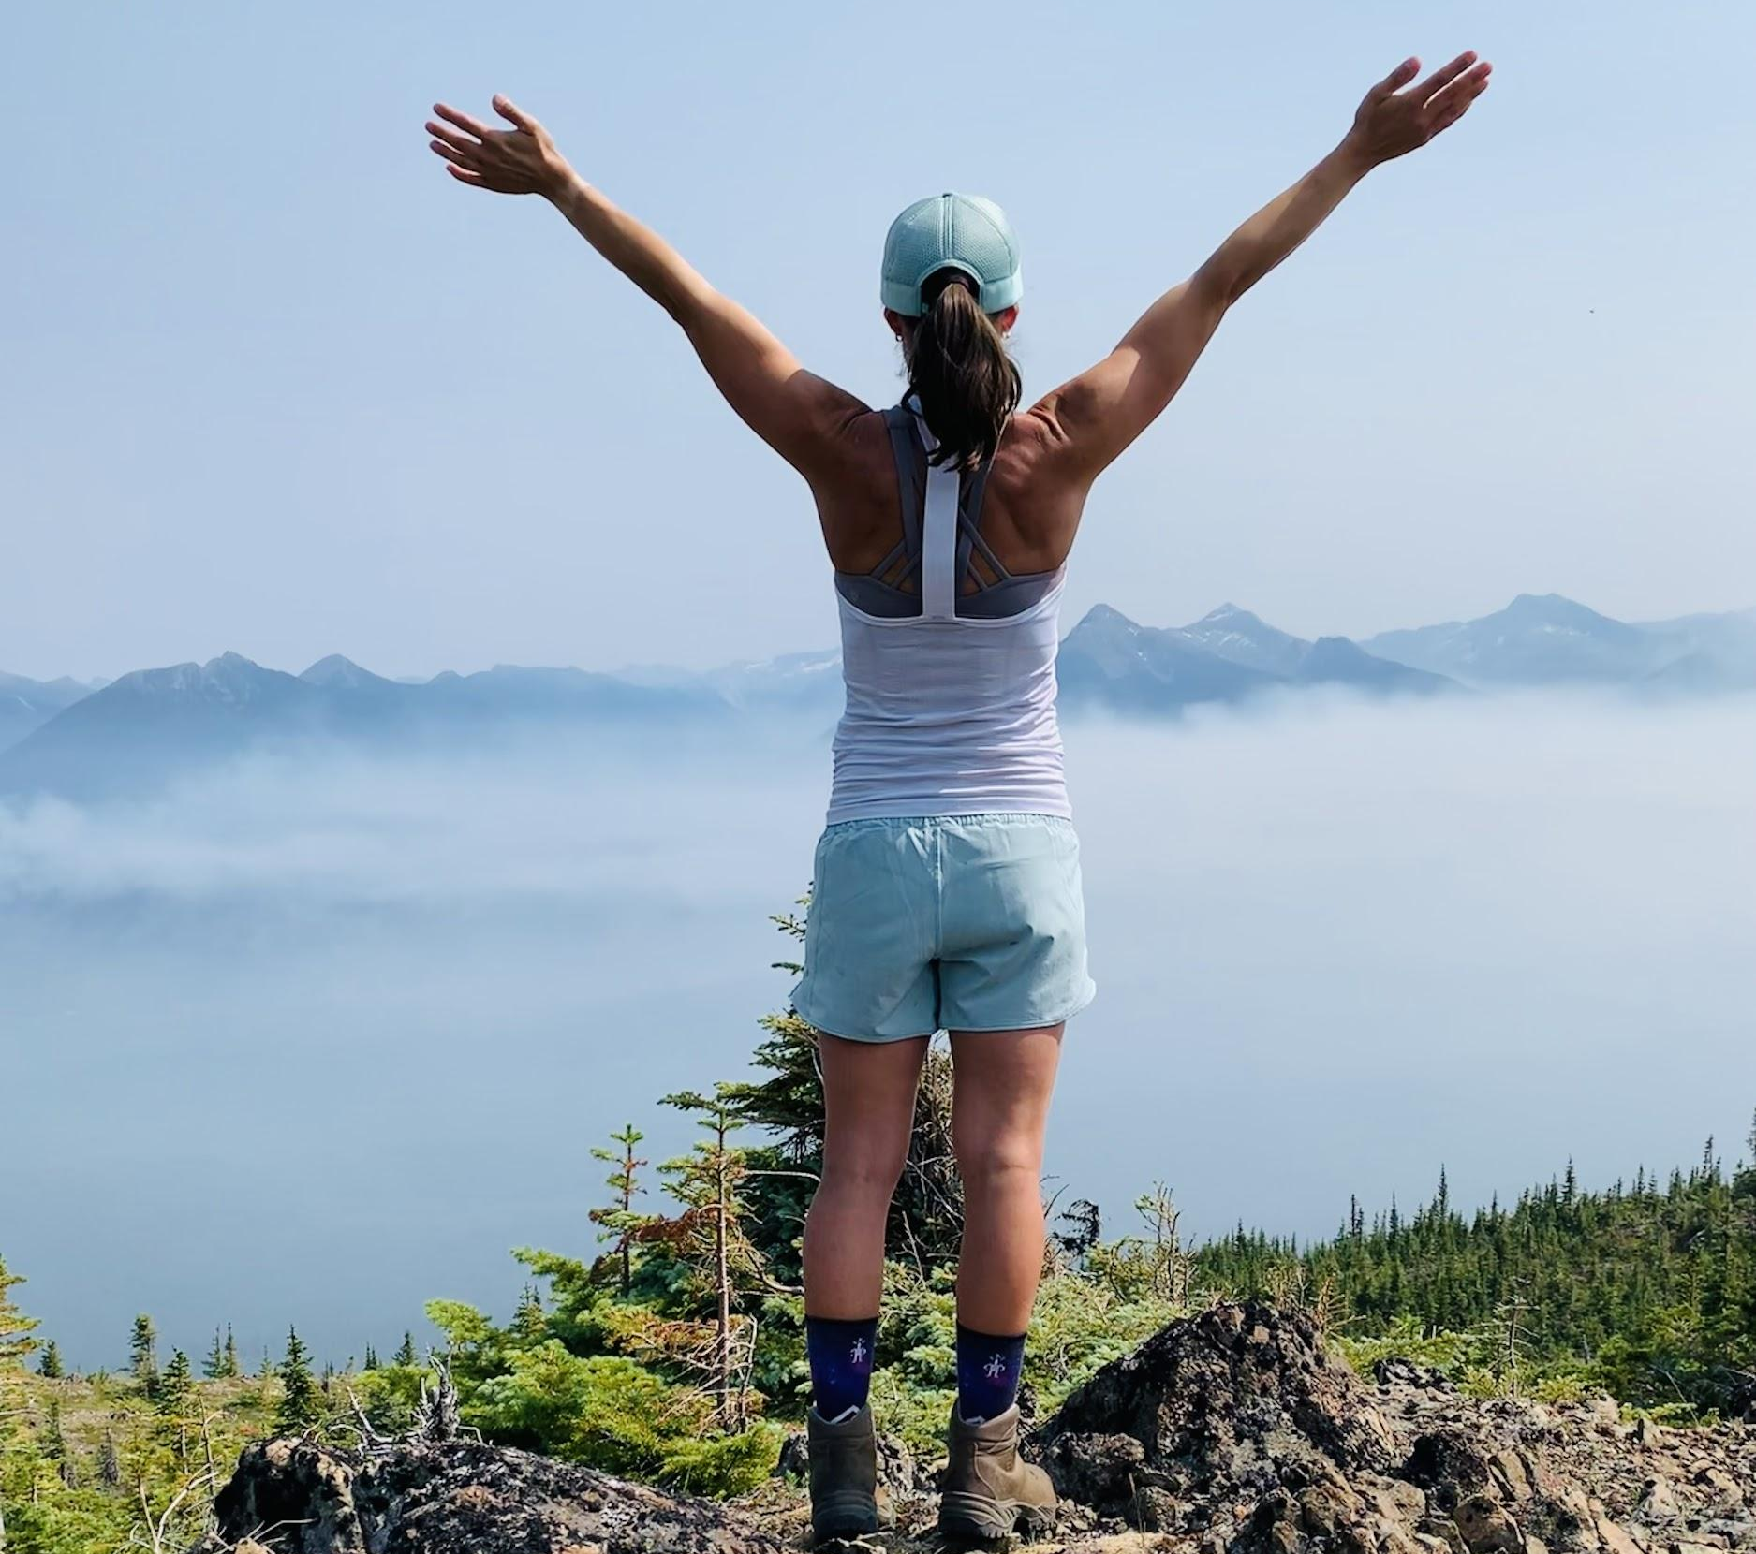
In teaching, we must also take time to reflect!
Notes:
Taking time for self-care and fostering reflective practice will benefit our health and well-being, as well as the health and well-being of our students and our careers.
We cannot pour from an empty cup.
To teach well, me must care for ourselves and reflect on our actions and behaviours in the classroom.
Allowing us to positively impact the lives of many students.

Slide 18
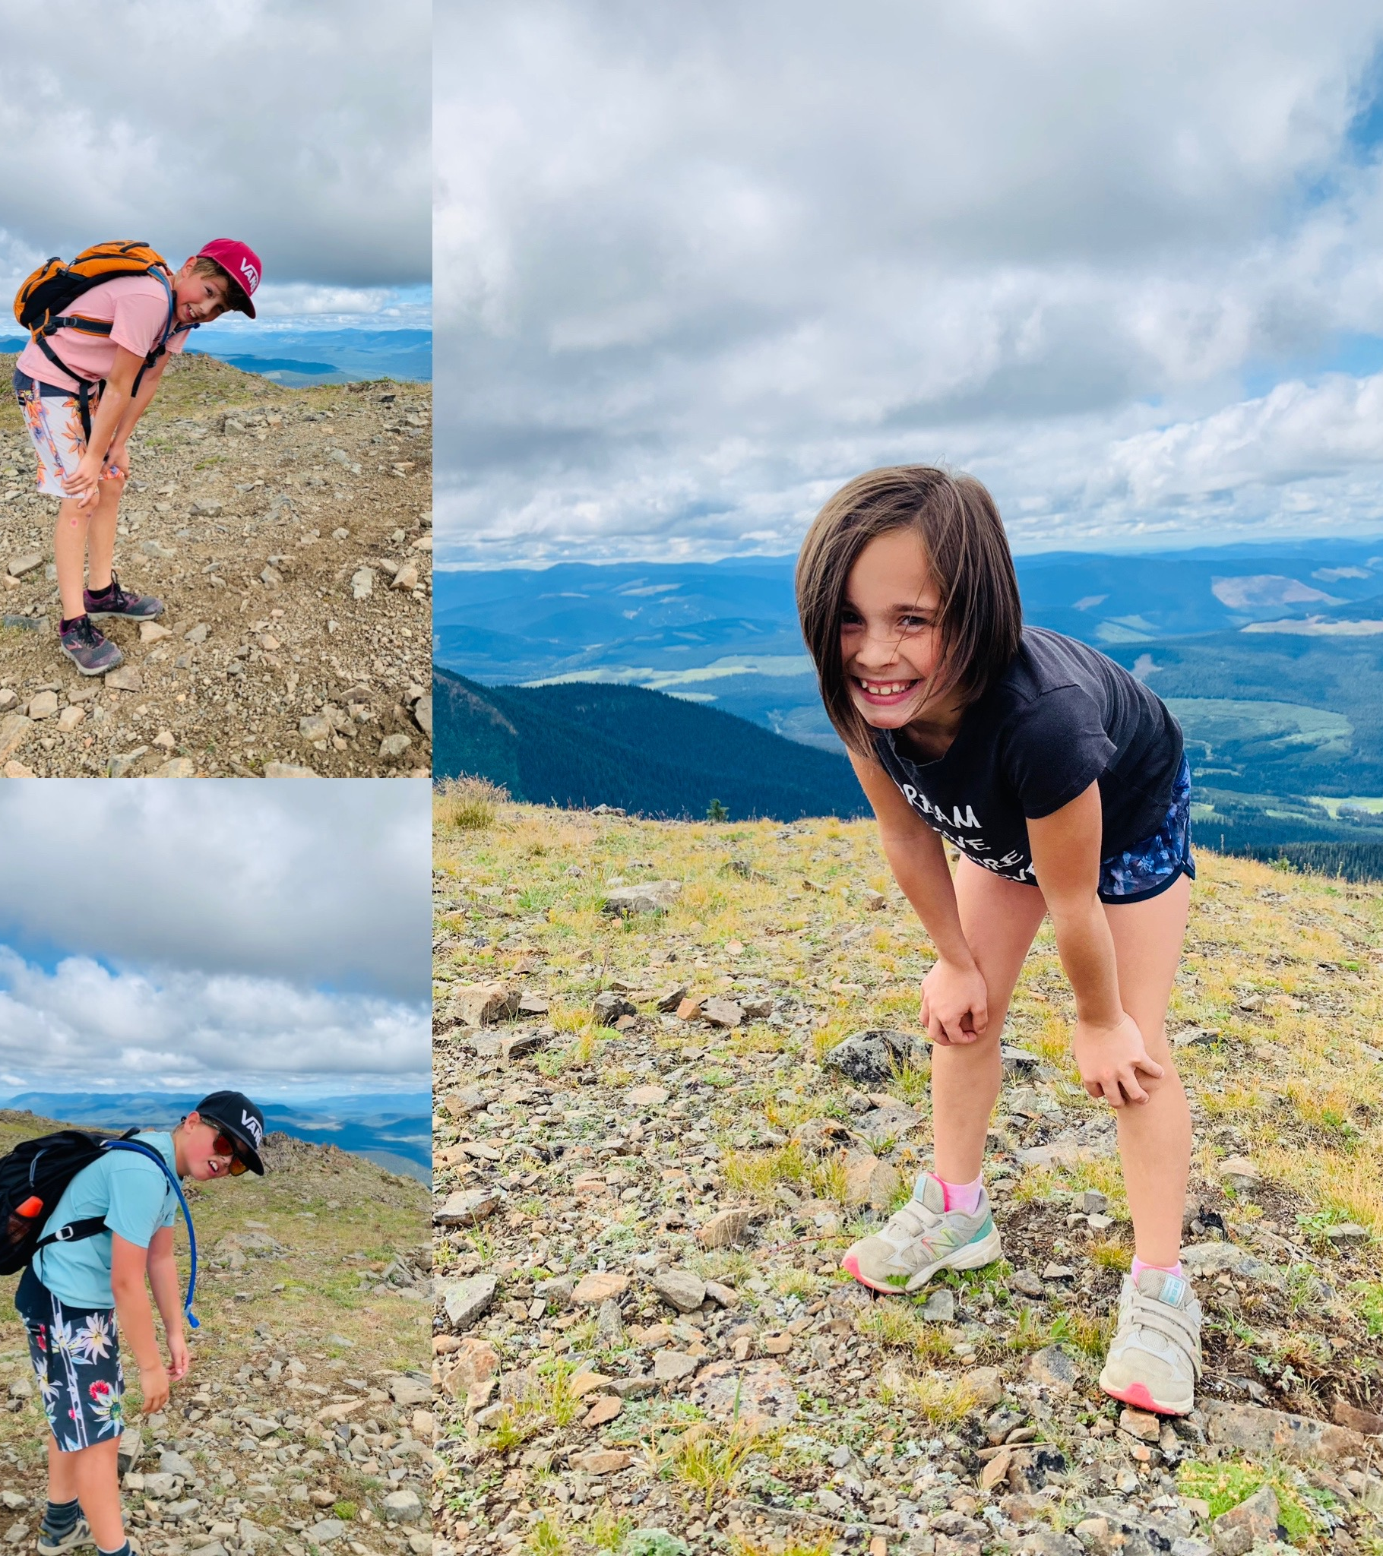
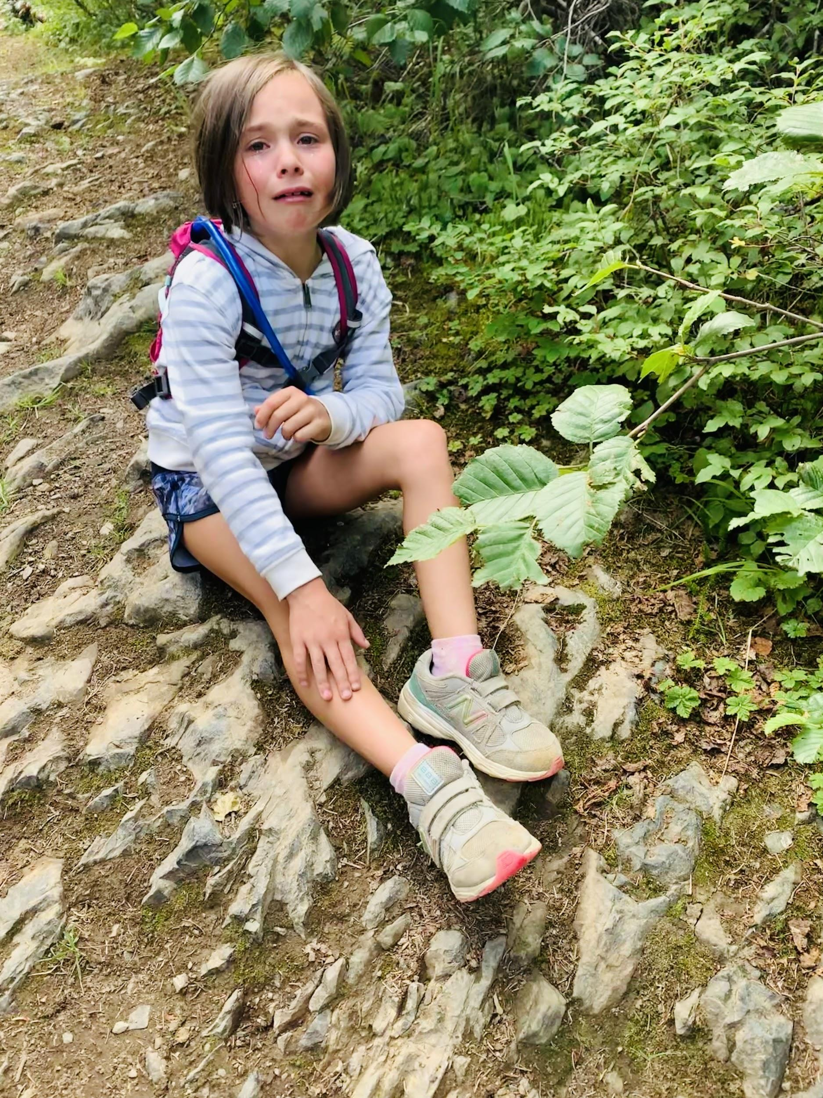
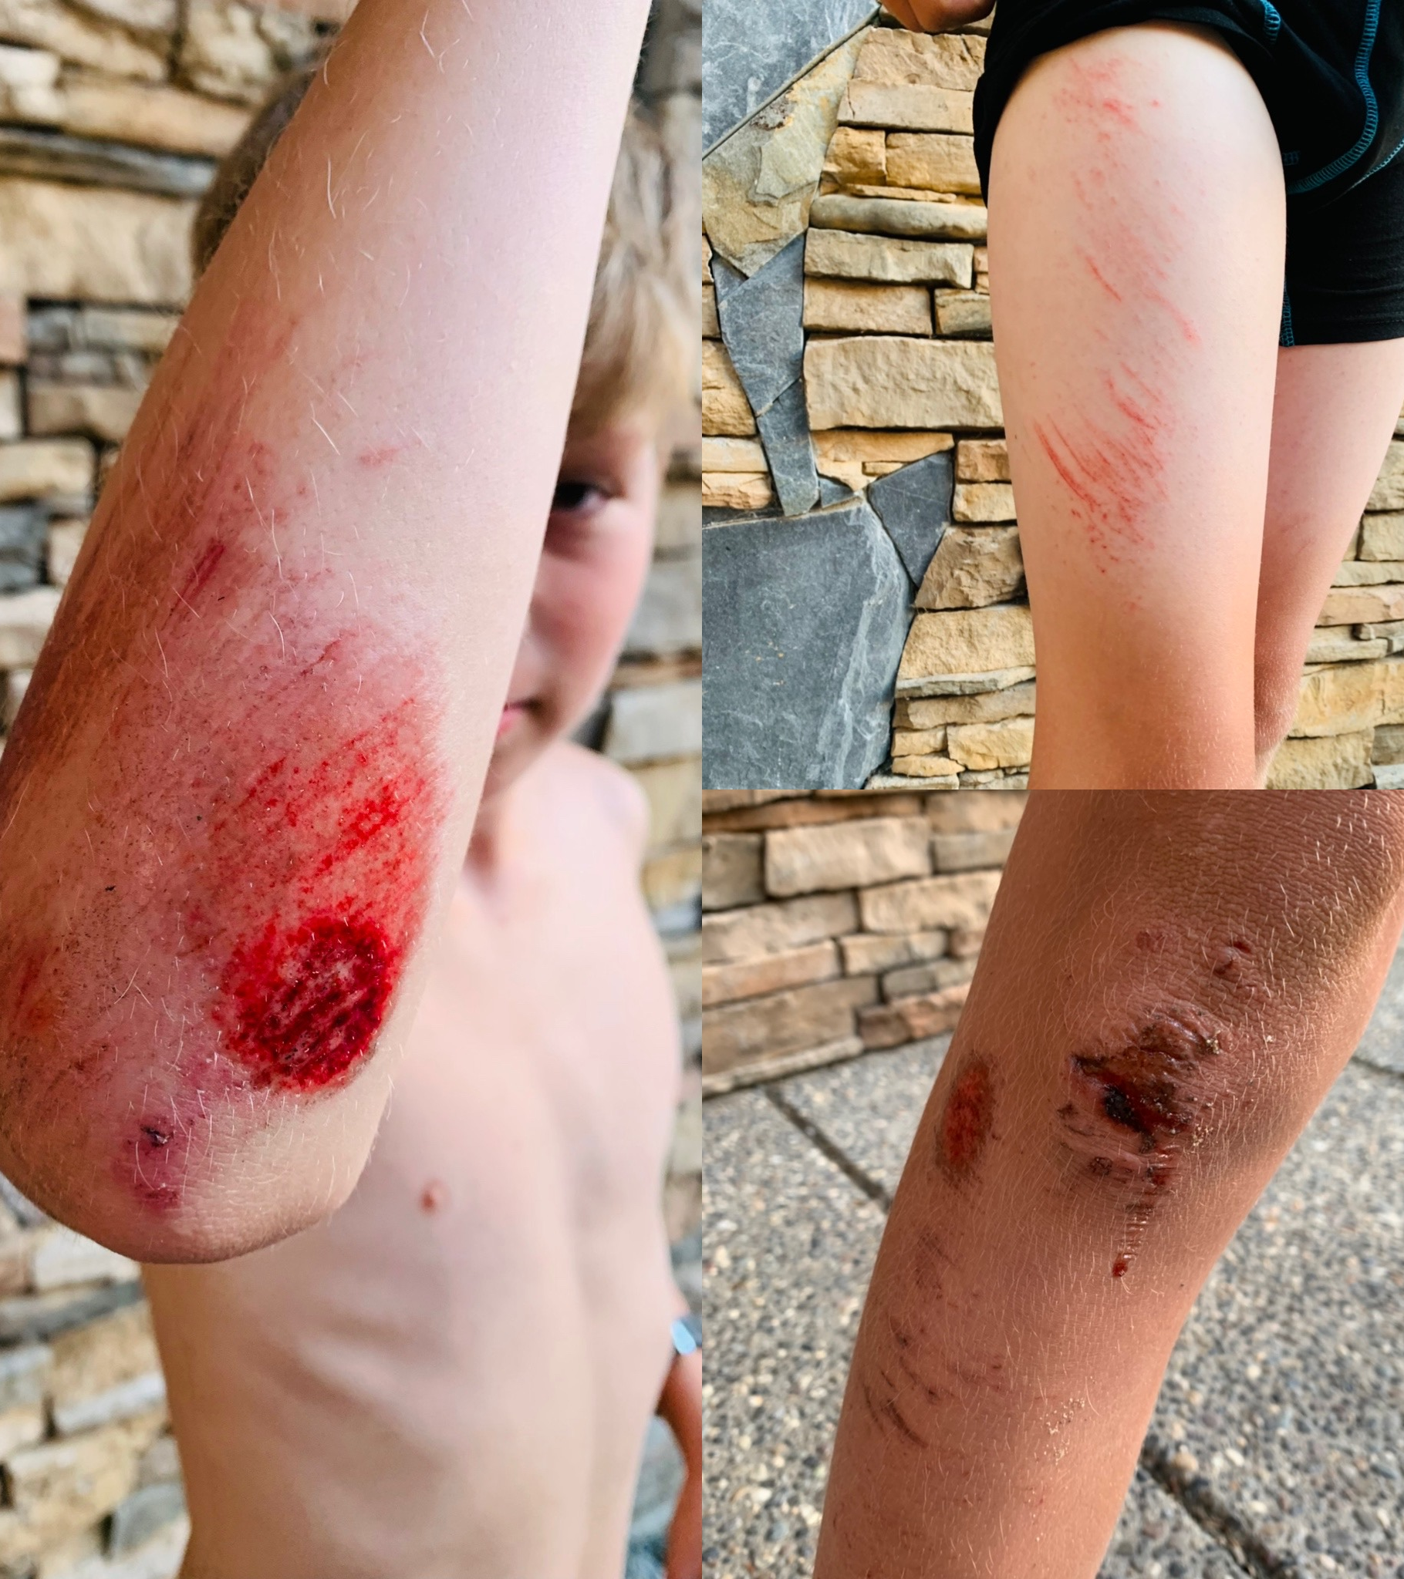
Teaching and reaching summits is hard, for both Teachers and Learners!
No one comes out unscathed!
Notes:
No one comes out unscathed!
I am not implying that teachers, or students, should emerge from the classroom as if they had gone to battle, but I would be lying if I said that teaching was not hard. And most learners would be lying if they said learning was easy.
Many days I come home from teaching feeling like I just climbed the steepest mountain of my life…I imagine I looked just like my kids do in these pictures–winded, legs burning & absolutely exhausted!

Slide 19
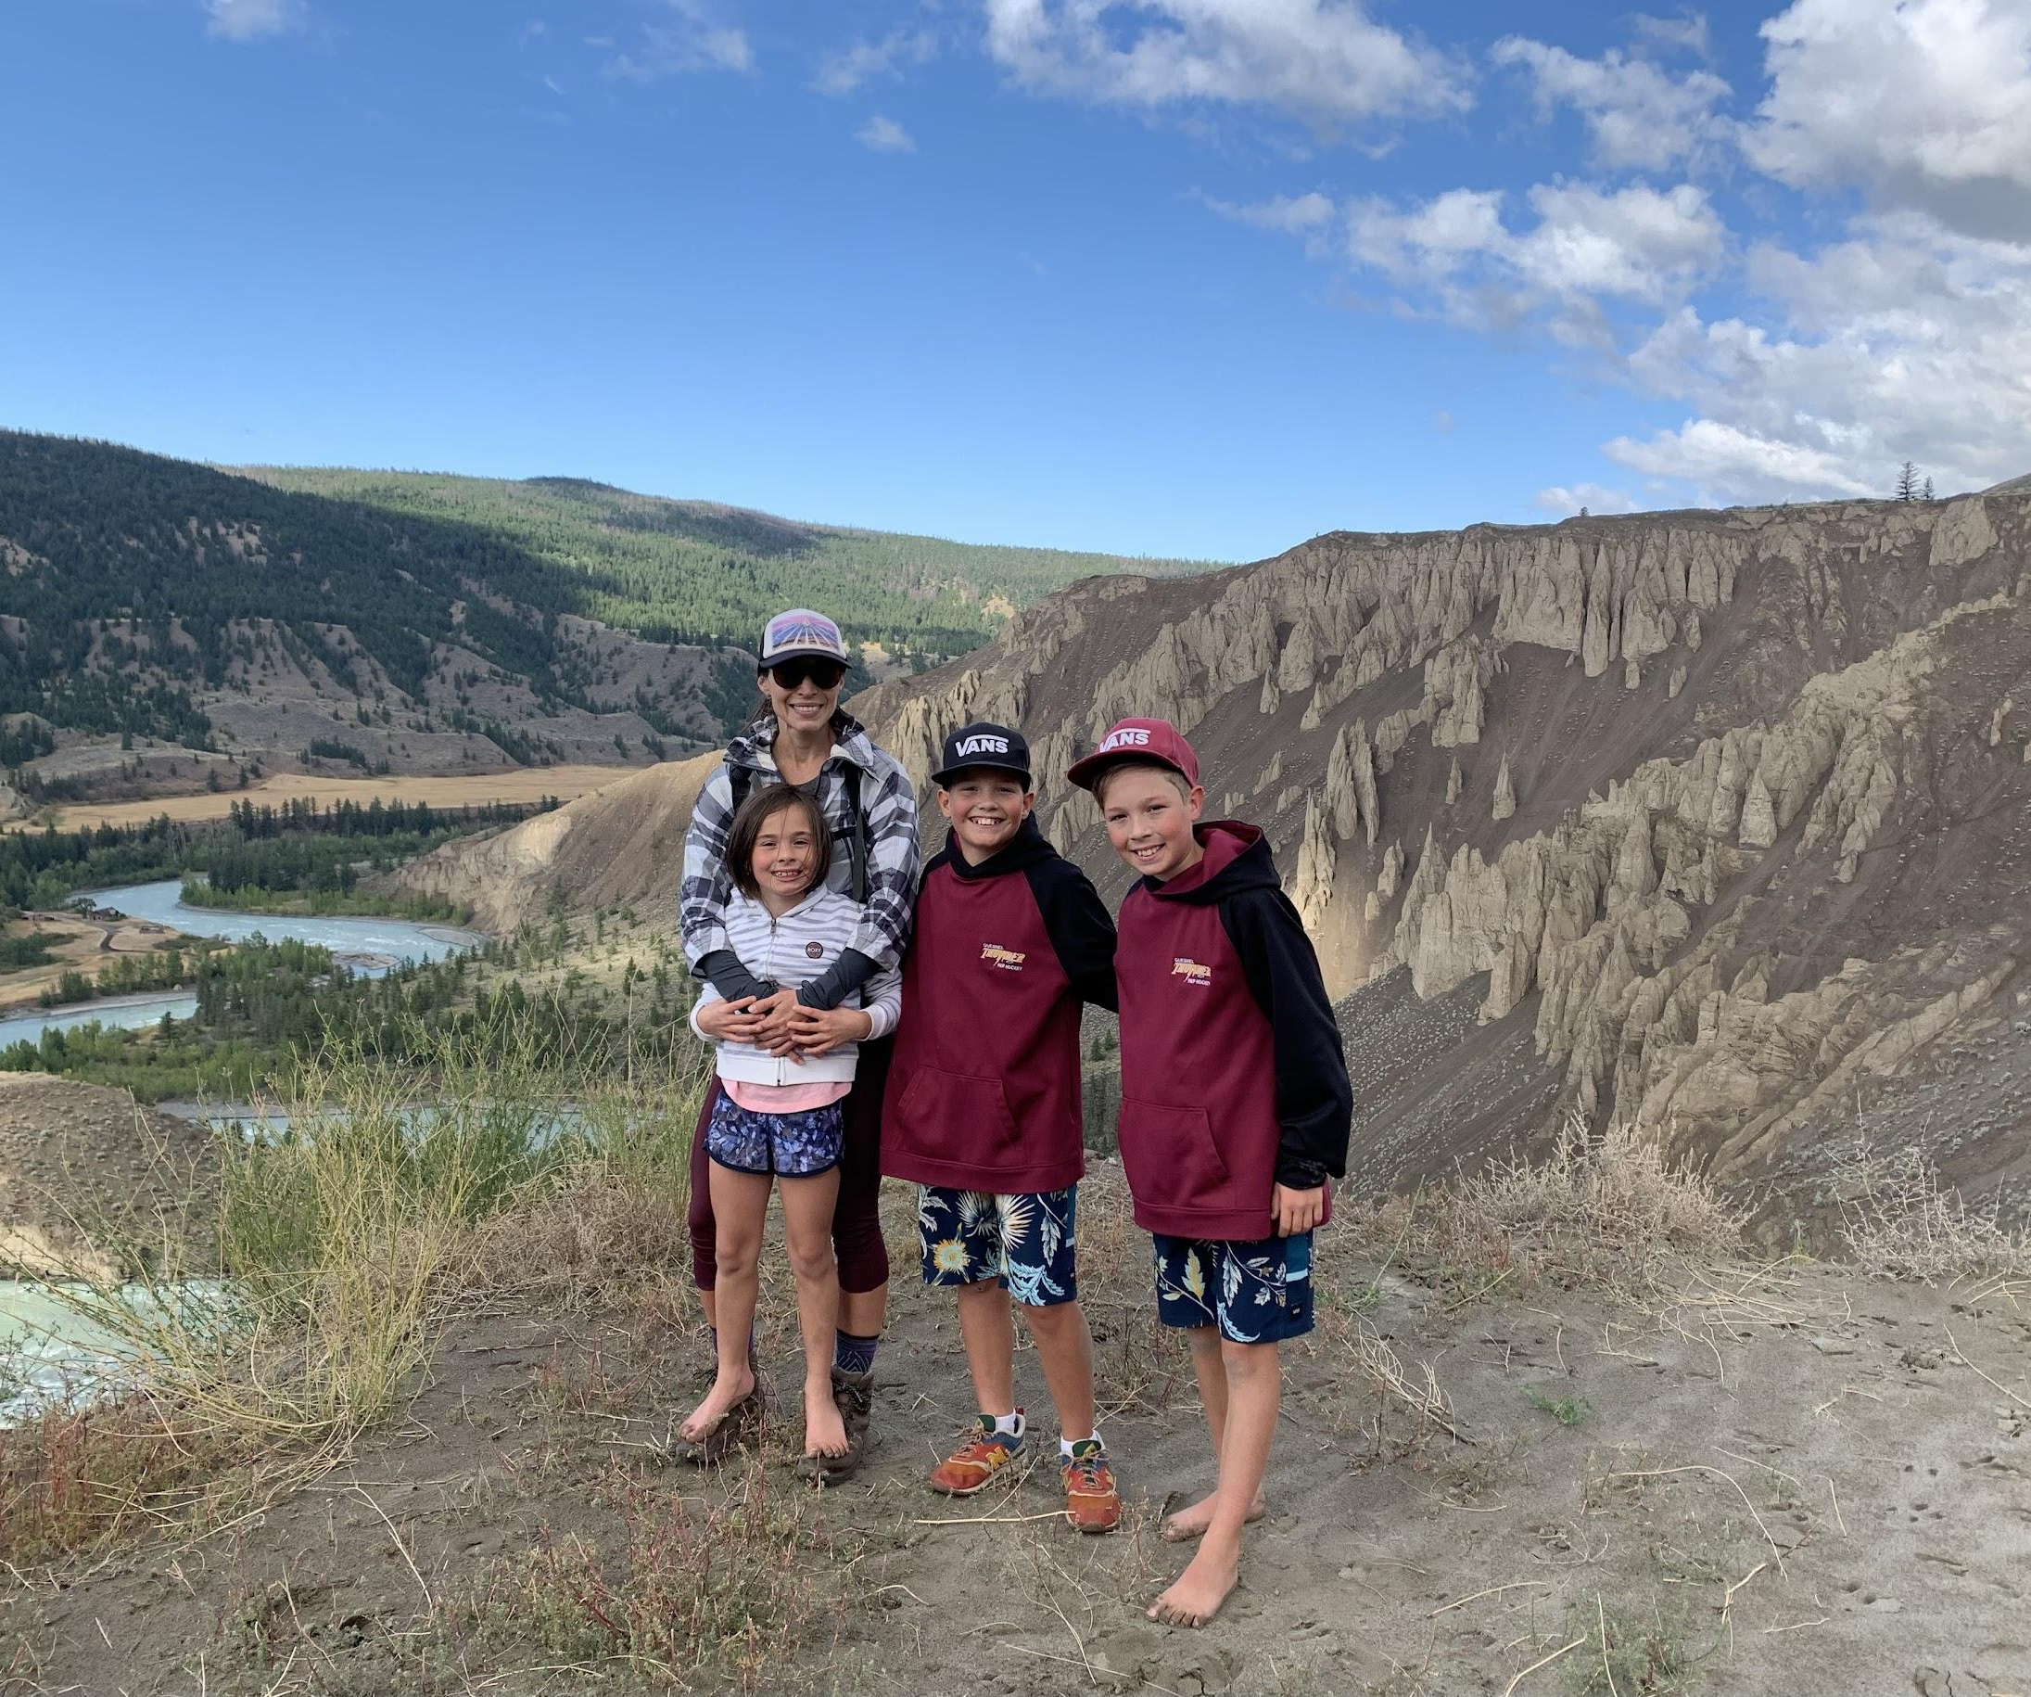
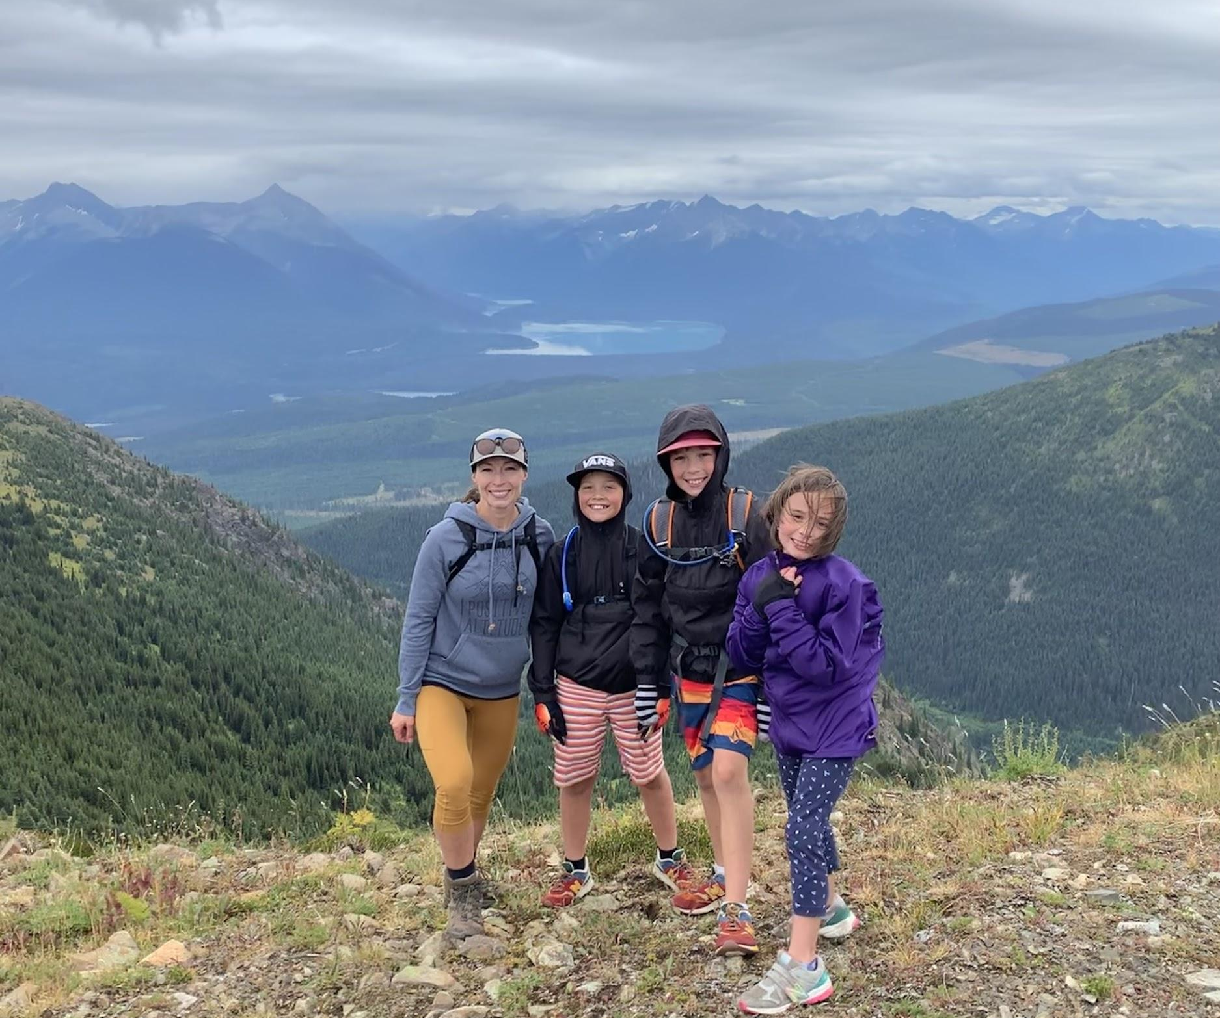
But, reaching “Summits” together is absolutely worth it!
Notes:
Taking students to the summits of their learning is the goal–it is why we are all here!
It is an amazing opportunity but it requires a tremendous amount of patience, empathy, grit and determination.
It is not for the faint of heart, but it will touch our hearts, and the hearts of our students, forever.

Slide 20
In teaching, students will be entrusted to our hands!
We must be cognizant of this, go forth, and become the best teachers we can be!
Future students and future generations rely on us to help them reach their Educational “Summits!”
Notes:
In teaching, students will be entrusted to our hands!
We must be cognizant of this, go forth, and become the best teachers we can be!
Future students and future generations rely on us to help them reach their Educational “Summits!”

