Slide 1
Community-Based Research Partnerships with Indigenous Communities:
What you need to know to create a successful working relationship
Geography 324
Joni hesselgrave, Marina craig, & Holly brown.

Slide 2
OCAP: Guiding Principles of Practice
https://www.youtube.com/watch?v=SNpZw3DI4S4
“Indigenous methodologies seek to ensure that the
research is culturally safe and culturally respectful through recognition of Indigenous worldviews, respect, and accountability. It is no longer research on or about
Indigenous people, rather it is becoming research for and with Indigenous people” (Singh & Major, 2017, 5).

Slide 3
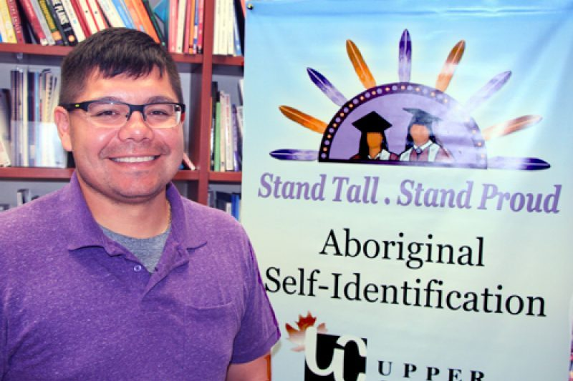
How should the group be identified?
“Self-Identification is a fundamental criterion for defining Indigenous peoples” (TCPS, 2014, 112)
Researcher’s obligation to respect how the group wishes to be represented.
Avoid Pan-Indigenous approaches.
Respect internal differences amongst the community.
Recognize the group’s traditions and customs when in their territory.
Image: https://thefirstnationscanada.com/2017/09/ryan-jacobs-to-serve-as-indigenous-trustee-for-ucdsb/

Slide 4
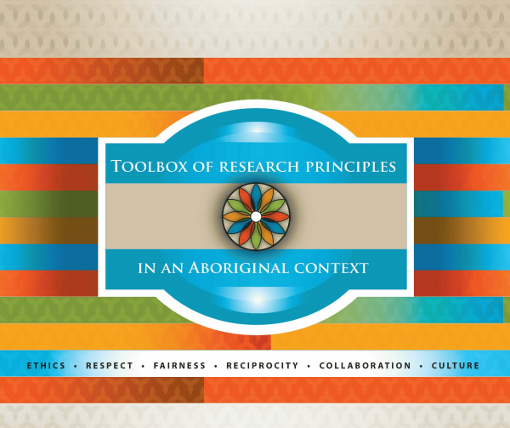
Consult Proper Resources & Guidelines
When seeking to enter into a research partnership with an Indigenous community it is important to consult Indigenous-specific research guidelines that also relate to the field of study in advance.
Example Resource:
(Basile, Gentelet, & Gros-Louis Mchugh, 2015)

Slide 5
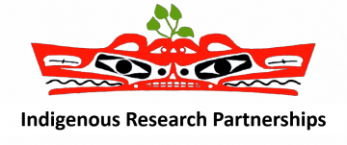
Considerations for Recruiting Participants & Negotiating Roles
Some may be untrusting or uncomfortable participating in research for colonial institutions
Participants deserve proper compensation for their time and energy. (Ex. Special training or certification, honorariums, etc.)
Transparent and informed communication of the risk and benefits of participating in the research relationship.
Equitable balances of power in the partnership.
Research questions, objectives & methodology should be defined by the community (Hodge & Lester, 2006).
A Memorandum of Understanding (Ball, 2014).
(TCPS, 2014)
Benefits of enlisting the help and guidance of an Indigenous "advisor" or intermediary (Hodge & Lester, 2006).

Slide 6
Engaging Members of the Community
Indigenous communities are more likely to actively participate in research if they feel it represents their self-defined interests…
Communities should be consulted on research design to determine which type of research they feel would be most valuable to their community.
Researchers must be flexible with their research expectations.
This Includes:
Deciding research questions and objectives
Sharing world-views & ways of knowing
Practicing empathy, respect for differences and circumstance, honesty, and thoughtfulness.
Spending actual time in communities, speaking and listening to others.
(Ball, 2014; TCPS, 2014; Hodge & Lester, 2006; Singh & Major, 2017)

Slide 7
Considerations for Proper Research Conduct in the Canadian Context
“Must recognize existing Aboriginal and treaty rights of the Aboriginal peoples of Canada, that is, the Indian, Inuit and Metis peoples of Canada, were recognized and affirmed in the Constitution Act, 1982.2” (TCPS, 2014, 112).
“In 2015, the Truth and Reconciliation Commission of Canada released its final report and a list of… 94 recommendations” (Morton Ninomiya & Pollock, 2016)

Slide 8
Two-Eyed Seeing (Peltier, 2018)

Slide 9
References
Ball, J. (2014). “On Thin Ice: Managing Risk in Community-University Research Partnerships”. Learning and Teaching Community-Based Research: Linking Pedagogy to Practice. Toronto, Buffalo and London: U of T Press. 25-44.
Basile, Suzy, Karine Gentelet, and Nancy Gros-Louis Mchugh. (2015). Toolbox on the Research Principles in an Aboriginal Context: Ethics, Respect, Equity, Reciprocity, Collaboration and Culture. Accessed on January 21st, 2019 from http://www.cssspnql.com/docs/default-source/centre-de-documentation/toolbox_research_principles_aboriginal_context_eng16C3D3AF4B658E221564CE39.pdf.
Canadian Institutes of Health Research, Natural Sciences and Engineering Research Council of Canada, and Social Sciences and Humanities Research Council of Canada (2014). TriCouncil Policy Statement: Ethical Conduct for Research Involving Humans. Available from the Government of Canada’s Panel on Research Ethics (www.pre.ethics.gc.ca).
Hodge, Paul and John Lester. (2006). Indigenous Research: Whose Priority? Journeys and Possibilities of Cross-Cultural Research in Geography. Geographical Research. 44(1), 41-51.
Morton Ninomiya, M. E., & Pollock, N. J. (2017). Reconciling community-based indigenous research and academic practices: Knowing principles is not always enough. Social Science & Medicine, 172, 28-36.
Peltier, Cindy. (2018). An Application of Two-Eyed Seeing: Indigenous Research Methods with Participatory Action Research. The International Journal of Qualitative Research Methods. 17,1-12.
Singh, M., & Major, J. (2017). Conducting indigenous research in western knowledge spaces: Aligning theory and methodology. The Australian Educational Researcher, 44(1), 5-19.

