Slide 1
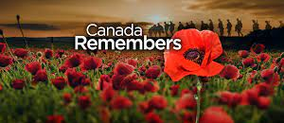
Le Jour du Souvenir
Vocabulaire

Slide 2
the veterans

Slide 3
the sacrifices

Slide 4
a ceremony

Slide 5
a flag

Slide 6
a poppy

Slide 7
a soldier

Slide 8
the war

Slide 9
the peace

Slide 10
freedom

Slide 11
Canada

Slide 12
a country

Slide 13
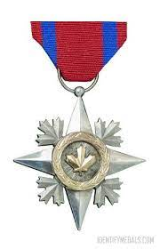
courage

Slide 14
remember

Slide 15
A veteran

Slide 16
November

Slide 17
to honour

Slide 18
a hero

Slide 19
quiet

Slide 20
beaten down

Slide 21
military

Slide 22
a crown

Slide 23
a cenotaph

Slide 24
the fights

Slide 25
commemorate

Slide 26
Remembrance day

Slide 27
The First World War (1914-1918)

Slide 28
The Second World War (1939-1945)

Slide 29
honourable

Slide 30
a citizen

Slide 31
pride

Slide 32
a memorial monument

Slide 33
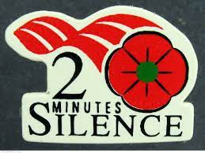
two minutes of silence

