Slide 1
Indigenous Education
Grade 4: English Language Arts Unit
By: Amanda Sumption, Carly Lorntsen, and Joni Hesselgrave
UNBC School of Education, EDUC 346, Winter 2022

Slide 2
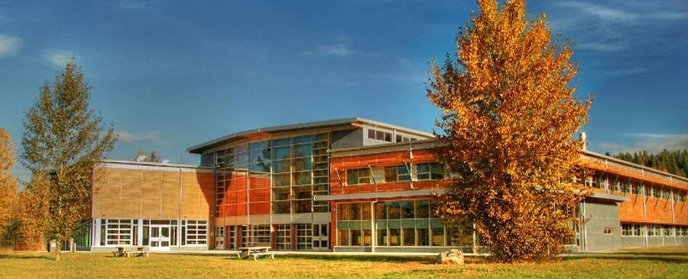
Land Acknowledgement
We would like to acknowledge that we are presenting on the traditional, unceded, ancestral territory of the Lhtako Dene. Each day, we are grateful and humbled to be living, learning, and loving on this magnificent land.

Slide 3
Outline
Unit and British Columbia’s English Language Arts Curriculum
  Big Ideas
  Core Competencies, Curricular Competencies & Content Learning Standards
  First People’s Principles of Learning (FPPL)
Unit Plan Overview
  Part 1: Stories & Storytelling
  Part 2: Poetry
  Part 3: Legends & Myths
Individual Lessons
  “Creating Stories & Storytelling: Connecting Us to People, Place & Land” (Joni)
  “Introduction to Haiku: Who Am I & What Would I Like to Share…” (Carly)
  “Legends & Myths” (Amanda)

Slide 4
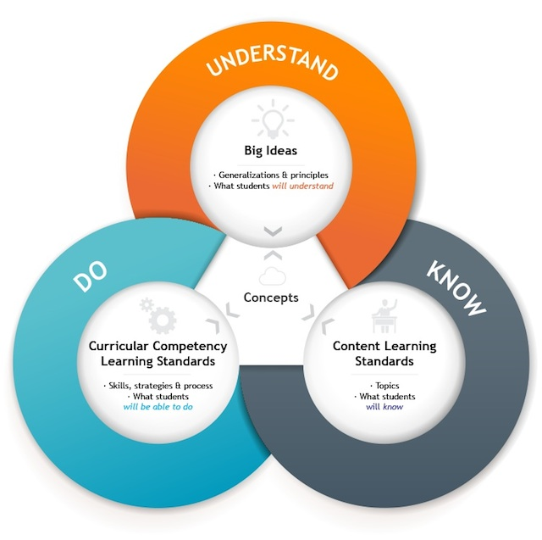
Big Ideas
Language and text can be a source of creativity and joy.
Exploring stories and other texts helps us understand ourselves and make connections to others and the world.
Texts can be understood from different perspectives.

Slide 5
Unit Understandings
Upon completing this unit, students will understand that:
  Stories can be represented in different ways (oral, written, visual, and digital).
  Stories have a beginning, a middle, and an end.
  Stories have various literary elements (theme, character, setting, plot, conflict, and purpose).
  Stories have various meanings and connect us to people, place, and land.
  Personal experience and reflection can help us create several types of text (i.e., stories, poems, legends, and myths).
  Text is an important form of expression and communication.
  Text can be written and understood from different perspectives, and every perspective is valuable and deserving of respect.
  Oral stories are essential to indigenous cultures and their ways of knowing and being.

Slide 6



Core Competencies
Communication
  Communicating: I can communicate purposefully, using forms & strategies I have practiced.
  Collaborating: I can contribute during group activities with peers and share roles and responsibilities to achieve goals.
Thinking
  Creative Thinking: I can get new ideas in areas in which I have an interest and build my skills to make them work.
  Critical & Reflective Thinking: I can gather and combine new evidence with what I already know to develop reasoned conclusions, judgments, or plans.
Personal & Social
  Personal Awareness and Responsibility: I can recognize my strengths and take responsibility for using strategies to focus, manage stress, and accomplish my goals.
  Positive Personal and Cultural Identity: I am aware of different aspects of myself. I can identity people, places, and things that are important to me. I can identify how my life experiences have contributed to who I am; I recognize the continuous and evolving nature of my identity.
  Social Awareness and Responsibility: I can interact with others and the environment respectfully and thoughtfully.

Slide 7
Curricular Competencies
Students will do the following:
  Consider different purposes, audiences, and perspectives in exploring texts.
  Apply a variety of thinking skills to gain meaning from texts.
  Identify how differences in context, perspectives, and voice influence meaning in texts.
  Recognize the role of language in personal, social, and cultural identity.
  Use personal experience and knowledge to connect to text and deepen understanding of self, community, and world.
  Respond to text in personal and creative ways.
  Recognize how literary elements, techniques, and devices enhance meaning in texts.
  Demonstrate awareness of the oral traditions in First Peoples cultures and the purposes of First Peoples texts.
  Identify how story in First Peoples cultures connects people to land.
  Exchange ideas and perspectives to build shared understanding.
  Use writing and design processes to plan, develop, and create texts for a variety of purposes and audiences.
  Use language in creative and playful ways to develop style.
  Use oral storytelling processes.

Slide 8
Content Learning Standards
Upon completing this unit, students will know:
  Text Features – students will work on various tasks that will help them work toward understanding, communicating, and displaying texts in a variety of ways.
  Literary Elements – students will work through stories, identifying the essential elements of story: theme, character, setting, plot, conflict, and purpose.
  Oral language strategies & features of oral language – students will be introduced to oral storytelling; students will listen to and study speaker communication skills, voice, tone, inflection, etc.
  Functions and genres of stories and other texts – students will discuss the functions and genres of stories and other texts, paying particular attention to purpose and perspective.
  Writing processes – students will take what they have learned from reading stories and other texts and transfer it to their own writing.

Slide 9
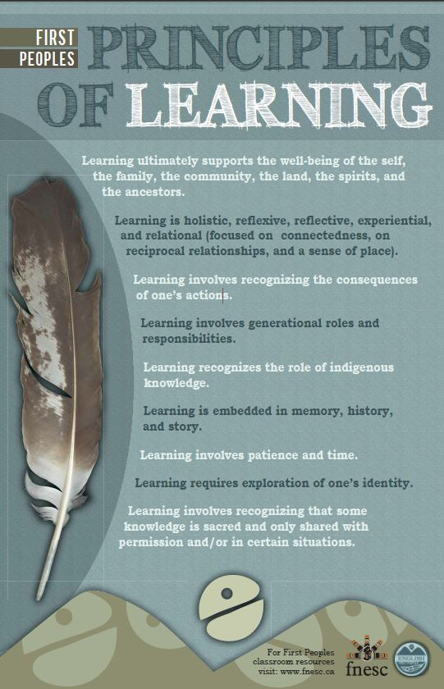
First People’s Principles of Learning
Learning ultimately supports the well-being of the self, the family, the community, the land, the spirits, and the ancestors.
Learning is holistic, reflexive, reflective, experiential, and relational (focused on connectedness, on reciprocal relationships, and on a sense of place).
Learning involves generational roles and responsibilities.
Learning recognizes the role of Indigenous knowledge.
Learning is embedded in memory, history, and story.
Learning involves patience and time.
Learning requires exploration of one’s identity.
Learning involves recognizing that some knowledge is sacred and only shared with permission and/or in certain situations.

Slide 10
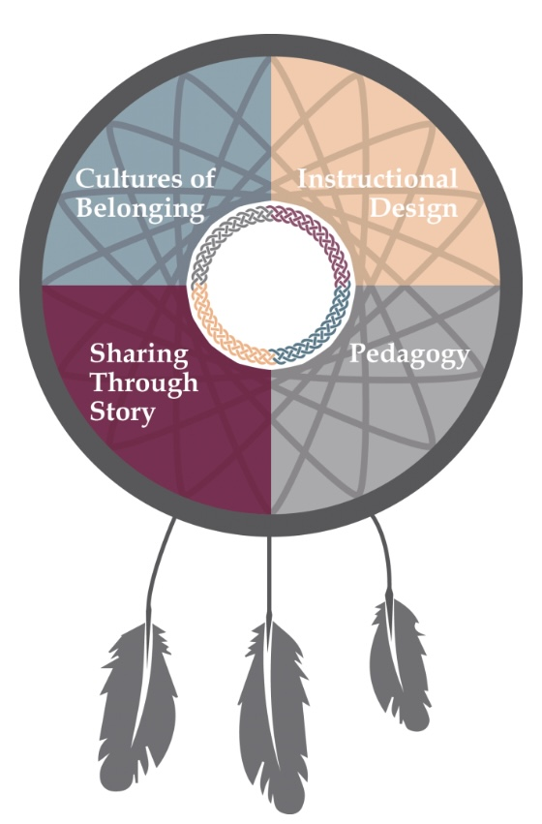
Unit Overview – Part 1: Stories & Storytelling
Duration: 2 weeks
Suggested Lessons:
  “Stories Can Be Represented in Different Ways”
  “Essential Elements of Story”
  “Stories Connect us to the World”
  “Stories Are All Around Us”
  “Creating Visual Stories”
  “Story Writing”
  “Stories & Storytelling”
https://empoweringthespirits.ca
Notes:
Suggested Lessons:
“Stories Can Be Represented in Different Ways”
Introduce different types of stories (oral, written, visual, digital).
Discuss different ways of telling stories
“Essential Elements of Story”
Read 3 Haida stories including Taan’s Moons.
Identify theme, character, setting, plot, conflict, and purpose in each of story.
Pair & share.
“Stories Connect us to the World”
Students encouraged to find connection to a variety of stories.
Focus on People, Place and Land.
Brainstorm, bring in books to share, and show-and-tell favourite books.
“Stories Are All Around Us”
Talk about how stories are all around us and how we can write about our own experiences in the world.
Front-load students with ideas and let students know that they will be exploring their local environment for ideas that will be used write their own personal story.
Forage in area surrounding the school.
Encourage students to find items in their foraging that could help guide their story.
“Creating Visual Stories”
Collaborate with a friend, ask questions, share stories, and play with items to get ideas for story.
“Story Writing”
Write, in words, a story from story map and drawing (i.e., from story planning).
Adaptations (have teacher/TA scribe or have the student use google read/write). Story map – write/draw ideas that will be incorporated into written story.
“Stories & Storytelling”
Orally, share stories to class.
Adaptations (Pre-record or tell teacher privately).

Slide 11
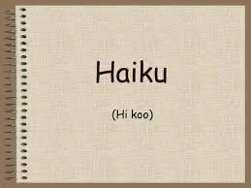
Unit Overview – Part 2: Poetry
Duration: 1.5 – 2 weeks
Suggested Lessons:
  “Introduction to Poetry”
  “Introduction to Haiku”
    Who Am I and What would I like to Share with My Friends?
  “Writing Poetry - Pre-writing for Haiku”
  “Writing Poetry - Revising and Final Draft of My Haiku”
  “Reading Poetry”
https://slideplayer.com
Notes:
Suggested Lessons:
“Introduction to Poetry”
Discuss different forms of expressing selves.
“Introduction to Haiku: Who Am I and What would I like to Share with My Friends?”
Read Taan’s Moons (again).
Read multiple Haiku poems (give examples).
Discuss general topics, vocabulary, and ideas for students to write about.
“Writing Poetry - Pre-writing for Haiku”
Review and display expectations and an exemplar on the smartboard.
“Writing Poetry - Revising and Final Draft of My Haiku”
Pair and Share (discussion with partner).
“Reading Poetry”
Front-load students with oral presentation expectations.
Revisit oral strategies.
Share Haiku poems to class.
Adaptations (Pre-record or tell teacher privately).

Slide 12
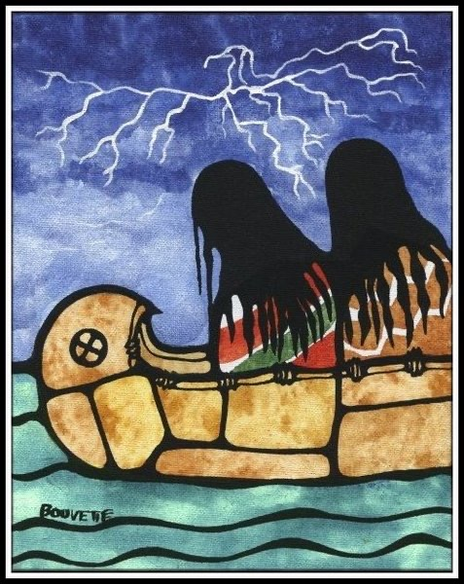
Unit Overview – Part 3: Legends & Myths
Duration: 1.5 – 2 weeks
Suggested Lessons:
  “Introduction to Legends & Myths”
  “Exploring Haida, Carrier and Nisga’a Legends”
  “Researching Indigenous Legends & Myths”
  “Writing Legends & Myths”
  “Sharing Legends & Myths”
https://marniej.wordpress.com/first-nations-legends/
Notes:
Suggested Lessons:
“Introduction to Myths and Legends”
Discuss different ways of passing down stories.
What is a Legend?
What is a Myth?
“Exploring Haida, Carrier and Nisga’a Legends”
Read a variety of legends.
Watch a variety of legends.
“Researching Indigenous Legends”
Brainstorm, as a class, ideas for writing a legend of their own.
“Writing Legends”
Individual or in pairs.
Organize ideas.
Write a draft.
Teacher to review draft.
Make revisions and do final draft.
“Sharing Legends”
Front-load students with oral presentation expectations.
Revisit oral strategies.
Share legends to class.
Adaptations (Pre-record or tell teacher privately).

Slide 13
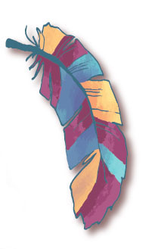
Part 1 Sample Lesson:
Creating Stories & Storytelling: Connecting Us to People, Place & Land
Overview
In this culminating Part 1 lesson, students create their own stories, emphasizing connections to people, place, and/or land.
A “Story Workshop” approach gives students the opportunity to:
  Create and share their stories in:
    Story maps made from materials they have foraged.
    Illustrations
    Written word
    Orally, to the class, a small group, or the teacher (depending on student).
Why is this important?
  Empowering the Spirit, Sharing Through Story
    “The Power of Storytelling” https://www.youtube.com/watch?v=CaHinOaygqk

Slide 14
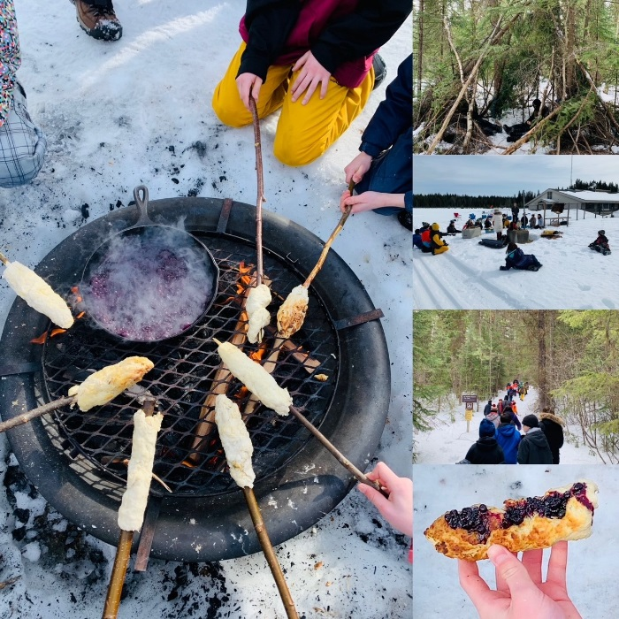
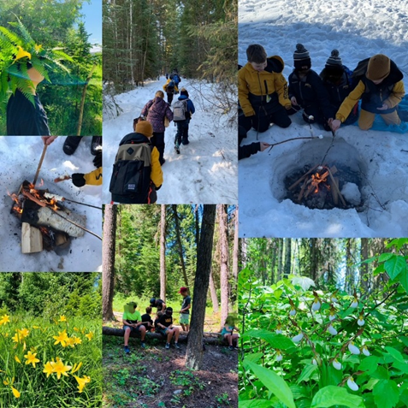
Foraging & Outdoor Experience:
Helping Students Create Stories & Storytelling Opportunities
Pictures taken during Winter and Summer “Outdoor Forage & Survival Days” with my Grade 4/5 class at Parkland Elementary, 2020/2021 School Year

Slide 15
Part 1 Sample Lesson continued:
Creating Stories & Storytelling: Connecting Us to People, Place & Land
Success Criteria - Students are expected to:
Communicate in personal and creative ways.
Generate ideas during forage & transfer them to story maps, illustrations & written word.
Use their imaginations and be willing to think “outside the box”—beyond what they already know.
Reflect upon the information they received while observing and foraging in their local, natural, environment.
Think critically and reflectively as they create stories with an indigenous perspective connecting themselves to others and to the world around them.
Recognize that they are part of the “bigger picture” and create stories that showcase personal awareness and responsibility to people, place, and land.
Reflect positively upon their own personal values, beliefs, & perspectives (and those of their family’s and community’s); and upon the perspectives of indigenous peoples and their connectedness to people, place, and land.
Appreciate connections between and among people and stories.
Contribute positively to small and large group discussions and empathize with each other and appreciate others’ perspectives (even when different from their own).

Slide 16
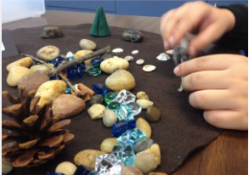
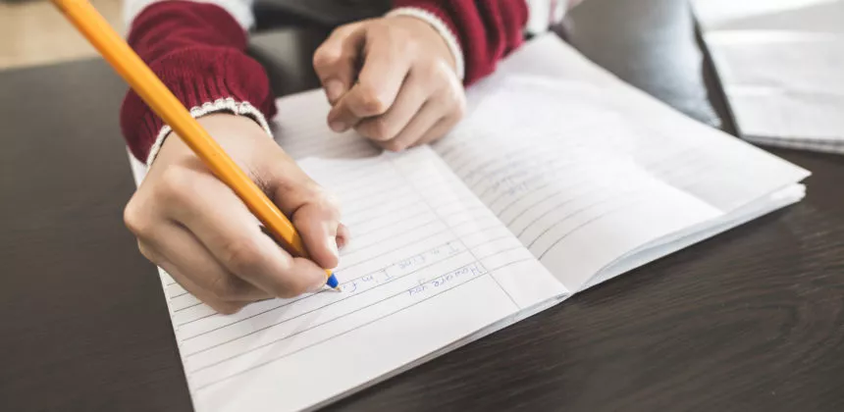

Part 1 Sample Lesson continued:
Creating Stories & Storytelling: Connecting Us to People, Place & Land
Assessment Plan
Students will demonstrate their learning in three ways:
  First, they will demonstrate that they understand the foundational concept of the lesson by incorporating elements of people, place, and land into their story map and illustration.
  Second, they will write down their stories, which will be assessed against a simple “Written Story Rubric” (next slide).
  Third, they will demonstrate their proficiency in oral storytelling by verbally communicating their story (drawing upon the oral storytelling processes they learned in a previous lesson). The teacher will assess students against a simple “Oral Storytelling Rubric” (next slide).

Slide 17
Story Writing Rubric: /16 | Emerging (1) | Developing (2) | Proficient (3) | Extending (4)
Story makes connections to people, place, and/or land.
Story has a beginning, a middle, and an end, and flows in a clear, understandable sequence.
Learner experiments with words, structures, and ideas to create an original story.
Learner uses elements of story to create meaning.
Oral Storytelling Rubric: /4 | Emerging (1) | Developing (2) | Proficient (3) | Extending (4)
Learner shares their story using effective oral communication skills: a clear voice, vocal expression, varied tone to differentiate the storyteller’s natural voice from the characters’ voices, presents the story efficiently, keeping the listeners’ attention throughout.

Slide 18
Part 2 Sample Lesson:
Introduction to Haiku –
Who Am I and What would I like to Share with My Friends?
Overview
In this intriguing part 2 lesson, students will be introduced to the world of poetry, and how it can be used as a form of self-expression in creative ways while sharing thoughts and ideas with peers.
Being exposed to the beauty of poetry will give students the opportunity to:
  Understand and respect the viewpoints of all people around them (creating a safe and effective classroom climate and culture).
  Put language to use and have them find their voice through a brand-new vocabulary scope.
  Provide a gift of inspiration to classmates and the teacher.
Why is this important?
  In learning about poetry, students will be encouraged to connect with themselves and others while finding meaning in their own experiences.
  Poetry will have a positive impact on students and their social and emotional learning.
  Rachel Piercey - Why is poetry important? - YouTube

Slide 19

Part 2 Sample Lesson Continued:
Introduction to Haiku –
Who am I and What would I like to Share with My Friends?
Students will learn that there are a variety of forms of poetry that we can write, read, and analyze.
In this lesson, the primary focus will be on Haiku poetry.
Students will understand that Haiku poetry follows strict guidelines and has unrhymed poetic lines of 17 syllables arranged in 3 lines of 5, 7, and 5 syllables.

Slide 20
Part 2 Sample Lesson Continued:
Introduction to Haiku –
Who am I and What would I like to Share With My Friends?
Success Criteria – Students are expected to:
Apply various thinking skills to derive meaning from texts.
Use personal and lived experience to connect to texts while learning about themselves and those around them.
Acknowledge the oral tradition in First Peoples cultures.
Respond and use language in personal and creative ways to develop a sense of style and individuality.
Develop deeper word knowledge and vocabulary while recognizing how literary elements, techniques, and devices will strengthen meaning in texts.
Learn the different forms, functions, genres of text, literary elements such as the theme and purpose, literary devices such as imagery, effective reading strategies, oral language strategies, and metacognitive strategies such as in reflective learning about the self and those around us.

Slide 21
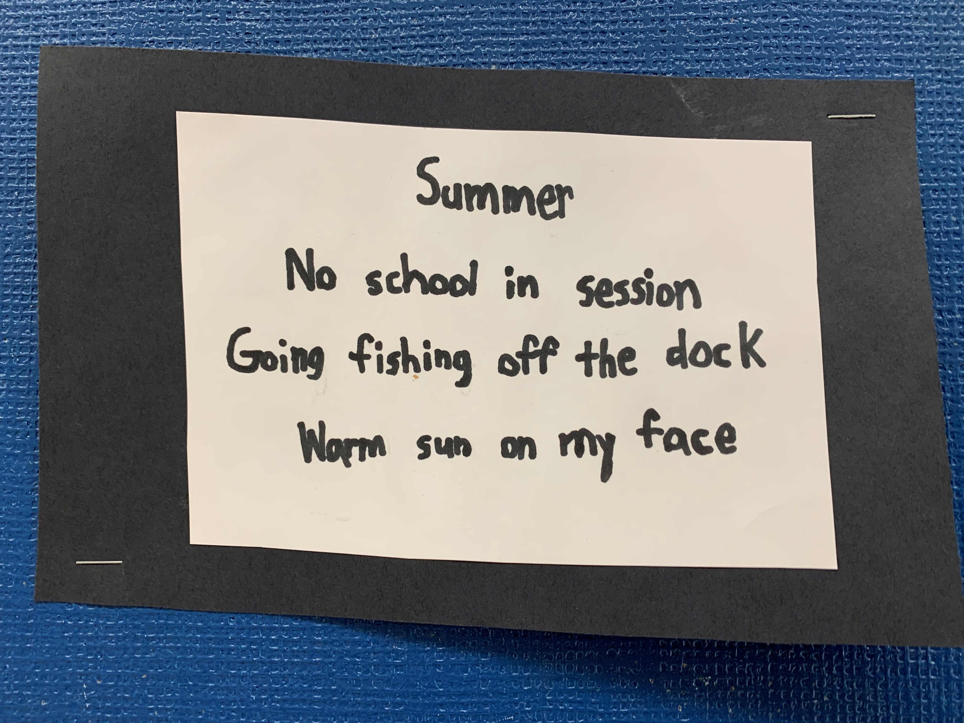
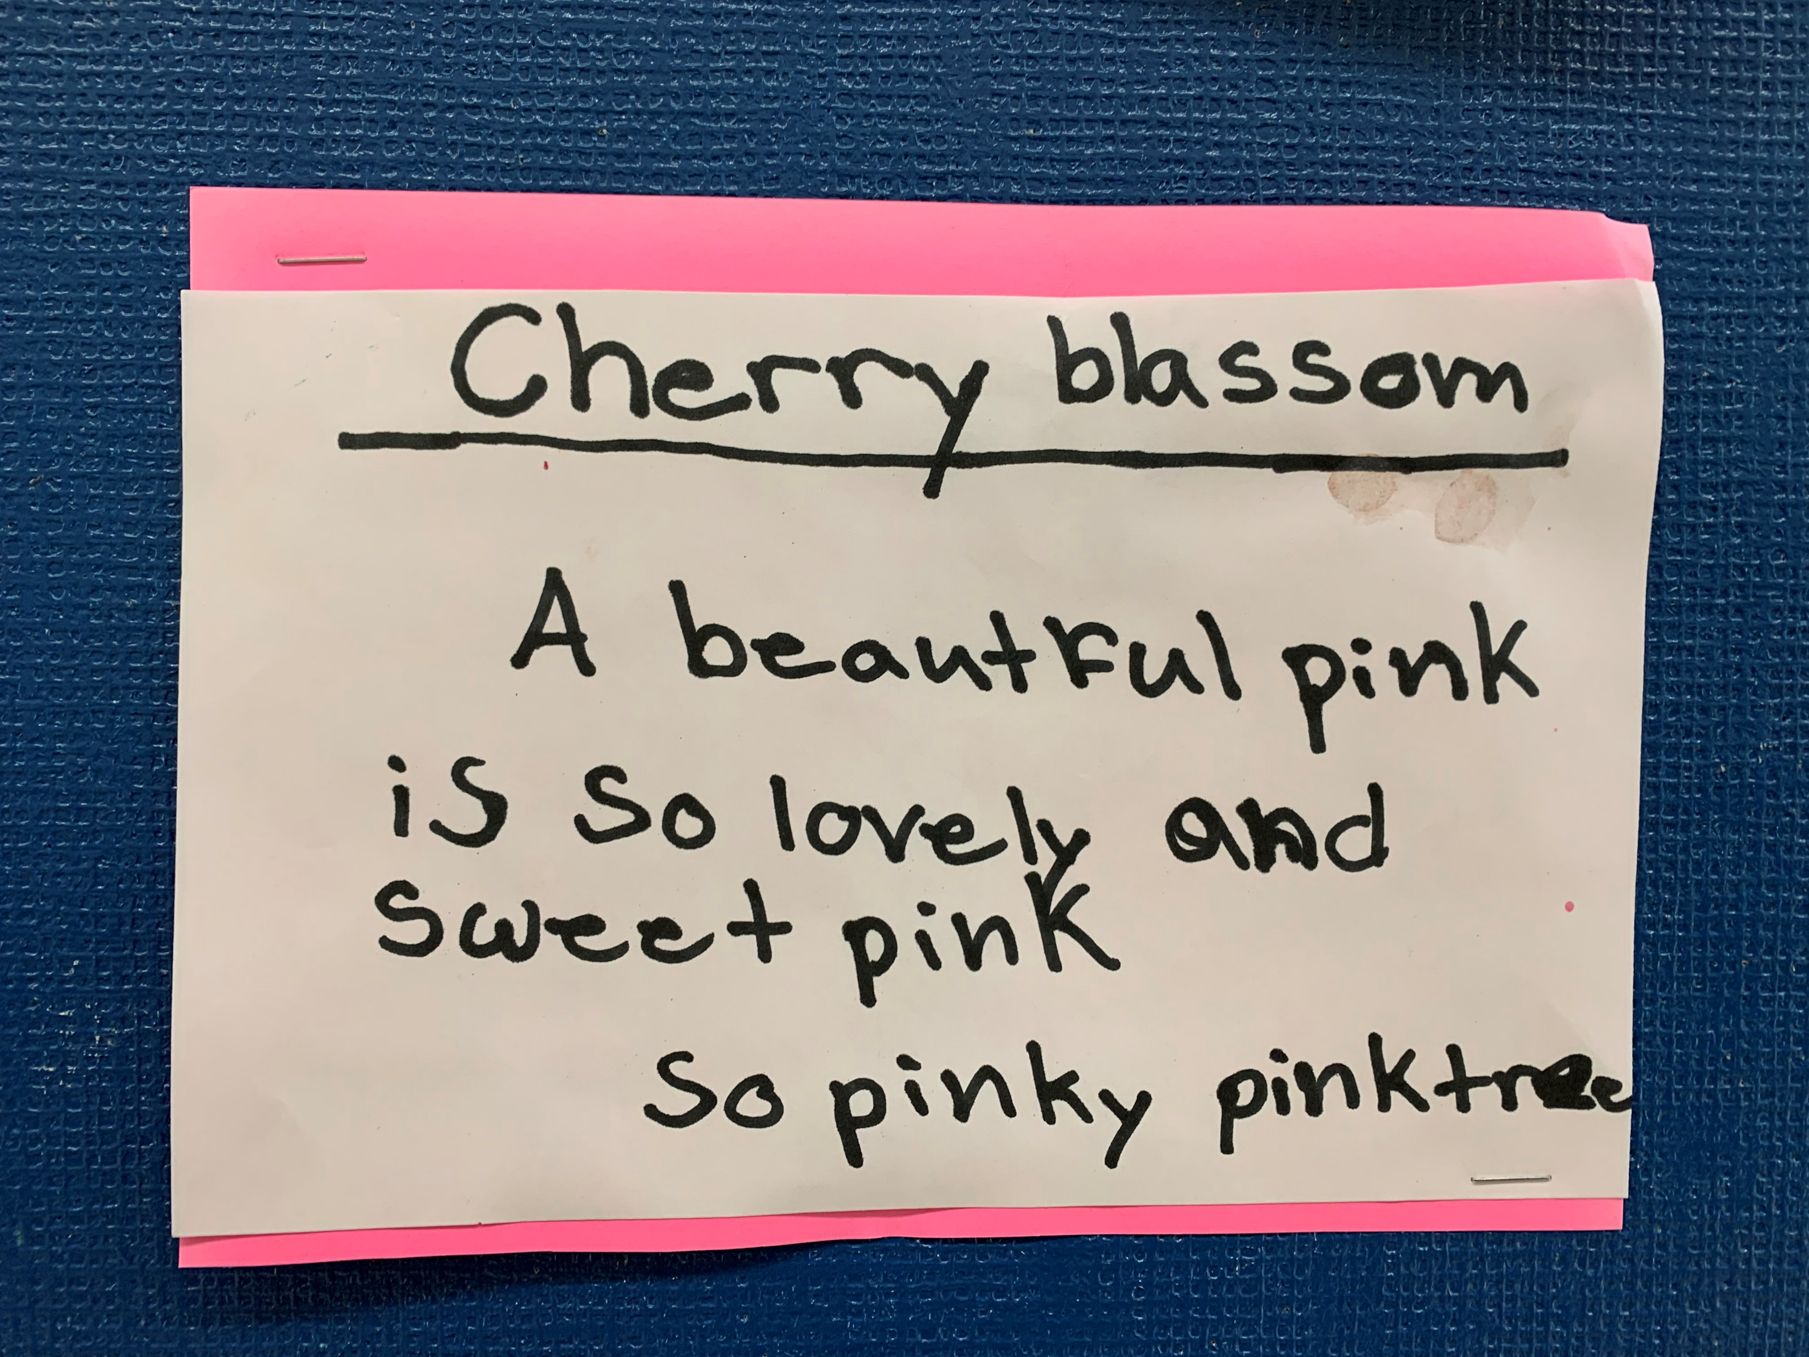
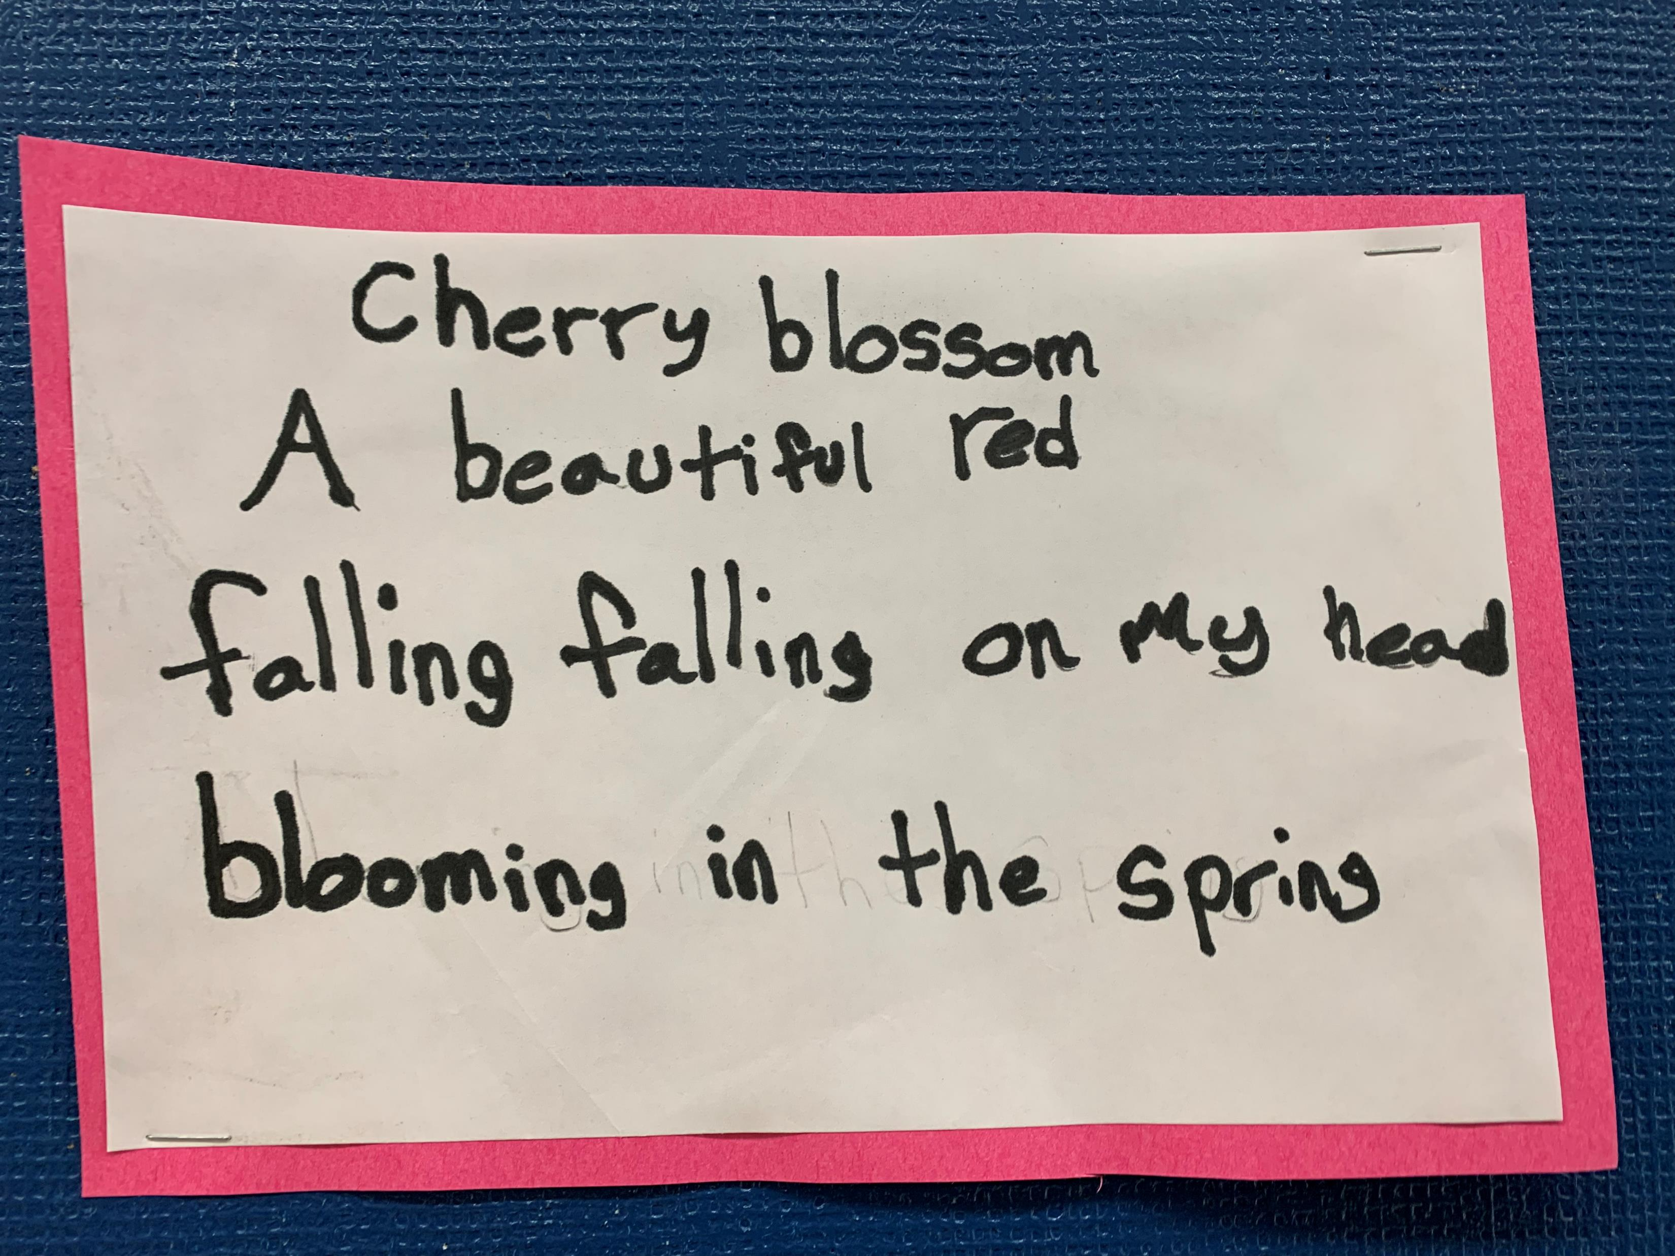
Providing Student Haiku Exemplars
Student exemplars from a Grade 3/4/5 class Parkland Elementary - 2021/2022 School Year
Quesnel, British Columbia.

Slide 22
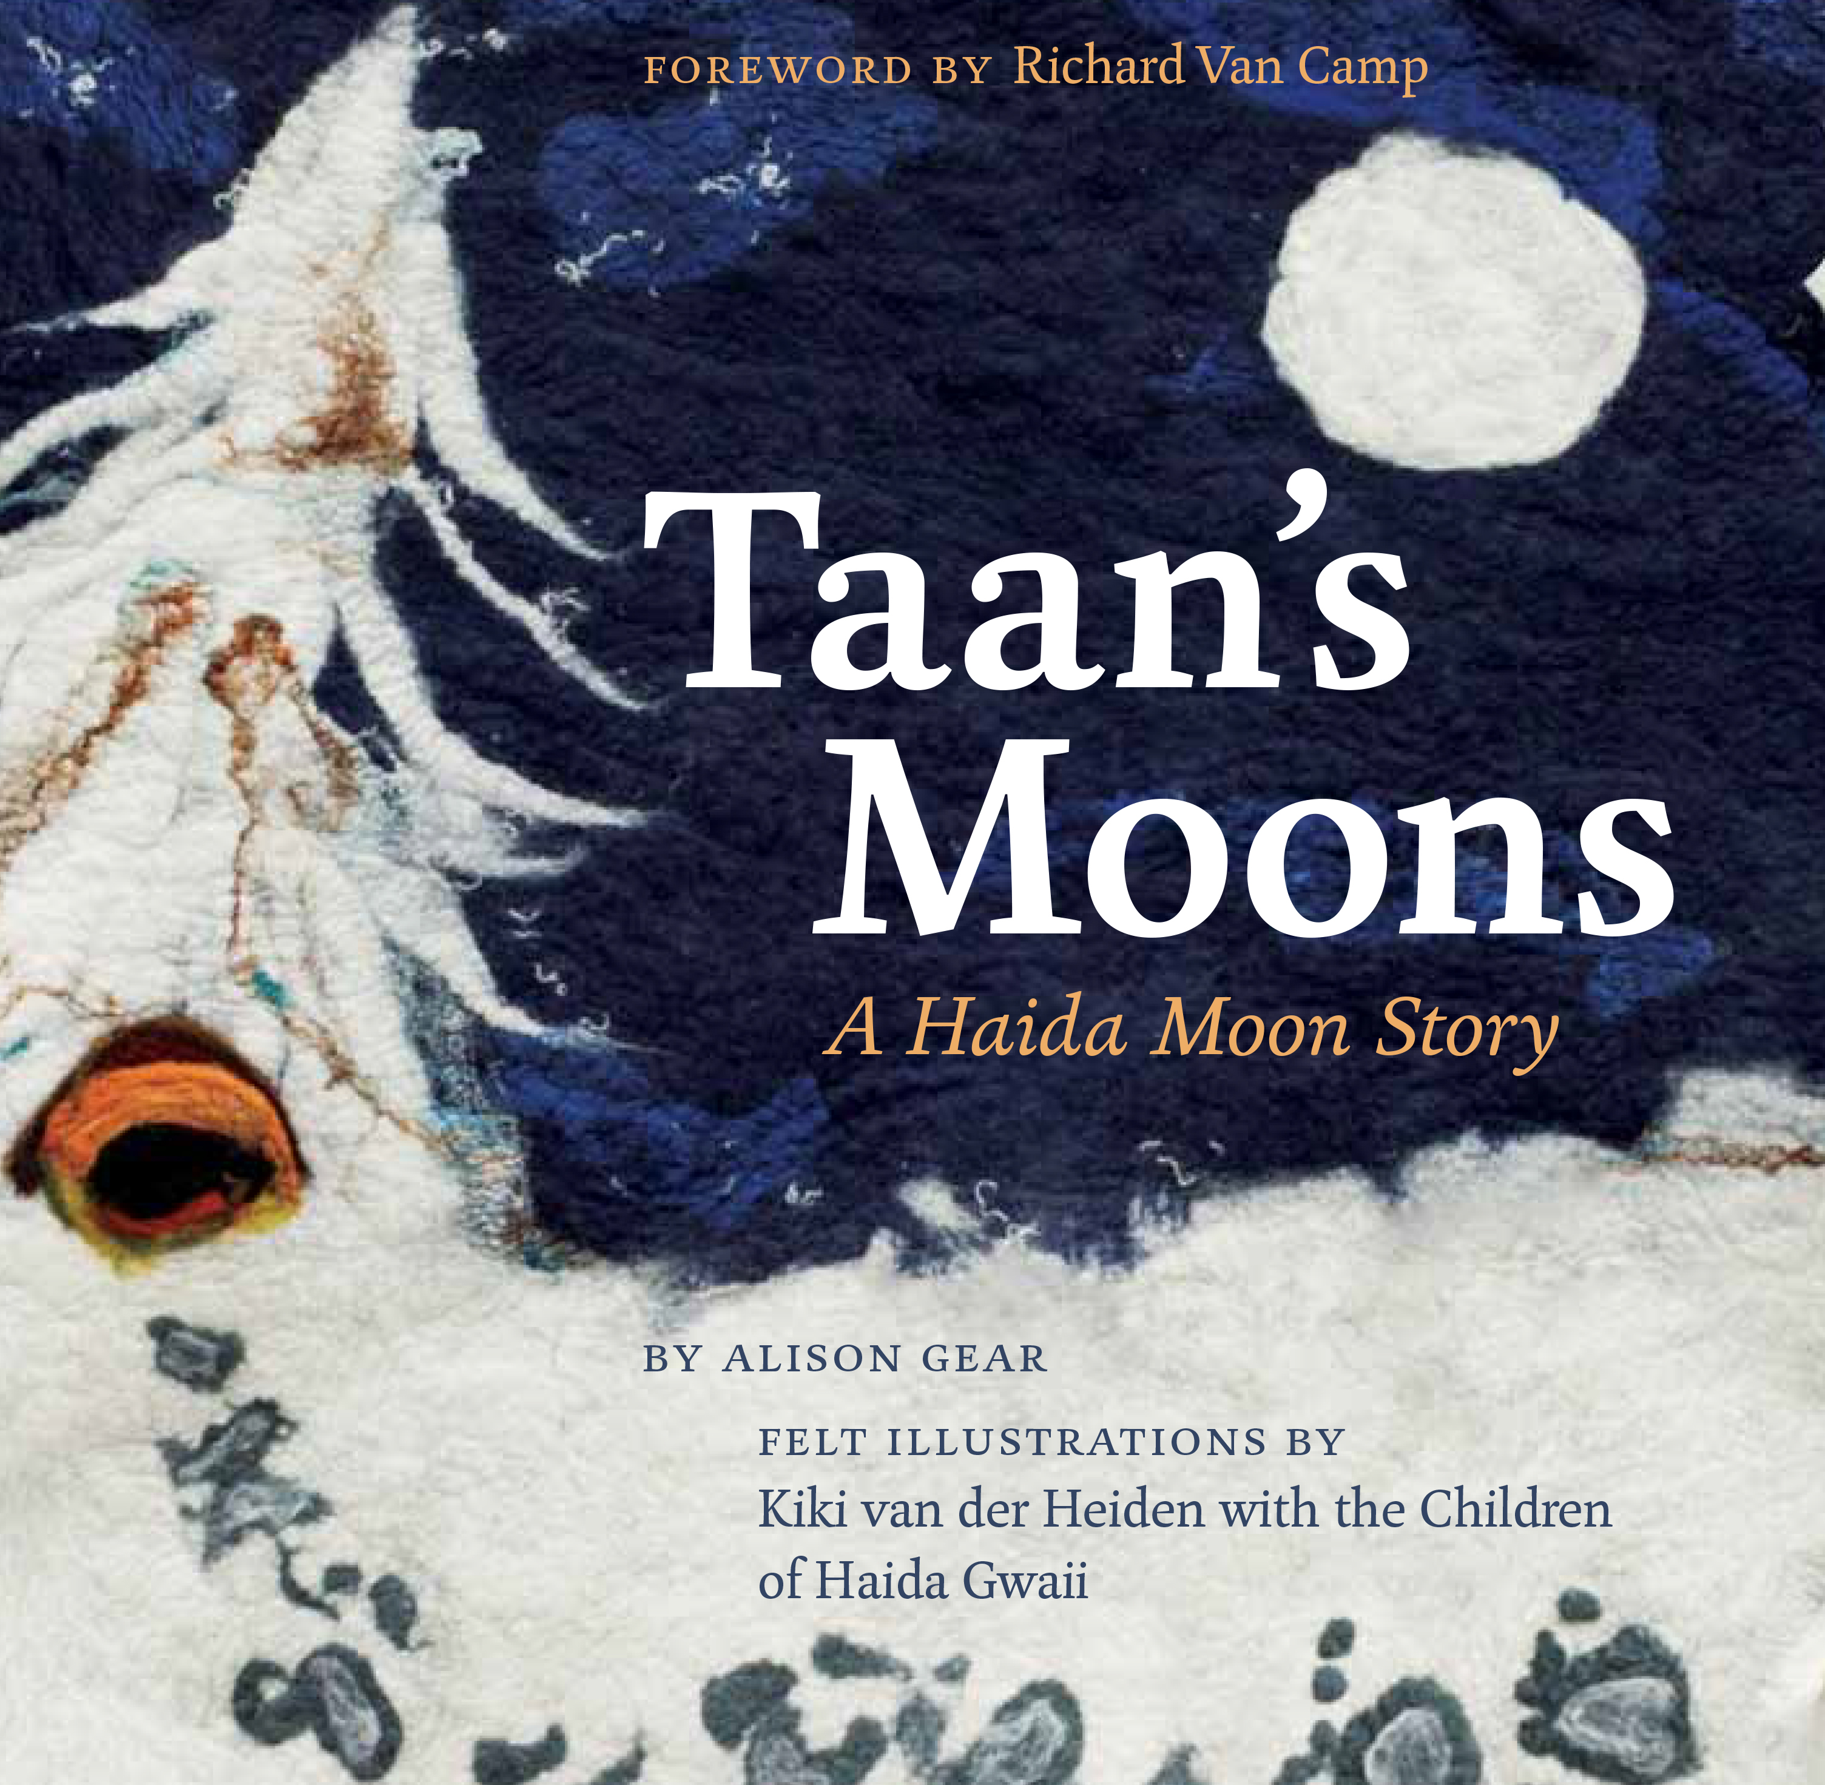
Part 2 Sample Lesson Continued:
Introduction to Haiku –
Who am I and What would I like to Share With My Friends?
Assessment Plan
Students will demonstrate their learning by:
  Working in groups of 2 - 3 to explore individual copies of the book, Taan’s Moons: A Haida Moon Story, written by Alison Gear. Students will use individual whiteboards to record their interpretations of the meaning of the text and identify Haikus that they see in the story (ideas can be recorded visually or written).
  Collaborating with one another while creating a safe space to exchange ideas about the text; connecting it to their own lived experiences and how they relate to the text; learning from one another by providing each other with feedback, questions, and encouragement.
  Working to complete a “Who Am I?” brainstorming worksheet about self-identity (i.e., students will brainstorm vocabulary words that they believe defines who they are as an individual - funny, smart, determined, caring).
  Brainstorming vocabulary words about who their families are and where they come from; then record them.
  Journaling and writing Haiku poems about themselves, who they are, and where they come from while referring to the group collaboration and individual brainstorming activity notes, with the goal of presenting their Haiku poems to the class the following day (students can bring their Haikus home to revise, edit, and read to their guardians in preparation of presentation day).

Slide 23
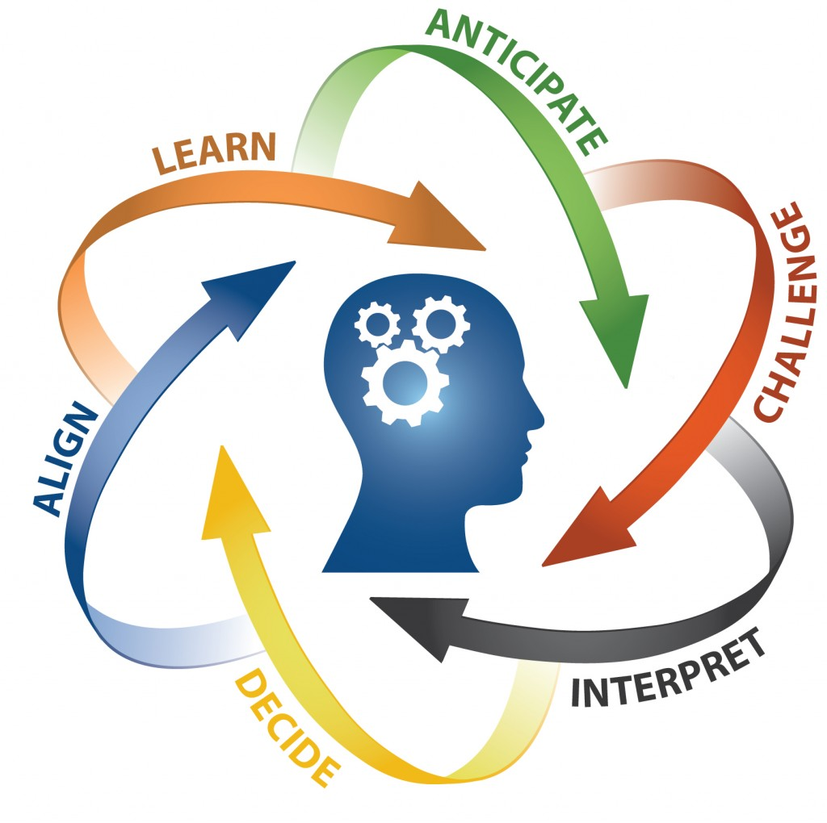
Part 2 Sample Lesson Continued:
Introduction to Haiku –
Who am I and What would I like to Share With my Friends?
Assessment Plan Continued:
Students will produce final written Haiku poems in their individual journals (provided to them at the beginning of the school year as a form of formative assessment).
Students will present their poems and classmates will provide peer assessment, recording on a piece of paper 3 things they liked about the student’s poem.
The teacher will talk to each student one-on-one about their progress. This will provide an opportunity for the student to receive plenty of feedback.
Rubrics will be used to assess student learning and will include the BC Performance Standard Quick Scale for Grade Four Personal Writing (see BC Performance Standards - Writing Grade 4 (gov.bc.ca)).

Slide 24
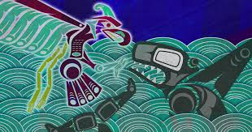
Part 3 Sample Lesson:
Legends & Myths
Overview:
In this final Part 3 lesson, students will create an original Legend or Myth, continuing to focus on, and connect their texts to, people, place and land.
Students will explore the historical and cultural tradition of passing on legends and myths, generationally, through oral storytelling.
  As students explore various texts, they will consider the purpose of legends and myths and the meanings or morals that they teach.
Students will have the opportunity to explore and create a unique text that they will share using the oral storytelling techniques they have developed throughout this unit.
Why is this important?
  Historical literature can provide insights into various cultures and traditions.
  By reflecting on historical texts, and creating an original legend or myth, students will reflect on aspects of their own culture.

Slide 25
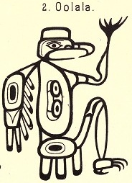
Part 3 Sample Lesson continued:
Legends & Myths
Success Criteria - Students are expected to:
Consider different purposes and perspectives while
exploring texts, using various thinking skills to gain
meaning.
Respond to text in personal and creative ways by developing their own unique legend or myth that encompasses various literary elements, techniques, and devices.
Exchange ideas and perspectives to build a shared understanding of the historical significance of legends and myths.
Identify and explore how story connects people.
Develop an awareness of self as a reader through oral storytelling, and as a writer in the development of their individual texts.
Demonstrate an awareness of the oral traditions in First Peoples cultures and the purpose of First Peoples texts.
Present their texts using a variety of oral language strategies including listening for details, speaking with expression, and taking turns sharing.
http://haidalegends.blogspot.com/p/about.html

Slide 26
Part 3 Sample Lesson continued:
Legends & Myths
Assessment Plan:
Students will demonstrate their learning by:
  Studying various legends and myths to build base knowledge, then sharing their learning in small groups, working to identify plot elements, characters, setting and theme.
  Working with a writing buddy to brainstorm ideas and solidify their understanding of what makes a good legend/myth and build ideas for their individual texts.
  Developing their own unique legend or myth following the legend/myth rubric (next slide)
  Respectfully participating in a sharing circle where each student will be given an opportunity to share their original texts using the oral storytelling techniques they have developed throughout the unit.
Students will have the opportunity to offer positive peer-feedback after each individual legend or myth is shared.

Slide 27
 | Original Legends & Myths Rubric ( /16)
 | Emerging (1) | Developing (2) | Proficient (3) | Extending (4)
Content | The requirements for the creation of a Legend or Myth were not met. | The content was not appropriate to the development of a Legend or Myth. | The Legend or Myth had variety of content but the content didn't lead to an explanation of the purpose of the Legend or Myth. | The content in the Legend or Myth fully explained purpose of the text.
Creativity of Ideas | There is little evidence of creativity or imagination in the Legend or Myth. | The Legend or Myth contains a few creative ideas or details but they do not fit into the text. | The Legend or Myth contains several creative ideas and details that add to the reader's enjoyment of the text. | The Legend or Myth contains many creative ideas and details that greatly enhance the reader's enjoyment of the text.
Organization | The Legend or Myth does not make sense. The ideas or events are randomly organized and there are no transitions between ideas. | The Legend or Myth is hard to follow. The events don't always fall in a logical order. There are not clear transitions between ideas. | The Legend or Myth is pretty well organized. The order of events are generally logical and there are transitions between ideas. | The Legend or Myth is very well organized. The order of events are logical and there are good transitions between ideas.
Overall | The requirements for a Legend or Myth were not met. | The Legend or Myth was confusing, hard to follow and understand the intended meaning or purpose. | The Legend or Myth was sensible throughout, there was a clear flow, but the overall purpose or meaning was not developed fully. | The Legend or Myth was completely developed, it had a very clear overall meaning or purpose that was fully developed.
Comments:

Slide 28
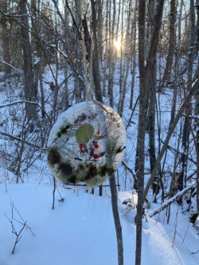
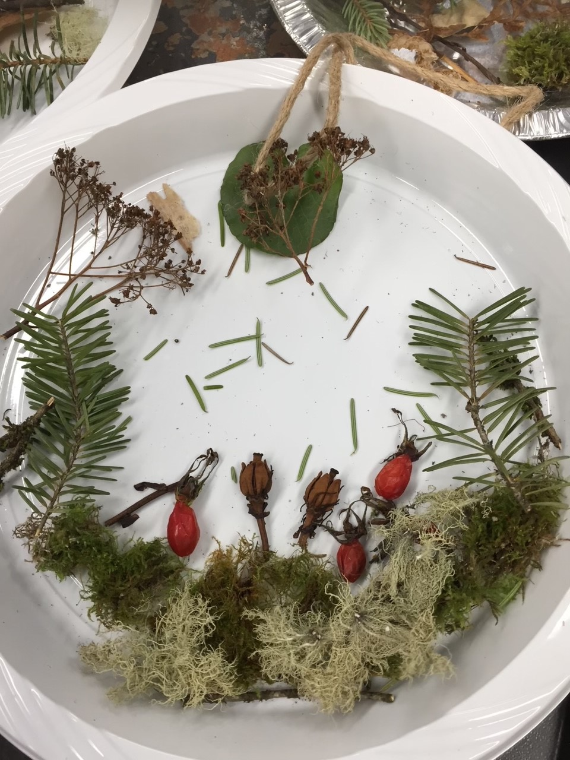
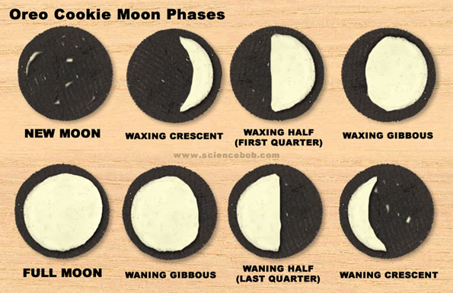
Cross-Curricular Extension Activities
Science, Art, P.E., L.A.
Moon Cycle Record Chart
Seasons Worksheet
Moon Phases Worksheet
Frozen Suncatchers
Oreo Cookie Moon Phases Activity

Slide 29
Unit Resources & References
Part 1: Stories & Storytelling
  Empowering the Spirit, Sharing Through Story, “The Power of Storytelling" https://youtu.be/CaHinOaygqk
  https://www.firstvoices.com/explore/FV/sections/Data/Nisga'a/Nisga'a/Nisga'a/learn/stories
  https://www.pbslearningmedia.org/resource/echo07.lan.stories.lporaltrad/storytelling-oral-traditions/
  https://www.nccie.ca/lessonplan/youth-digital-storytelling-project/
  https://www.nccie.ca/lessonplan/elder-digital-storytelling-project/
  www.firstpeople.us
  Taan’s Moons (2014) by Alison Gear.
  https://www.nccie.ca/lessonplan/understanding-indigenous-stories-and-storytelling/
  https://www.nccie.ca/lessonplan/first-nation-stories/
  https://www.nccie.ca/videos/the-stories-i-can-tell-by-lynn-cote/
  “Why Story Workshop”, School District 28, Professional Development Day Resource Package.
  www.ravenspeaks.ca
  BC Performance Standards - Writing Grade 4 (gov.bc.ca)
  https://www.pbslearningmedia.org/resource/echo07.lan.stories.lporaltrad/storytelling-oral-traditions/

Slide 30
Unit Resources & References
Part 2: Poetry
  Elements of Poetry: A Complete Guide for Students and Teachers (literacyideas.com)
  https://thehaikufoundation.org/learn/the-haiku-foundation-education-wall/haiku-writing-plan-for-grades-3-4/
  Taan’s Moons (2014) by Alison Gear.
  BC Performance Standards - Writing Grade 4 (gov.bc.ca)
  Strategies-to-Promote-Oral-Expression.pdf (compasseducationalservices.com)
Part 3: Legends & Myths
  https://www.teachingtimes.com/curriculum_resources_mythsandlegends/
  https://coastfunds.ca/first-nations/nisgaa-nation/
  http://www.native-languages.org/nisgaa-legends.htm
  https://www.first-nations.info/first-nation-legends
  http://haidalegends.blogspot.com/?m=1
  http://www.native-languages.org/haida-legends.htm
  https://www.scholastic.com/teachers/unit-plans/teaching-content/myths-folktales-and-fairy-tales/
  http://www.fnesc.ca/wp/wp-content/uploads/2015/06/PUB-LFP-K-3-In-our-Own-Words-for-Web.pdf
  Strategies-to-Promote-Oral-Expression.pdf (compasseducationalservices.com)

Slide 31
Unit Resources & References
Additional Resources/Extensions:
  https://www.curriculum.gov.bc.ca/curriculum/english-language-arts/4/core
  http://nvsd44curriculumhub.ca/unit-plan-creative-writing-english-language-arts-grade-4-5/
  http://www.bcpta.ca/wordpress/wp-content/uploads/2018/10/We-Are-All-Connected-Adrienne-Gear.pdf
    Great resource for primary storybook ideas/activities.
  https://vft23.weebly.com/resources.html
    Virtual Field Trip Ideas
  https://www.historymuseum.ca/cmc/exhibitions/aborig/haida/hapmc01e.html
  https://www.strongnations.com/store/item_list.php?it=3&cat=3738
    Indigenous Book List

